Slide 1
Growth Mindset
Module 1 of 4: What is a Mindset
Developments in Neuroscience
What is Neuroplasticity?
What are Mindsets and how do they impact on learning?
Designed and written by Rachael Whitney-Smith

Slide 2
Australian Professional Standards for Teachers
Professional Knowledge
1. Know students and how they learn
Professional Practice
3. Plan for and implement effective teaching and learning
Professional Engagement
6 Engage in professional learning

Slide 3
Modules Objectives:
Participants will learn about how understandings of neuroscience are informing understandings of learning.
Participants will learn what is a mindset and what are the differences between having a growth mindset and a fixed mindset.
Participants will be provided opportunity to self reflect and then share mindset experiences.

Slide 4
Neuroscience
In recent decades the science of the brain has evolved.
Diffusion Imaging (such as MRI and DTI scanning) can now allow scientists to see actual brain activity when someone is learning and then measure differences.
Notes:
Having a greater understanding of the human brain and how we think, can assist in understanding how we learn
https://www.scientificamerican.com/article/10-big-ideas-in-10-years-of-brain-science/
http://www.mayfieldclinic.com/PDF/PE-fMRI_DTI.pdf

Slide 5
Human Brain
3 Main parts of the brain;
Cerebrum
Cerebellum
Brain Stem
Notes:
It has three main parts:
The cerebrum fills up most of your skull. It is involved in remembering, problem solving, thinking, and feeling. It also controls movement.
The cerebellum sits at the back of your head, under the cerebrum. It controls coordination and balance.
The brain stem sits beneath your cerebrum in front of your cerebellum. It connects the brain to the spinal cord and controls automatic functions such as breathing, digestion, heart rate and blood pressure.

Slide 6
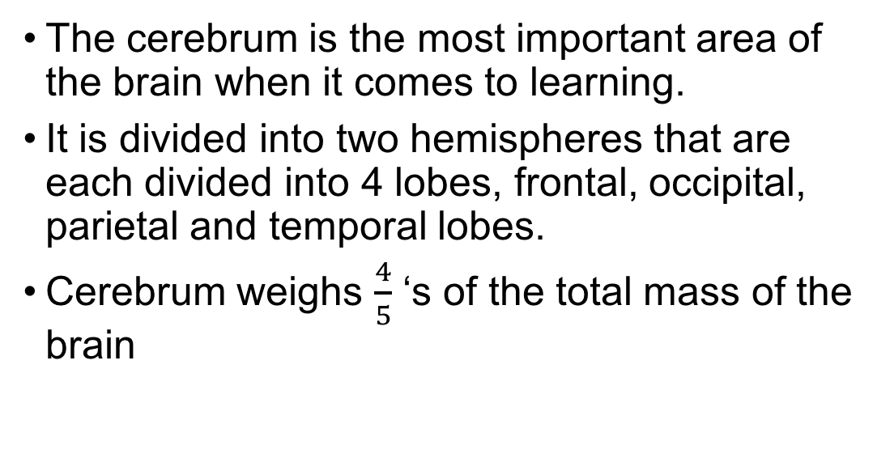
Human Brain
The cerebrum is the most important area of the brain when it comes to learning.
It is divided into two hemispheres that are each divided into 4 lobes, frontal, occipital, parietal and temporal lobes.
Cerebrum weighs $\frac{4}{5}$ ‘s of the total mass of the brain

Slide 7
Busting the brain myth
We only use 10% of our brain
We use all of our brain even when we are sleeping. Different parts of the brain enable us to act and think in different ways.

Slide 8
Activity: Left brain right brain
Notes:
Can everyone please stand up and raise your hands in the air
With your right pointer finger draw a circle in the air
With your left pointer finger can you draw a square in the air

Slide 9

Human Brain
Network of neurological fibre pathways consisting of approximately 100 Billion (${10}^{10}$) neurons connected by 1000’s synapses which give a typical brain over 100 trillion synapses
Notes:
http://www.brainfacts.org/brain-basics/neuroanatomy/articles/2012/the-neuron/
Your brain is made up of 100 billion or so neurons each making up to 10,000 connections, or synapses, with other neurons. Neurons communicate by sending chemical signals (a.k.a. neurotransmitters) across the synapse, with neurotransmitter release determined by patterns of neural impulses.
“Neural impulses code your thoughts, actions and experiences. But they’re not simply transmitted along hard-wired pathways in the brain; the same thoughts, actions and experiences continually reorganise the structure and function of pathways enabling your brain to respond efficiently and effectively to the world around you.” http://yourbrainhealth.com.au/what-actually-is-neuroplasticity/

Slide 10
Human Brain
What are Neurons?
What are synapses?

Slide 11
Neuron
A neuron is a brain cell designed to transmit information with other neurons or between other nerve cells throughout the body.
Neurons receive/transmit messages by electronic pulses along their axons. Axons range in length from 1cm to over 1m.

Slide 12
Synapses
Synapses are neural bonds acting like roots holding the neurons together.
They allow communication to take place when they fire, sending electrical pulses between neurons. These pulses are called neurotransmitters.
The more synapses present the stronger the neural bond and the faster the communication.

Slide 13
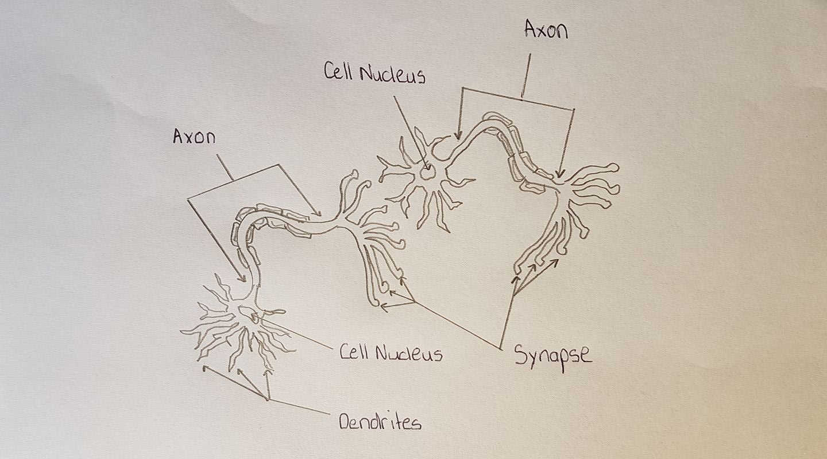
Brain Cells

Slide 14
How does learning take place?
Neurons connected by neural pathways allow for sensory information to be transmitted by synapses
Sensory information is then stored in our short term memory to be processed. It has a limited capacity.
Crucial connections between this information are then made with other neurons in our working memory
Drawing upon our long term memory and previously ascertained knowledge
The new information is then stored in long term memory if these connections are made successfully
This new information now forms part of our knowledge banks
Notes:
Neural impulses or synapse firings between neurons code all of your thoughts, experiences and actions to form learned experiences. These form the basis of our retained knowledge bank.

Slide 15
Retaining information in the brain
The strengthening of connections between neurons is achieved by increasing the interaction between them and strengthening their bonds.
Multiple sensory inputs allow for stronger bonds and improved memory and recall.
Frequent and recent use of stored memories allow for faster travel of electronic signals along neural pathways.

Slide 16
Activity: Left brain right brain
Phrase 1: Hey Bum Pin
Than Height
Phrase 2: This Guys They’ll Hymn It
Notes:
Processing between your right brin and the left bra=in starts to kick iin you can hear the phrase and it jumps out at you. The more you fdo these the easirer they become.

Slide 17
What does this mean for learning?
Learning is the organisation and restructuring of the physical structure of the brain
The most effective learning engages multisensory and multimodal experiences
Making strong connections between previously learned experiences is highly beneficial for sustained understanding
Learning can be represented as a cycle
Notes:
Multimodal approaches to teaching concepts increases the strength of bonds (development of synapses) between thoughts, learned experiences and memories
Our brains are “hard wired” for learning, being curiosity driven and memory acquisition constructed
The work of Zull and Kolb(1982)

Slide 18
Learning Cycle
New Experience or exposure to a new concept
Gathering sensory experiences using the sensory cortices of the brain
Reflection through observation using the temporal lobe
Creation of new skills and concepts using the pre-frontal cortex
Actively Testing these newly acquired skills using the motor cortices
Notes:
http://www.themaritzinstitute.com/perspectives/~/media/files/maritzinstitute/white-papers/the-neuroscience-of-learning-the-maritz-institute.pdf

Slide 19
Fast versus slow thinking
There are two basic modes of thinking we use on a daily basis:
System 1: Intuitive: involuntary and is instantaneous
System 2: Cognitive: deliberate, concentrated, requires effort and reasoning

Slide 20
Teacher Activity:
The next two slides will allow you to experience the two forms of thinking.
Call out the answer to the question as fast as you can solve it.

Slide 21
2 + 2 =

Slide 22
28 x 17=

Slide 23
Disadvantages
Certain tasks can take advantage of our different systems of thinking and can encourage students to answer involuntarily without using their conceptual thought processes.
Notes:
https://youtu.be/JiTz2i4VHFw

Slide 24
Example:
A bat and a ball together cost $1.10. The bat cost $1 more than the ball. How much did the bat cost?

Slide 25
Recent Brain Research
The process of learning causes a physical change to the brains’ structure, which can translate into the “Use it or lose it” philosophy
That is we can get better at learning
Our students can get better at learning
They can learn to learn

Slide 26
Recent Brain Research
Brains are stimulated by unusual and new experiences and so, intrinsic motivation through inquiry learning and discovery can improve student engagement in the learning process.

Slide 27
Recent Brain Research
Memory is increased by the frequent and recent development of synapses, which can be translated into the language of learning as “Fluency”.

Slide 28
Recent Brain Research
Students’ knowledge of the brain, how we learn and Neuroplasticity impact positively upon their motivation to learn.
Notes:
Improved student motivation towards learning has been measured after students were made aware of how their brain works
http://www.pearson.com.au/community/in-conversation/judy-willis-science-of-learning/

Slide 29
What is Neuroplasticity?
This is the ability of our brain to undergo change and re-wire itself as a result of our experiences
Plasticity refers to the malleability of our brain and its network of neurons and neural pathways.
Notes:
https://youtu.be/ELpfYCZa87g “Neuroplasticity” video and https://youtu.be/5KLPxDtMqe8 “Your Brain is Plastic” . “The concept of neuroplasticity is not new and mentions of a malleable brain go all of the way back to the 1800s, but with the relatively recent capability to visually “see” into the brain allowed by functional magnetic resonance imaging (fMRI), science has confirmed this incredible morphing ability of the brain beyond a doubt.” http://reset.me/story/neuroplasticity-the-10-fundamentals-of-rewiring-your-brain/

Slide 30
What does this mean?
Intelligence
Intelligence
Intelligence
Your brain can grow and so can your intelligence

Slide 31
How does this relate to learning?
New neurons can be created as we learn new things, which is called neurogenesis
Brains are designed to run efficiently and effectively so restructuring pathways as we gain more knowledge or experience occurs
Knowledge, skills and thoughts are then compressible
Notes:
The pathways that these electronic pulses travel along change continually like the “Hogwarts Staircases” in the world of Harry Potter.

Slide 32
Teacher Activity: Learning to Drive
Think of the first time you learnt to drive a car
L

Slide 33
The impact this has on learning
Knowing that your intelligence is not fixed, that your brain capacity can grow and change empowers learning
Knowing about neuroplasticity can positively impact upon motivation
Understanding how the brain works informs our pedagogies and what we do as teachers to encourage and facilitate the learning of our students

Slide 34
What is a Mindset?
Mindset is a term coined by psychologist, Dr Carol Dweck from Stanford University developed from over 30 years of research
It is is a collection of your beliefs, ideas and attitudes about traits such as talent, skills, personality and intelligence
Your mindset effects your behaviour and ultimately your ability to learn and your academic achievement
Notes:
http://mindsetonline.com/whatisit/about/
Carol Dweck a psychologist from Stanford University developed the science and research of Mindsets.

Slide 35
Traits can be inherited or acquired
Traits are defined as characteristics of living organisms.
A trait can be inherited through our genes
A trait can be acquired through learned experiences and practice
Traits can be behavioural and physical

Slide 36
Teacher Activity: Traits Worksheet
Complete the Traits Worksheet independently then share your responses with the people around you.
Were there any traits that provided different responses from the group?

Slide 37
Types of Mindset
There are two main types of mindset;
  Fixed Mindset
  Growth Mindset
NOTE: You may demonstrate both mindsets in different situations or at different stages in your life
Notes:
Mindset: The New Psychology of Success
© 2006 by Carol Dweck, Ph.D.
NY: Random House (www.atrandom.com) ISBN 1­4000­6275­6

Slide 38
Fixed Mindset
You're ability to learn is fixed
You are destined to be good at some things and bad at others
Performance Goals are crucial to achievement
Your intelligence is completely genetic and determined at birth

Slide 39
Growth Mindset
Effort is a pathway to Mastery
You can grow your intelligence
Setting learning goals is important to improved outcomes
We learn from our mistakes, challenge is good

Slide 40
Teacher Activity
Think about something you are “good” at
Do you believe that you have a natural gift?
How do you know you are good at it?
Do you believe that you can get better at it?
Will you always be good at it?
Briefly share your thoughts with the people around you

Slide 41
Learning Mindset
This is the way you approach learning situations and your attitude towards learning
It impacts heavily on choices you make
It can encourage or discourage engagement
It will effect your confidence and willingness to challenge yourself

Slide 42
Encourage a Growth Mindset
I can become smarter
Learning comes through effort and practice
I will achieve better results
Notes:
https://ed.stanford.edu/sites/default/files/manual/dweck-walton-cohen-2014.pdf
https://www.aacu.org/sites/default/files/files/ild/symonette.makeassessmentwork.dweck_.pdf
The color graphic of the Fixed and Growth Mindsets was created by graphic artist Nigel Holmes (www.nigelholmes.com) for as article in the March/April 2007 issue of Stanford Magazine (www.stanfordalumni.org/news/magazine/2007/marapr/ features/dweck.html). The added text is written by Michael Graham Richard (www.michaelgr.com).

Slide 43
Moving from a Fixed to Growth Mindset in Learning
Fixed Mindset
Mixed Mindset
Growth Mindset

Slide 44
Summary
Recent understandings of neuroscience are informing our understandings of learning.
intelligence is not fixed and can grow
your mindset influences your learning
mindsets can change
having a growth mindset can impact positively upon your motivation and aptitude towards learning

Slide 45
Other modules in this series
Module 2: The impact of mindsets on mathematical learning
Module 3: The impact of mindsets on mathematics pedagogy
Module 4: Classroom activities and strategies to promote a growth mindset in mathematics

