Slide 1
Growth Mindset
Module 2 of 4: The impact of Mindsets on Mathematical Learning
What is mathematics?
Mindsets in mathematics
Impact of mindset on performance
Maths anxiety and assessment
Designed and written by Rachael Whitney-Smith

Slide 2
AITSL Proficiencies
Professional Knowledge
1. Know students and how they learn
3. Plan for and implement effective teaching and learning
5. Assess, provide feedback and report on student learning
Professional Engagement
6. Engage in professional learning

Slide 3
Module Objectives
Define mathematics and identify its purpose
Provide the research behind mindsets from a mathematical perspective
Identify the link between mindset and maths anxiety
Identify the factors that influence mindsets in mathematics

Slide 4
Mathematics: What is it?
Mathematics is a human endeavour, a discipline and an interdisciplinary language or tool by which problems are identified, relationships are formed and solutions are derived. How we teach mathematics will vary due to how we view it. Some view the subject of mathematics taught in schools as being different to the field of mathematics used in industry.
Notes:
See Ernest (1980) and Beswick (2005:2012)

Slide 5
Mathematics: What is it?
Mathematics is the study of patterns and relationships
Mathematics is the science of abstractions
Mathematics is a thinking process involving problem solving, reasoning, communicating and connection making

Slide 6
What do you notice?
24 x 21 = 42 x 12
Notes:
Ask teachers to share their thoughts generated by this prompt. What do they find interesting? What thinking does it motivate?

Slide 7
Australian Mathematics Curriculum
Australian Curriculum caters for student diversity.
“All students are entitled to rigorous, relevant and engaging learning programs drawn from a challenging curriculum that addresses their individual learning needs.”

Slide 8
Australian trends in Mathematics
ACER TIMMS and PISA infographics
First look at Australia’s results
PISA Findings
Notes:
http://www.smh.com.au/national/education/the-toughest-question-of-all-why-is-australia-falling-behind-in-maths-20150706-gi5ztd.html
http://www.abc.net.au/news/2016-11-30/timss-australian-schools-continue-to-fall-behind/8078060
http://www.afr.com/news/policy/education/australias-maths-crisis-20140606-iwfn1
https://www.acer.org/timss/australian-results-timss-2015-dec-2016
http://research.acer.edu.au/cgi/viewcontent.cgi?article=1021&context=ozpisa

Slide 9
Student motivation
Why are some students highly motivated when it comes to learning and others struggle to get out a pen?
Think about your own experiences as both a student and a teacher and take a minute to discuss this with the people around you.
Notes:
Think of your own experiences and those of past and present students. Same year level, same content, same delivery but some students are engaged and motivated whilst others seem not interested and completely disengaged and as hard as you try to real them in it seems near impossible. Might be good to prompt them to think about a time when they had to learn something they were not motivated to learn and to compare to a time when they were motivated. What motivates you to learn?

Slide 10
Mathematics motivation
Insert video compilation of students perceptions on mathematics
I intend making a short video asking students about their perceptions of mathematics around 5 min duration

Slide 11
Impact of Mindsets on Maths
Decades of quality research has shown that there is a direct connection between;
MINDSET and PERFORMANCE
in Mathematics
Notes:
Litterature has used the word attitude .Do kids dislike maths because they do badly or do they do badly because they dislike maths?

Slide 12

Mathematics is hard & boring
Retrieved from Google Images when searching for Mathematics
Notes:
Most students will tell you that maths is useflu and important but this doesn’t impact heavily on their engagement.

Slide 13
Mathematical mindset
Insert video of adults reflecting on their mathematical learning in school
I intend making a short video 5 min duration

Slide 14
Journey to success
Finish
Fixed Mindset
Growth Mindset
Start
Finish
Start
Notes:
We may all start with a fixed mindset thinking success is a straight and path viewing growth as liinear when in fact it is not linera at all.

Slide 15
Why is Mathematics viewed negatively?
Viewed as a performance based subject
Perceived as being routine and not creative
Lack of relevance or realism
Notorious as being elitist
Pressure to perform and a fear of getting it wrong, leading to a fear of failure
Having to memorize and execute multiple disconnected procedures.
Notes:
This is not in fact what mathematics is all about. If we teach maths like this then what does it say about what teacher’s think it is?

Slide 16
Mindsets are shaped by everyday interactions
The LANGUAGE we use as teachers
The FEEDBACK we give our students
The TASKS we set
The ASSESSMENT processes we use
Notes:
Link this back to the beliefs of what is mathematics as this will influence the language you use, the feedback tyou provide students the types of tasks you use in the classroom and the assessment you set .

Slide 17
Stanford University research
Professor Jo Boaler co-founder of YouCubed has applied Carol Dweck’s extensive work on Mindsets to mathematical learning. Her work on visual mathematics, mathematical talks and the importance of mistakes in mathematics support the development of a Growth Mindset in mathematics.
Notes:
https://www.youcubed.org/new-person-workshops/

Slide 18
Mistakes are learning opportunities
Mind shift needed to value mistakes
Failure at a task should be instructive
Identifying where you went wrong can demonstrate a deeper understanding of concepts
Neuroscience supports that our brain grows when it is challenged
Notes:
https://www.youcubed.org/think-it-up/mistakes-grow-brain/ Professor Jo Boaler Stanford University

Slide 19
Fixed mindset view of mistakes
They demonstrate failure
They provide areas of incompetence
They are a measure of your intelligence
They impact negatively on progress
Indicator of your mathematics ability

Slide 20
Growth mindset view of mistakes
Identifying mistakes demonstrates a higher level of conceptual understanding
Understanding why it didn’t work can help guide you to the solution
Mistakes motivate and encourage effort
Working through mistakes provides ownership of your learning
Mistakes can make solving a problem more rewarding (value challenge)

Slide 21
Learning to ride a bike
https://youtu.be/p6SNCvIN4EI
Notes:
Discuss how each time you fall off you learn what not to do. It is the struggle that teaches you to ride not a set of instructions presented in a manual at the beginning. Pose questions such as , “If you only rode your bike on a straight flat road would you know what to do the first time you went down a hill or the first time you had to turn a corner?”

Slide 22
Working memory
We know that the working memory;
consists of two parts, auditory memory and visual-spatial memory
has a limited capacity (max of 7 chunks info.)
responsible for recalling information from your long term memory for real time action
Notes:
http://www.cheri.com.au/documents/handout_maths_ld_John_Munro.pdf

Slide 23
Working Memory Activity
University of Washington have designed a test to demonstrate your working memory.
You are to use the worksheet entitled
short term memory test
Note: You only write down the letters you can remember in order after they have disappeared from the screen as it is designed to test your working memory.
Notes:
http://www.cogmed.com/working-memory-challenge
It tests how many letters you can hold in your short-term memory at one time.
This test starts off easy but gets hard fast.

Slide 24
Mathematics is compressible
As you learn a concept you may take time to grapple with it
Your brain provides links between prior thoughts too help consolidate your understanding
Working through the processes step by step until the concepts make sense and then you become fluent
The multiple steps are then compressed mentally
This knowledge is then stored into your memory banks for easy recall
Using multiple representations in a multimodal approach increases the level of fluency
The conceptual understanding is learned and compacted to a concept
Working memory has a limited capacity so compressing mathematical learning allows for more knowledge to be accessed in the working memory
Notes:
As with any complex idea or process, ie: reading rinding a bike driving a car playing an instrument

Slide 25
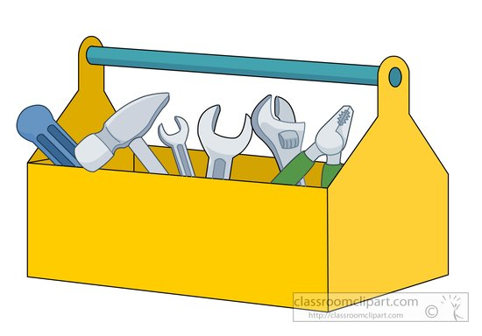
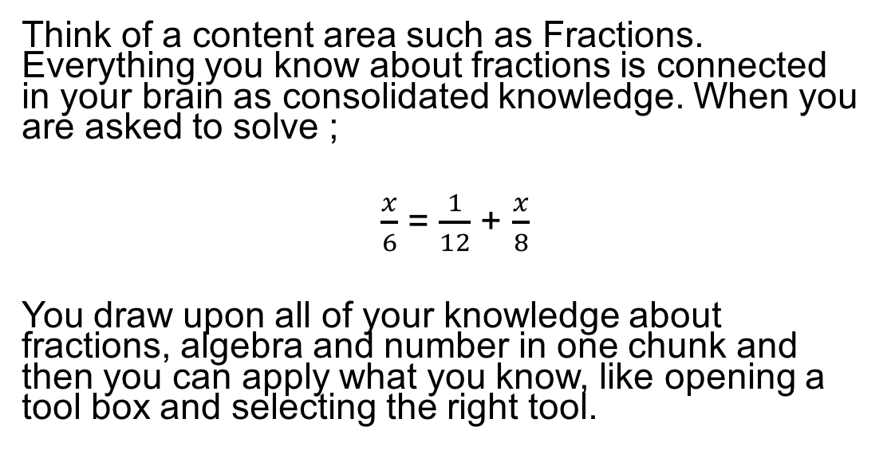
Example:
Think of a content area such as Fractions. Everything you know about fractions is connected in your brain as consolidated knowledge. When you are asked to solve ;
$\frac{x}{6}$ = $\frac{1}{12}$ + $\frac{x}{8}$
You draw upon all of your knowledge about fractions, algebra and number in one chunk and then you can apply what you know, like opening a tool box and selecting the right tool.

Slide 26
Teacher task
Complete the “chunking” worksheet in pairs and then share your thoughts amongst the group.

Slide 27
Mathematical talks
Students explain, describe, reflect and constructively critique
Importance of dialogue as well as discussion
Improves students’ thinking and reasoning skills in mathematics

Slide 28
Mathematical talks
Need to emphasise the importance of listening not just talking
Need to create a supportive culture where participation in discussions is safe and rewarding
Teacher initiated questions can close down discussions whereas open statements can encourage participation

Slide 29
How many dots do you see?
Notes:
Take teachers through the number talk activity. Ask teachers how many dots there are then before they can present their answer acknowledge that the answer is 7. Now focus on how they came up with the number seven. Go around the group and ask teachers to describe how they came up with the number 7 then draw a visual representation of this on a white board. Finally when you have many different visual representations convert them to numerical and conclude with the announcement that isnt mathematics wonderful that we all know the answer is 7 but look at how many different ways we can get the same answer.

Slide 30
Visual representations
Notes:
Ask particpants to come an draw how they visually counted the number of dots. U

Slide 31
When is this statement true?
7 – 11 = 8
Notes:
Ask the participants to provide explanations of when this statement might be true. The original question is referring to time 7pm – 11 hours is 8am.. Discuss the value in mathematical discussions as a lesson starter to encourage students to communicate their thinking.

Slide 32
Assessment and mindsets
Using only summative assessment perpetuates a fixed mindset in students
Formative assessment measures with positive feedback like, “you are not quite there yet” can assist students in developing a growth mindset in mathematics
Neurologically, formative assessment can assist in the development of synapses and increase students capacity to learn
Notes:
https://bhi61nm2cr3mkdgk1dtaov18-wpengine.netdna-ssl.com/wp-content/uploads/2015/10/1439422682-AssessmentPaper.pdf

Slide 33
Mathematics assessment
Placing value on the mathematical thinking processes rather then focusing on the solution improves students’ mindsets
Timed assessment can impact negatively on students mathematical mindsets
Addressing the process errors in mistakes and allowing students to re-do assessment questions to demonstrate their learning can assist the development of a growth mindset

Slide 34
Assessments that encourage a growth mindset in mathematics
Using self and peer assessments
Diagnostic assessment with quality feedback encourages growth (without a grade attachment)
Using rubrics or flowcharts for assessment focusing on the processes rather than the final answer
Providing positive feedback on what they can do, not just on what they can’t do
Notes:
http://map.mathshell.org/index.php
You could show some examples of assessments at this point. You may also ask particpants to bring in past assessments for reflection
https://www.mindsetkit.org/topics/assessments-growth-mindset-math/assessments-for-learning-encourage-growth-mindset

Slide 35
Mathematics anxiety
Fear or nervousness that arises from the pressure to perform in mathematics
Can negatively impact upon mathematical attainment
International PISA data supports that in Western societies more females suffer from maths anxiety then do male students
Can be perpetuated by a fixed mindset pertaining to mathematical ability where failure is viewed as a lack of intelligence and visa versa maths anxiety can result in students developing a fixed mindset
Notes:
https://www.acer.org/occasional-essays/deconstructing-maths-anxiety-helping-students-to-develop-a-positive-attitude by Sarah Buckley
http://theconversation.com/maths-anxiety-is-creating-a-shortage-of-young-scientists-heres-a-solution-58889
https://www.ncbi.nlm.nih.gov/pmc/articles/PMC2836676/

Slide 36
Strategies to reduce maths anxiety
Avoid placing the emphasis on the test but rather the learning ie: mastery goals vs performance goals
Provide students with ample time to complete assessment tasks noting stress can increase the time needed to think effectively
Develop a culture that making mistakes can be a valuable learning experience if used appropriately
Provide more formative assessment and valuable feedback to students to inform their learning

Slide 37
Summary
Having a growth mindset can improve student outcomes in mathematics
Fixed mindsets are perpetuated by placing emphasis on summative assessments and mathematical answers rather than the mathematical thinking processes
Fixed mindset can lead to maths anxiety in students
Female students are more likely to suffer from maths anxiety

Slide 38
Other modules in this series
Module 1: What is a mindset?
Module 3: The impact of mindsets on mathematics pedagogy
Module 4: Classroom activities and strategies to promote a growth mindset in mathematics

