Slide 1
Growth Mindset
Module 3 of 4: The impact of Mindsets on Mathematics Pedagogy
Identifying your mindset
Implications of a teacher’s mindset
Designed and written by Rachael Whitney-Smith

Slide 2
AITSL Proficiencies
Professional Knowledge
1. Know students and how they learn
3. Plan for and implement effective teaching and learning
5. Assess, provide feedback and report on student learning
Professional Engagement
6 Engage in professional learning

Slide 3
Module Objectives
Provide participants with tools to identify their own mindset
Provide research on mindsets and teaching
Give participants the opportunity to share their experiences

Slide 4
What is a Mindset?
Recall and reflect on the definitions and ideas associated with mindsets from modules 1 & 2 focusing on the following questions;
What are mindsets?
Define some of the differences between having a Growth mindset or a Fixed mindset?
Share your ideas as a group

Slide 5
Fixed vs Growth Mindset
FIXED Mindset
Intelligence is pre determined at birth
You cant change how smart you are.
Growth Mindset
You can grow your intelligence
All students can become smarter and more capable

Slide 6
Teacher Activity: What is your mindset?
Individually complete the self reflection worksheet as both a reflection of you past experiences and in your current situation

Slide 7
What mindset do you have about learning mathematics?
Do you ever say or think…
I was never that good at mathematics
I failed that test because I am not smart enough
Some people are just really gifted at maths
Some students are just not capable of learning
Your innate abilities determine your performance
When someone achieves success I feel threatened

Slide 8
What mindset do you have about learning mathematics?
Or do you ever say or think…
I failed that test because I didn't learn the material well enough
The majority of students are capable of learning
I like to challenge myself
The success of others inspires me
When I struggle with a question I persevere and it challenges me to put in more effort

Slide 9
Numbered Graph Activity
Can you number the nodes using only the numbers 1 -11 (using each number only once) such that the sum of the number in the node added to all of the numbers in adjacent nodes is equal to the same value? (called the node sum).
Here we have a set of nodes connected by edges.
Notes:
https://mav.vic.edu.au/files/conferences/2011/Peter_Sullivan.pdf
http://nrich.maths.org/content/id/7105/sol2.pdf

Slide 10
Impact of mindsets on teaching
How do your beliefs impact upon your teaching?
Do you use group work in mathematics and if so do you use homogenous or mixed ability groups? Why?
Do you think parts of the curriculum content are beyond some of your students? If so why / why not?
Do you goal set with your students? If so what kind of goals? & If not why?
Break into small groups of 4-5 people and discuss the questions above.

Slide 11
Impact of a teacher’s fixed mindset in Mathematics
Setting performance goals rather than learning goals for your students
Measuring success based on the students’ grades rather than their progression in learning
Fear of failure can impact upon how you assess and grade students ie: teaching for the test
Praising students for getting the right answer, rather than praising their effort in getting the right answer
Promoting students who have received the top marks in an assessment to being smart or clever rather than hard working
Not examine/reflect on teaching when some students don’t learn effectively

Slide 12
Impact of a teacher’s fixed mindset in Mathematics
Not teaching the mathematical proficiency strands
Early streaming based on pathways using fixed ability groupings
Using previous grades to determine the level of teaching and making lesson plan judgments rather then using diagnostics or formative assessment strategies
Dumbing down of curriculums rather than differentiation within the topic areas
Only extending your “A Grade” students
Not noticing sophisticated mathematical behaviours in students deemed not good at maths
Notes:
https://youtu.be/J25d9aC1GZA?list=PLMK38U7-6iQIw8pDrmDYeGT_9Y-WjPhZu

Slide 13
Fixed Mindsets on assessment failure
They always perform badly on exams
They don’t retain anything
The exam was too hard for our kids
Fixed Mindset Belief
Making excuses
Lowering of expectations
Blaming the difficulty of questions
Fixed Mindset Behaviour
Perpetuating the myth that intelligence is fixed
Continuation of poor performance
Tell students to move on and don’t dwell on the exam
Fixed Mindset consequences
From a teacher’s perspective

Slide 14
Growth Mindsets on assessment failure
Did we support the students enough in exam preparation
They didn’t fully learn the concepts
We need to revise our teaching pedagogies to provide richer learning opportunities
Growth Mindset Beliefs
Analysis of students errors to inform future teaching
Help students to identify their errors and understand where they went wrong
Growth Mindset Behaviour
Review of the course structure
Assist students to identify their areas of weakness and provide them with opportunities to address these. Encourage students to redo questions they got wrong after addressing the errors to show they are capable
Growth Mindset Consequences
From a teacher’s perspective

Slide 15
Actions that encourage a growth mindset in mathematics
Providing constructive feedback on all work and praising effort and perseverance on tasks
Using well structured group work in mixed ability groups
Using differentiated learning strategies

Slide 16
Differentiating in the classroom
How do you differentiate in the classroom and why?
How do you differentiate in assessment and why?
Break into small groups of 4-5 people and discuss the questions above.

Slide 17
Myths surrounding differentiation
It means I need to plan something different for every student
It means grouping students by ability and giving them different tasks
It means giving the high ability students more and the low ability students less
You don’t need to change your instructional practices to effectively differentiate

Slide 18
Ways to support differentiation
Engaging students in the learning process
Clearly defined learning goals based on a well defined quality curriculum
Use of regular informative assessment including diagnostic
Using assessment to inform teaching, deciding where students are at, where they need to be and what I need to do to help them get there

Slide 19
Differentiated learning in Mathematics
Setting student learning goals based on progression with high expectations
Using formative assessment strategies to inform planning and provide quality feedback to students
Praising progress and effort encouraging perseverance
Using open ended rich tasks with low entry and high ceiling opportunities allowing for differentiation and productive struggle

Slide 20
Mathematics Talks
Allows students to develop an understanding of mathematical language
Students are encouraged to actively listen to their peers
Encourages critical thinking and students reasoning in mathematics
Assists in formative assessment
Notes:
https://youtu.be/yXNG6GKFhQM
https://youtu.be/ytVneQUA5-c
https://youtu.be/ISDh-6KFDUo
https://youtu.be/n0_xDd5UyAU

Slide 21
Teacher Activity
Without using an algorithm or paper to work it out, write down the answer to
16 x 5
(Take note of how you came up with the answer)

Slide 22
Teacher Activity
The correct answer is 80 but what is more important is how did you get 80?

Slide 23
Teacher Activity Responses

Slide 24
Productive Struggle
Allow students time to process and grapple with tasks before rescuing them too soon
Create a classroom culture that encourages challenge through educating students about brain development and learning “How to grow your intelligence”
Notes:
https://youtu.be/HAd8n5x0LxU
https://youtu.be/tg0Z--pmPog

Slide 25
What do you notice?
2 x 3²⁰¹⁶ = 3²⁰¹⁷ - 3²⁰¹⁶

Slide 26
Encouraging Productive Struggle
Try not to always select students who know the right answer
Encourage students to support others who have made a mistake by getting them to identify where they may have gone wrong
Praise students who have stuck to a problem and found creative solutions rather than only those that solved it easily

Slide 27
Task selection
If students are continually given multiple short single answer, skill based procedural questions, they may view mathematics as being only black and white ie: you are either right or wrong, good or bad at maths, intelligent or not etc..
Try to use open ended questions that encourage students to think and apply their recently attained and prior knowledge with the opportunity for multiple response.
Encourage students to engage in mathematical thinking processes.

Slide 28
Example:
In the following right angle triangle, what is the length of the hypotenuse?
$$⍰$$
$$\sqrt{12}$$
$$\sqrt{37}$$

Slide 29
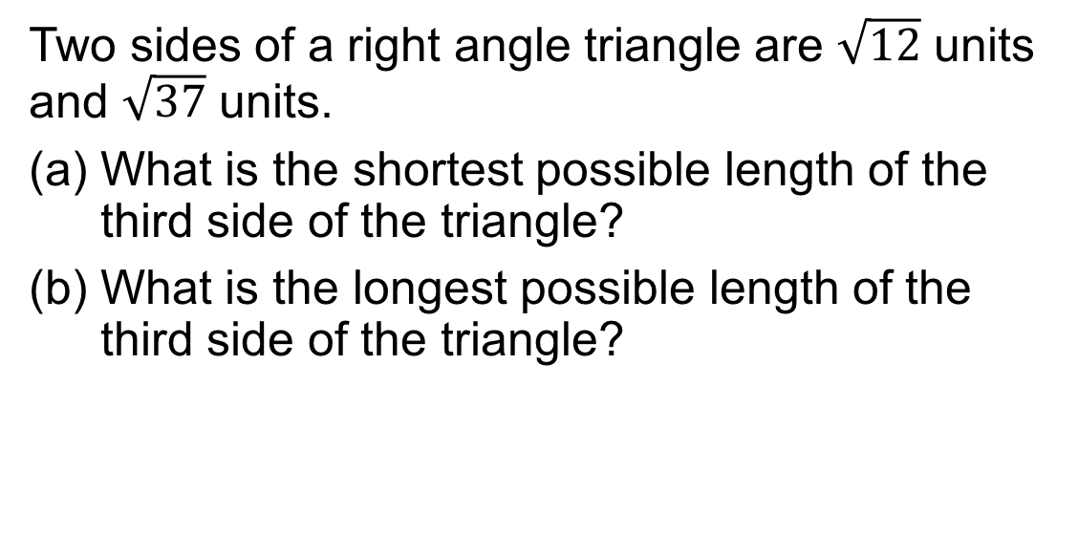
Example:
Two sides of a right angle triangle are $\sqrt{12}$ units and $\sqrt{37}$ units.
What is the shortest possible length of the third side of the triangle?
What is the longest possible length of the third side of the triangle?

Slide 30
Example:
I am an architect and wish to design a new building within a school that has three outward facing rooms, with an internal triangular space designed as a shared learning area. The rooms consist of 2 classrooms and a computer room. One of the classrooms is an existing square room with an area of 37m². The computer room is also to be square and is to have an area of 12m². If the buildings are to fit in a 400m² area of land, what possible dimensions could the other classroom and the shared learning area have?

Slide 31
Summary
Your own mindset can impact on your teaching pedagogies
Promoting a growth mindset in your students requires you modelling the same practices
Allowing students time to struggle with questions before rescuing them is crucial
Encouraging students to share their ideas and challenge themselves through rich tasks and mathematics talks promotes a growth mindset

Slide 32
Other modules in this series
Module 1: What is a mindset?
Module 2: The impact of mindsets on mathematical learning
Module 4: Classroom activities and strategies to promote a growth mindset in mathematics

