Slide 1
Opening the Top Drawer to Fractions
Module 1 of 6: What is ‘fraction sense’?

Slide 2
AITSL Professional Standards for Teachers
Professional knowledge
Standard 1: Know students and how they learn
1.1 Physical, social and intellectual development and characteristics of students 1.2 Understand how students learn 1.5 Differentiate teaching to meet the specific learning needs of students across the full range of abilities
Standard 2: Know the content and how to teach it
2.1 Content and teaching strategies of the teaching area
2.2 Content selection and organisation
2.3 Curriculum, assessment and reporting

Slide 3
…Continued
Professional practice
Standard 3: Plan for and implement effective teaching and learning
3.4 Select and use resources
Standard 5: Assess, provide feedback and report on student learning
5.1 Assess student learning
Professional engagement
Standard 6: Engage in professional learning
6.1 Identify and plan professional learning needs
6.2 Engage in professional learning and improve practice

Slide 4
Module objectives
To identify what it means to have ‘fraction sense’
To explore the ‘big ideas’ of fractions identified in the Top Drawer Teachers Fractions drawer
To identify the ‘big ideas’ of fraction within the Australian Curriculum: Mathematics.

Slide 5
Topic 1: Fraction sense
What is a fraction?
Why are fractions important?
What should students in your classroom know about fractions?

Slide 6
What is a fraction?
A fraction is an expression of a mathematical relationship between two or more numbers.
A fraction can be used in multiple ways such as a part of a whole, a ratio and as a division.
A fraction can be represented in multiple ways such as lengths, areas, volumes and as discrete objects or numbers.
Students need a conceptual understanding of fractions to support the development of procedural fluency and learning in other areas of mathematics.
Notes:
What is Fraction Sense? You could ask participants to brainstorm their ideas about what having fraction sense means prior to showing this slide, using Think Boards or a Think Pair Share activity.

Slide 7
Fraction notation
What name is given to the the top number?
Does the line separating the numbers have a name?
What name is given to the bottom number?
Notes:
Outline the importance of using the correct fraction language and terminology when using fractions. Research tells us that students who use mathematical terminology in a correct context when using fractions, have a greater conceptual understanding of fraction equivalence.
Further reading;
Assessing Students’ Understanding of Fraction Equivalence, AAMT 2011
Written by Monica Wong & David Evans

Slide 8
Fraction notation
Numerator: It represents the number of parts
Vinculum: The horizontal line used to separate the numerator from the denominator.
Denominator: It represents the number of equal parts the whole has been divided into
Why are the names important?
Notes:
Outline the importance of using the correct fraction language and terminology when using fractions. Research tells us that students who use mathematical terminology in a correct context when using fractions, have a greater conceptual understanding of fraction equivalence.
Further reading;
Assessing Students’ Understanding of Fraction Equivalence, AAMT 2011
Written by Monica Wong & David Evans

Slide 9
Types of fractions
A proper fraction is….................................... Some examples:
An improper fraction is…............................. Some examples:
A mixed fraction is…....................................... Some examples:

Slide 10
Types of fractions
Proper fractions: The numerator is less than the denominator and hence the fraction is less than one whole.
Examples:

Slide 11
Types of fractions
Improper fractions: The numerator is greater than the denominator and hence the fraction is larger than one whole.
Examples:

Slide 12
Types of fractions
Mixed Fractions: (sometimes referred to as mixed numbers) A combination of integers and fractions. The number of wholes is represented as an integer value and the number of parts is represented by the fraction component.
Examples:

Slide 13
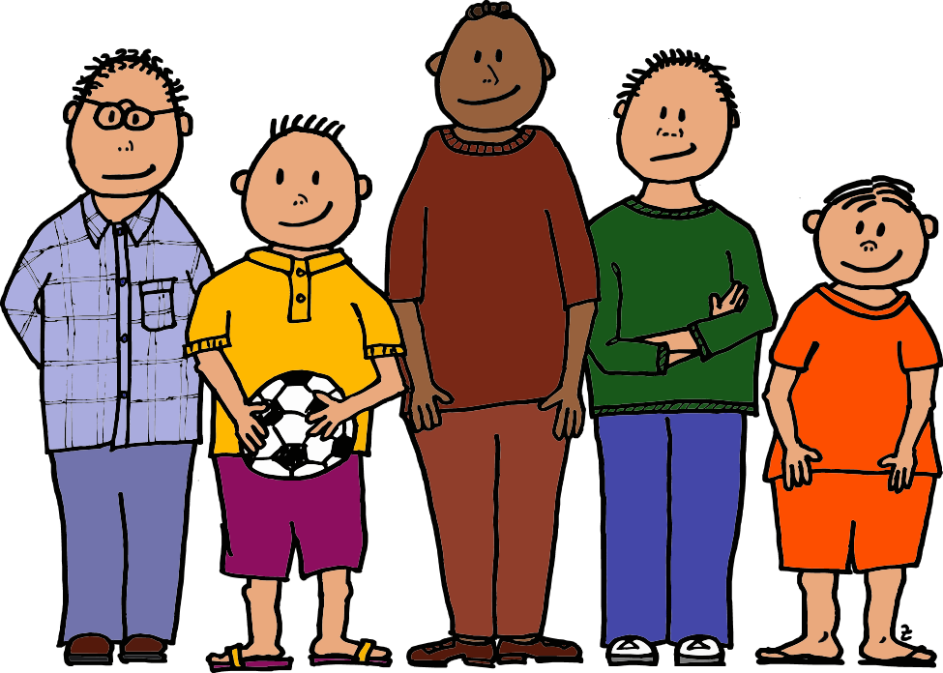

Teacher activity
Three pizzas were shared equally between five boys.
How much pizza does each boy get?
How do you solve this problem? Discuss.
How many different ways can you do this?

Slide 14
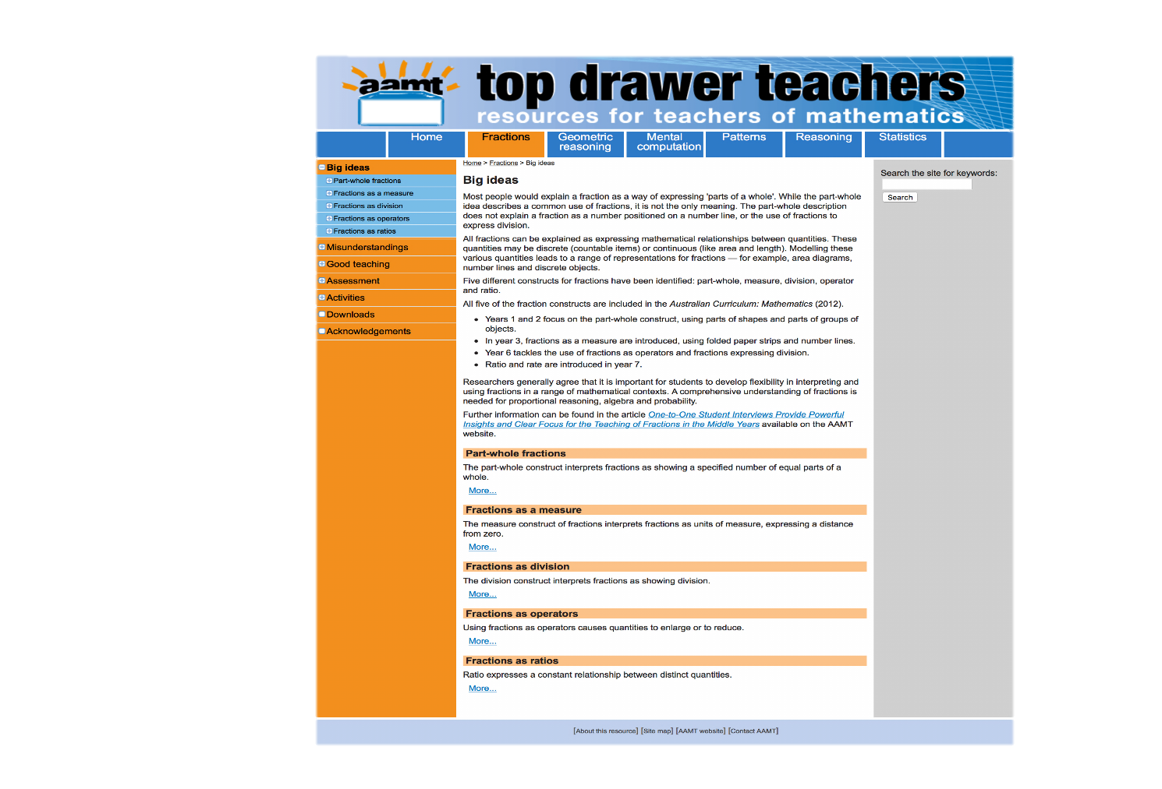
Topic 2: Big ideas in the fraction drawer

Slide 15
Fraction sub-constructs: Kieren (1980)
Fraction sub-construct | Meaning | Example
Part-whole comparisons | A fraction like represents 3 parts of four equal parts and equivalent fractions to this, represent the same relationship. | Place the following fractions in order of smallest to largest;
Quotient or Division | When one number or expression is divided by another it can be expressed as a fraction. Breaking up a quantity of something into a number of equal parts. | I have 2 cakes and I am sharing them evenly amongst 16 people. How big of a slice will they get each?
Measure | A fraction can be a position linearly on a number line or as part of a coordinate in a plane i.e., horizontal or vertical distance from the origin ( , ). | Plot the following fractions on a number line
Operator | You can use fractions as an operator using multiplication or division, to enlarge or reduce the size of an amount. | What is of 150 ?
Ratio | Can be used as a comparison in comparing quantities using the multiplicative relationship. | of the number of students doing Methods this year are girls. If there are 1500 girls enrolled in Methods how many students are there in total?

Slide 16
Part – whole comparisons
This fraction interpretation relies on partitioning either discrete or continuous objects into equal subsets or equal sized parts.
Discrete objects are countable (e.g. counters, blocks, cars). A more abstract interpretation could be that of time.
Continuous models include those of length, area and volume.

Slide 17
What do part-whole comparisons look like?

Slide 18
“In the part-whole interpretation, the denominator shows the number of equal parts in the whole and the numerator shows how many of those parts are included in the particular fraction.”
Top Drawer Teachers, AAMT
See video: The Part-Whole Meaning for fractions

Slide 19
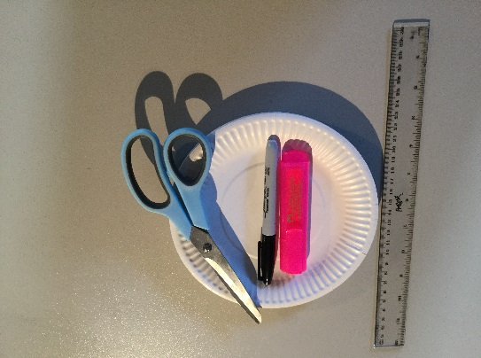
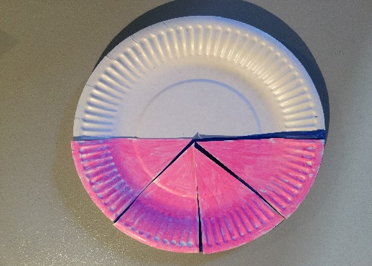
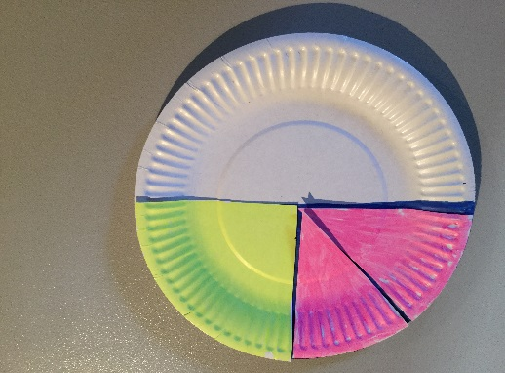
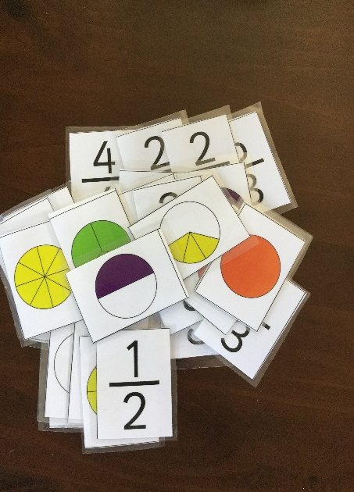
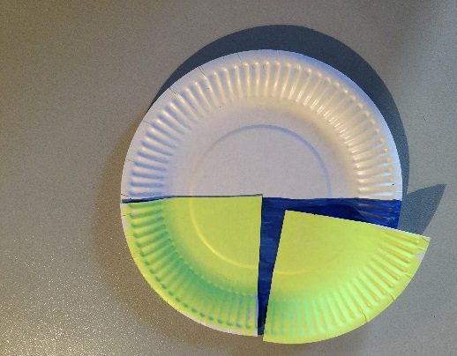
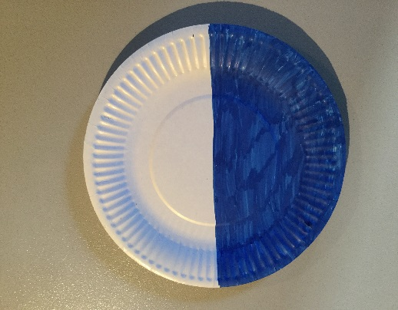
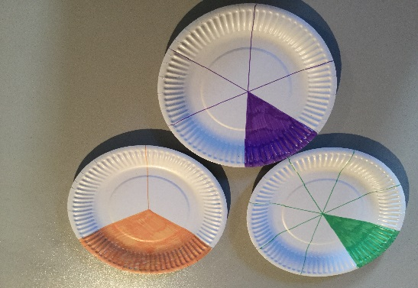
Examples of fractions as part-whole comparisons

Slide 20
Teacher activity
You will need paper or plastic plates (2 per person), scissors and a permanent marker pen.
Step 1: Make a cut in both plates from the circumference into the centre.
Step 2: Divide one of the plates up into equal segments and mark with a permanent marker.
Step 3: Insert one plate into the other.
Step 4: Rotate the plates to form different equivalent fractions.

Slide 21
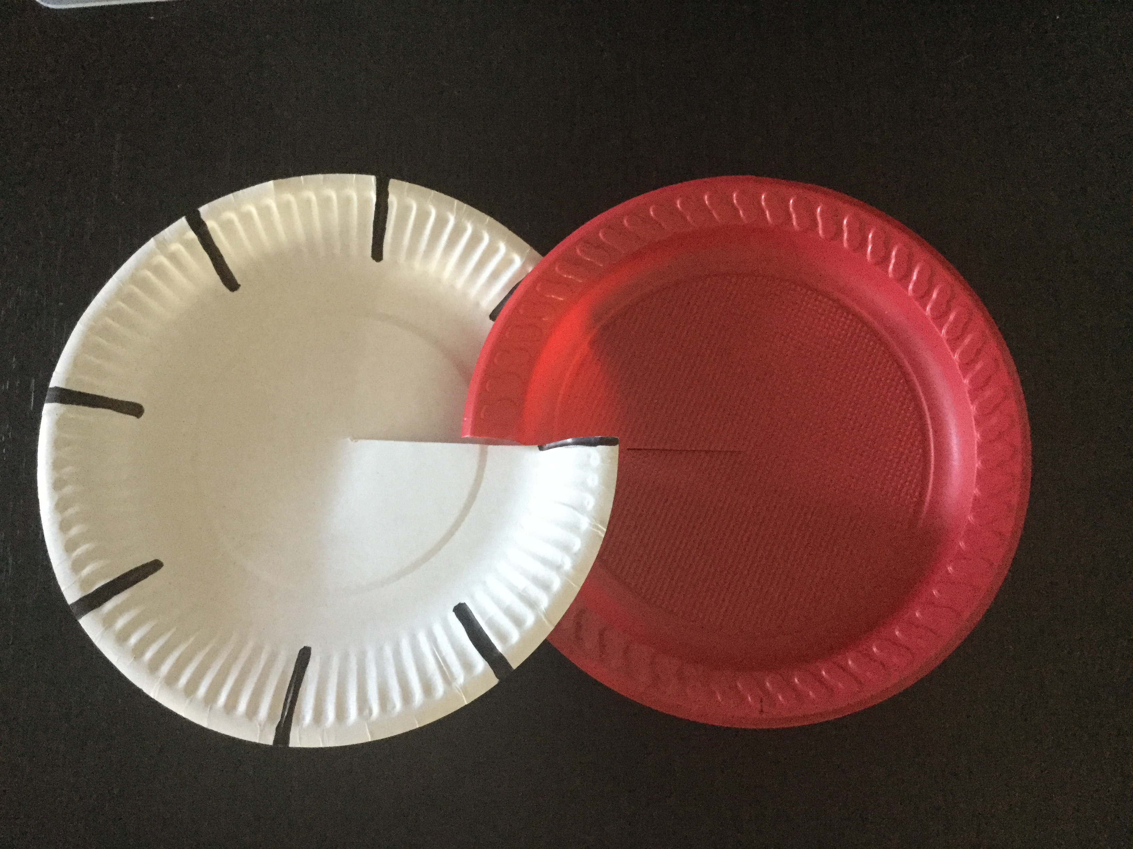
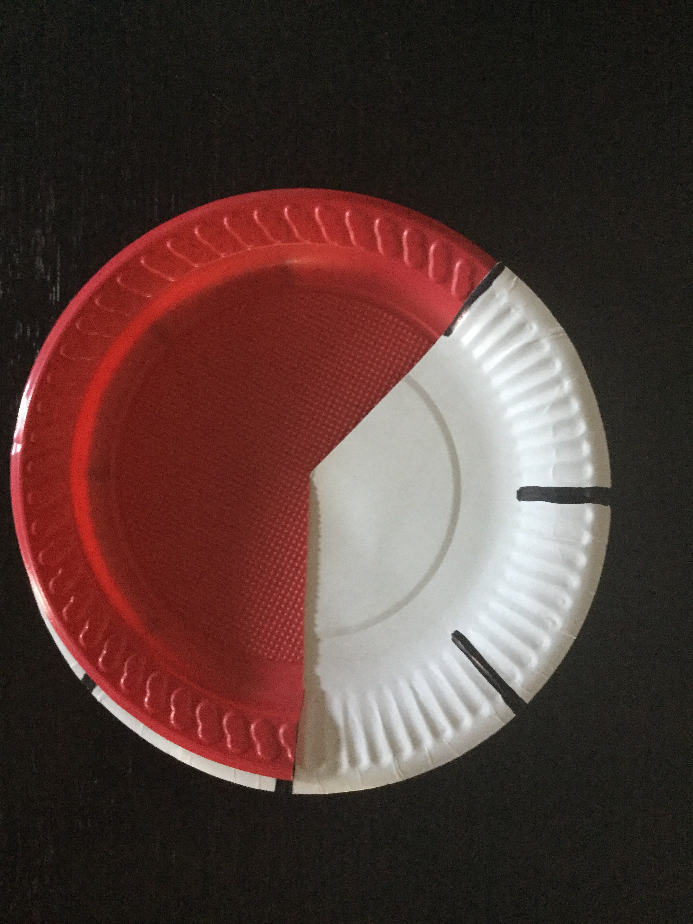
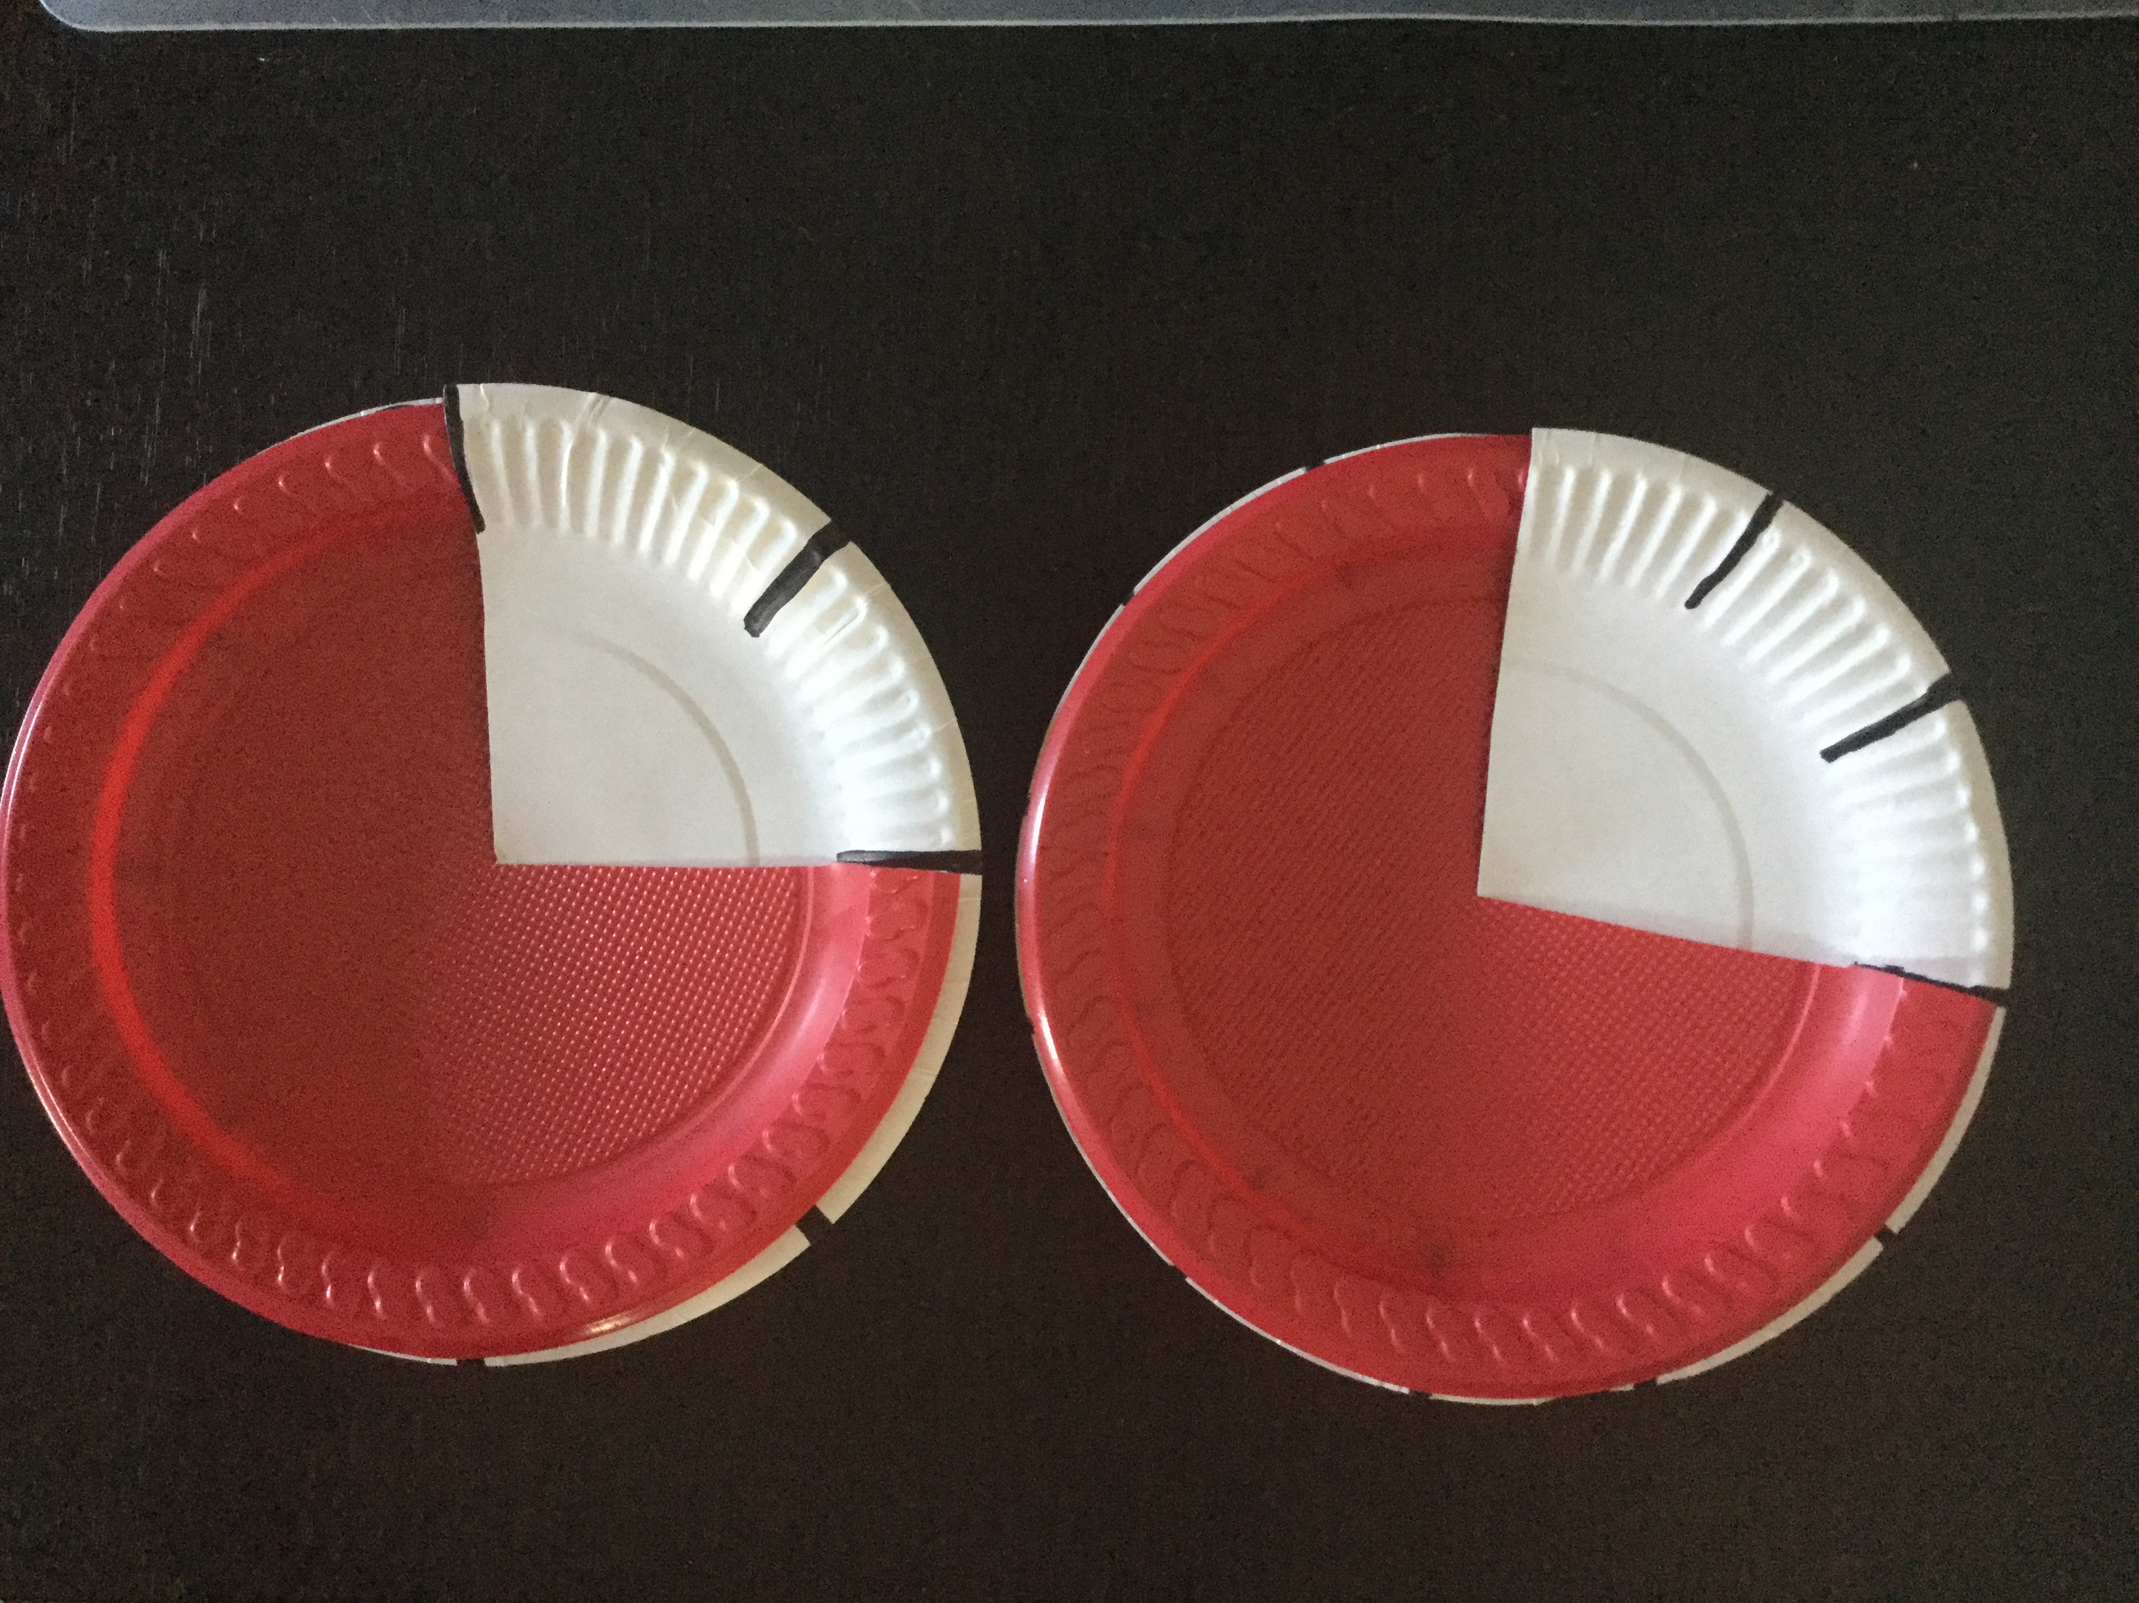
Examples

Slide 22
Fractions as a measure
Lamon (1999) defines the measure sub-construct, as being different from the others because the number of equal parts in a unit can vary depending upon the number of partitions. It is for this reason a number line and the use of a fraction strips is essential to develop understanding.
This understanding relies on the concept that a fraction is a quantity with a value and a size.

Slide 23
“The 'fraction as a measure' idea is best demonstrated using a linear model. The measure model supports the understanding that a fraction is a number, with a position on a number line.”
Top Drawer Teachers, AAMT
See video: Fractions as Measures

Slide 24
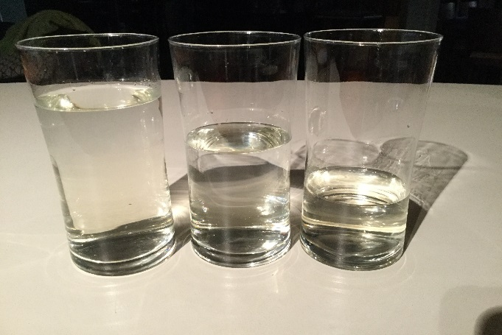
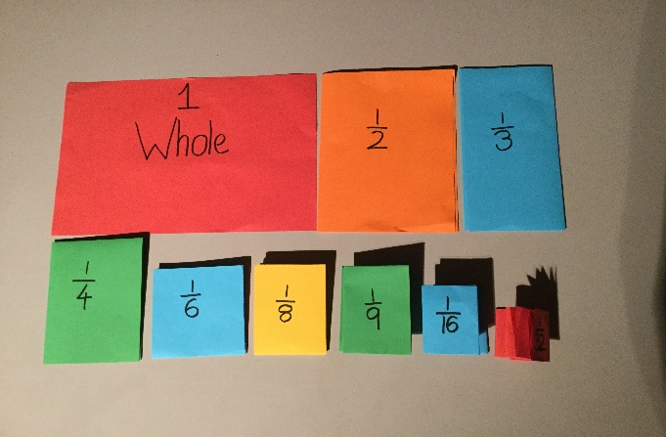
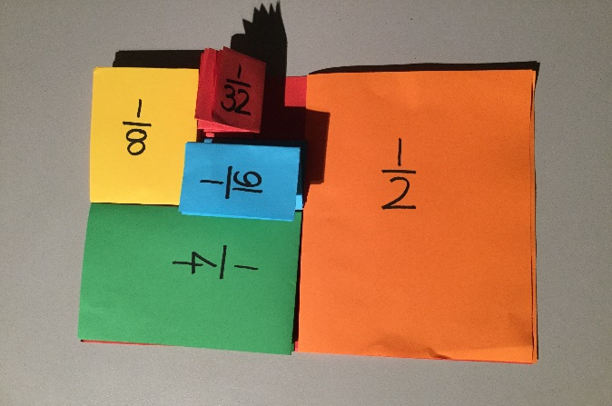
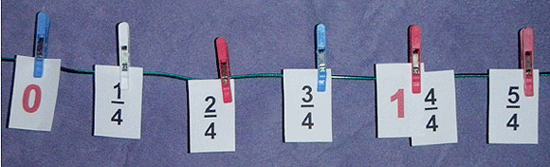
Examples of fractions as a measure

Slide 25
Teacher activity
Step 1: Fold one piece of paper in two to form halves
Step 2: Write the fraction on the front side of this piece
Step 3: Fold this piece in two to now form quarters
Step 4: Write the fraction on the front side of this piece
Step 5: Continue for eighths and if you can sixteenths
Step 6: Using the same process as above, fold the other piece of paper into thirds, then sixths and then twelfths
Step 7: Compare the fractions and then place in the correct order on a number line
What do you notice?

Slide 26
Quotient or division
This sub-construct uses the notion that ‘a’ over ‘b’ can be represented as a ÷ b and it means that the quantity a is divided into b parts.
For students to understand that a fraction can represent the concept of division, partitioning and equal sharing can also be used.

Slide 27
“People are perhaps less likely to think of the reverse situation, particularly in a real-life problem. For example, if asked to share two chocolate bars equally among three people, would you automatically think that each person would get two-thirds of a chocolate bar?”
Top Drawer Teachers, AAMT
See video: The Division Meaning of Fractions

Slide 28
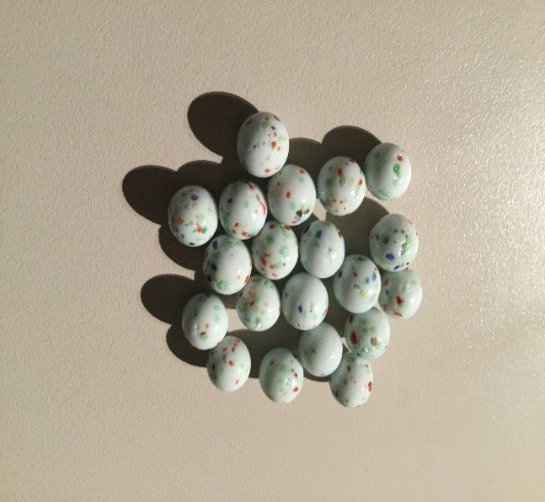
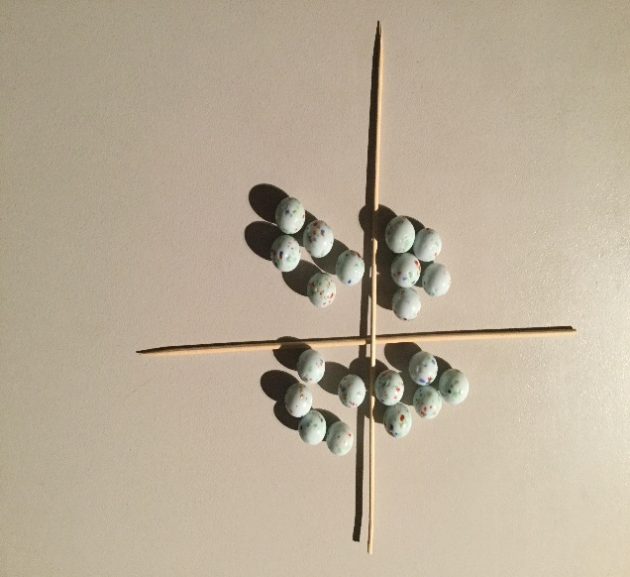
Example of fractions as a quotient or division
Dividing into quarters:
Reconsider the earlier activity of sharing 3 pizzas amongst 5 boys. How does it relate to this problem?

Slide 29
Fractions as an operator
Fractions can be used as an operator to reduce and enlarge objects or quantities. It requires an understanding that the word ‘of’ can be replaced by the symbol ‘x’ so that terminology like “I need half of a teaspoon” is converted into mathematical notation as:
“ "

Slide 30
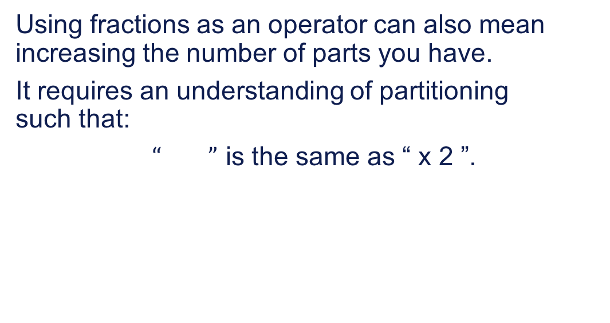
(…continued)
Using fractions as an operator can also mean increasing the number of parts you have.
It requires an understanding of partitioning such that:
$“ ”$ is the same as “ x 2 ”.

Slide 31
“A fraction can be used to 'operate' on a quantity. In other words, the fraction acts as a function.”
Top Drawer Teachers, AAMT
See video: Fractions as Operators

Slide 32
Example 1
If I have 4 sandwiches and I divide each up into halves how many halves will I have ?

Slide 33
Example 1
If I have 4 sandwiches and I divide each up into halves how many halves will I have ?
Abstract algorithm:
Pictorial model:
Answer:
I will have 8 halves.

Slide 34
Example 2
I need 24 orange quarters for half time at a game of netball, how many oranges will I need to buy?

Slide 35
Example 2
Pictorial model: Abstract algorithm:
Answer: I will have 6 whole oranges.

Slide 36
Fractions as a ratio
Using ratios for comparing the size of two sets or comparing the size of two measurements, fractions can be used as ratios.
It is important to understand that a ratio is a comparison of two quantities and not a single number, whereas a fraction represents a number.

Slide 37
“Even though ratio may not be explicitly taught as a distinct mathematical concept until the middle years of schooling, it is encountered in the earlier work done with equivalent fractions. Equivalent fractions express the same ratio.”
Top Drawer Teachers, AAMT
See video: Comparing Ratios

Slide 38
Teacher activity: How many ways can you express the following?

Slide 39
Example 3
If of a class are boys then what is the ratio of boys to girls?
Answer:
If are boys then will be girls which gives a ratio of which is then simplified to 2:3.
The ratio of boys:girls is 2:3 and boys:class is 2:5 and girls:class is 3:5.

Slide 40
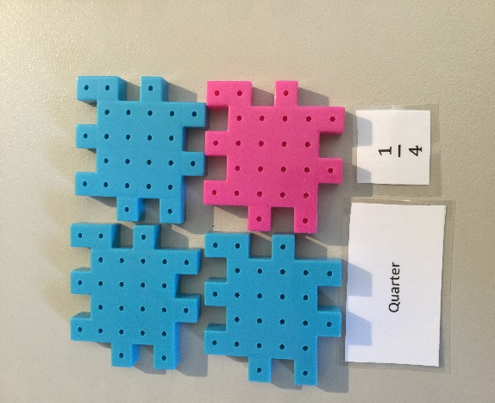
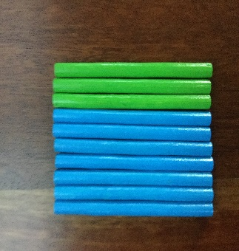
Examples of fractions as a ratio
Ratio blue to pink is 3:1 or are blue and are pink.
Ratio green to blue is 3:7 or are green or 30% are green.

Slide 41
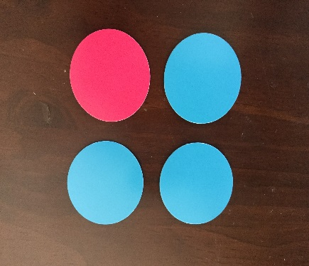
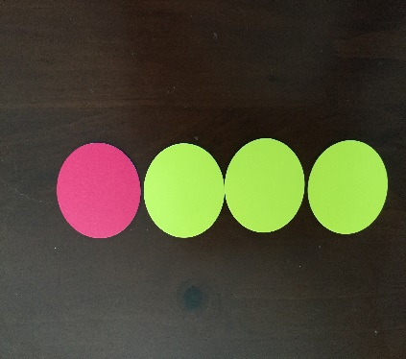
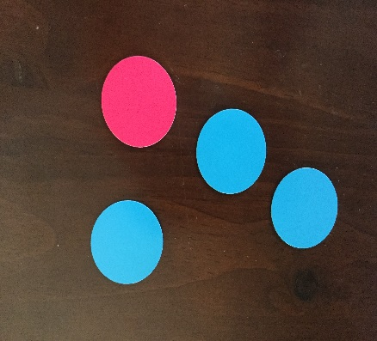
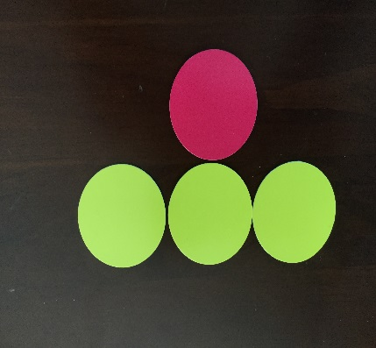
Teacher activity
What fractions are represented by these 4 pictures?
What ratios are represented by these four pictures?

Slide 42
Topic 3: Big ideas in the Australian Curriculum: Mathematics
“Students, need to understand that fractions are numbers with magnitudes.”
Lisa Fazio & Robert Siegler Teaching Fractions, 2011

Slide 43
Australian Curriculum: Mathematics
Content strands and sub-strands in the Australian Curriculum: Mathematics (F–10)
Number and algebra
Number and place value (F–8)
Fractions and decimals (1–6)
Real numbers (7–10)
Money and financial mathematics (1-10)
Patterns and algebra (F–10)
Note: Fractions & Decimals are a sub-strand until year 7 when the fractions content moves into the sub-strand Real Numbers.

Slide 44
Australian Curriculum: Mathematics
Content strands and sub-strands in the Australian Curriculum: Mathematics (F–10)
Measurement and geometry
Using units of measurement (F–10) Shape (F–7)
Geometric reasoning (3–10)
Location and transformation (F–7)
Pythagoras and trigonometry (9–10)
Linear and non-linear relationships (7–10)

Slide 45
Australian Curriculum: Mathematics
Content strands and sub-strands in the Australian Curriculum: Mathematics (F–10)
Statistics and probability
Chance (1–10) Data representation and interpretation (F-10)

Slide 46
Big ideas behind fractions in AC
All five of the fraction sub-constructs are included in the Australian Curriculum: Mathematics (AC).
Years 1 and 2 focus on the part-whole construct, dividing shapes up into equal parts and grouping objects into equal parts. Recognizing the uses of unit fractions.

Slide 47
Big ideas behind fractions in AC
In year 3, students begin to model fractions and measure with them to complete the whole. This continues into year 4 with locating fractions on a number line.

Slide 48
Big ideas behind fractions in AC
In Year 5 they begin to use fractions as an operator, then in Year 6 they progress to finding fractions of quantities and the concept of fractions being used to express a quotient or division. In Year 7 they continue using fractions as percentages, converting from one form to another as well as using fractions as operators with multiplication and division.

Slide 49
Big ideas behind fractions in AC
Ratios and rates as a further fraction sub-construct are consolidated in Year 8 along with the concepts of irrational numbers.

Slide 50
Australian Curriculum definitions
Fraction
Denominator
Numerator
Equivalent fractions
Related denominators
Ratio
Algebraic fraction
Irrational number
Real Number
Note: Rational numbers in the AC are defined under Real Numbers.

Slide 51
Rational vs Irrational numbers
Rational numbers can be written as a ‘simple’ fraction i.e., they can be written as a quotient of two integers where the denominator is not zero.
Examples:

Slide 52
Rational vs Irrational numbers
Irrational numbers cannot be expressed as a quotient of two integers i.e., any real number that is not rational.
Examples:
So the set of all Rational numbers added to the set of all Irrational numbers will give you the set of all Real numbers.

Slide 53
Number sets
Name | Symbol | Set | Examples
Natural (Counting) | N | {1,2,3,4,5,6,7,8,9,10….} | 3, 8, 125, 1052
Whole | N or W | {0,1,2,3,4,5,6,7.8.9.10…..} | 0, 12, 32,1026
Integers | Z | {...–4,–3,–2,–1,0,1,2,3,4...} | –25, 83, –129
Positive Integers | +Z | {1,2,3,4,5,6,7,8,9,10….} | 34, 102569
Negative Integers | -Z | {...–8,–7,–6,–5,–4,–3,–2,–1} | –3, –20567
Rational | Q | {…–8.5,..–10%,..0,. , ..99,..}
Irrational | I | {…0.1214734, e , ,….}
Real | R | {…–10234, ..–0.05,.., 18%…} | -2, 25%, 0.032
Imaginary | i | { i , 2i }
Complex | C | { a + bi , …} | –6i, 4 + 25i

Slide 54
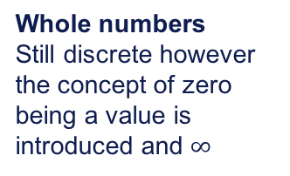
Number lines
Foundation – Year 1
Natural numbers Sometimes referred to as counting numbers. Concrete, discrete numbers represented by a dot on the number line.
0 1 2 3 4 5 6 7
Year 1 – Year 5
Whole numbers
Still discrete however the concept of zero being a value is introduced and $∞$
0 1 2 3 4 5 6 7

Slide 55
Number lines (cont.)
Year 6 +
Integers
Are whole numbers
that can be either
positive or negative with the number line extending Infinitely in each direction.
-4 -3 -2 -1 0 1 2 3 4 5 6 7 8
Rational numbers between each integer there are an infinite number of fractions.
0
1
Year 4 to represent fractions greater than zero and Year 6 + using directed numbers.

Slide 56
Research suggests…
It is generally agreed upon, by researchers, that students need to be exposed to fractions in a range of mathematical and real world contexts.
Although there are many models for representing fractions, the linear model is very important in building the concept that a fraction is a number and the concepts behind number density and number sets.

Slide 57
Research (cont.)
In order for students to develop a comprehensive understanding of proportional reasoning, algebra and probability they need to have grasped and understood the five sub-constructs of fractions and their application.
In order for students to progress in the secondary and senior curriculums and reach the standard required by the Australian Curriculum, teachers need to identify any misconceptions surrounding fractions early on rather than attempting to fix them later.

Slide 58
Reflection
What have I learnt?
What will I do with this knowledge?
Is there anything I will do differently having attended this professional learning workshop?

Slide 59
Acknowledgements for Top Drawer Fractions
The Fractions Drawer was designed and written by Dr Jennifer Way and reflects a long history of research and development in effective use of technologies in mathematics education.
The content of the drawer is supported by the extensive research into the learning of fractions carried out by several groups of researchers across Australia, some of which was published in a book edited by Dr Jennifer Way and A/Prof. Janette Bob is from The University of Sydney, titled Fractions: Teaching for Understanding (2011, AAMT).

