Slide 1
Opening the Top Drawer to Fractions
Module 2 of 6: What are misconceptions?

Slide 2
AITSL Professional Standards for Teachers
Professional knowledge
Standard 1: Know students and how they learn
1.1 Physical, social and intellectual development and characteristics of students 1.2 Understand how students learn 1.5 Differentiate teaching to meet the specific learning needs of students across the full range of abilities
Standard 2: Know the content and how to teach it
2.1 Content and teaching strategies of the teaching area
2.2 Content selection and organisation
2.3 Curriculum, assessment and reporting

Slide 3
…Continued
Professional practice
Standard 3: Plan for and implement effective teaching and learning
3.4 Select and use resources
Standard 5: Assess, provide feedback and report on student learning
5.1 Assess student learning
Professional engagement
Standard 6: Engage in professional learning
6.1 Identify and plan professional learning needs
6.2 Engage in professional learning and improve practice

Slide 4
Module objectives
To identify the key misunderstandings surrounding fractions.
To provide teachers with some strategies on how to address misunderstandings students may have developed.
To provide teachers with some strategies to prevent students developing misunderstandings in the first place.

Slide 5
Topic 1: Misconceptions
“Misconceptions are a problem with understanding, not fluency. Telling a student how to work out the answer and giving them the steps to memorise does not fix understanding, it fixes fluency.”
Tierney Kennedy Fixing Misconceptions in Fractions

Slide 6
Misconceptions in mathematics
What are misconceptions?
They are a misunderstanding that students develop when they incorrectly interpret mathematical ideas and concepts, form faulty thinking, or are taught shortcuts and algorithms that remove mathematical concept development.

Slide 7
Misconceptions in mathematics
What impact do they have on mathematical learning?
They can form a barrier that inhibits mathematical progress and conceptual understanding.

Slide 8
Misconceptions in mathematics
How do we identify misconceptions?
Teachers need to use diagnostic assessment and classroom observations and questioning to identify if students have developed misconceptions.
Effective teaching requires being prepared to anticipate and recognise common misconceptions and having a range of strategies to address them.

Slide 9
Fraction misconceptions
One of the leading contributing factors to students developing misconceptions about fractions is that they haven't developed the conceptual understanding that a fraction is a number that can be derived through partitive division.

Slide 10
The big questions we need to ask
What fractions misconceptions have students developed prior to entering my classroom?
How do these misconceptions surrounding fractions affect my mathematics instruction?
How do I fix these misconceptions about fractions?
How can I avoid students developing misconceptions in the first place?

Slide 11
Topic 2: TDT identifying four main fraction misunderstandings
Number of parts only: unequal areas
Fractions as a double: wrong number
Different wholes: shifting wholes
Using rules blindly: wrongly applying pre-learned strategies

Slide 12
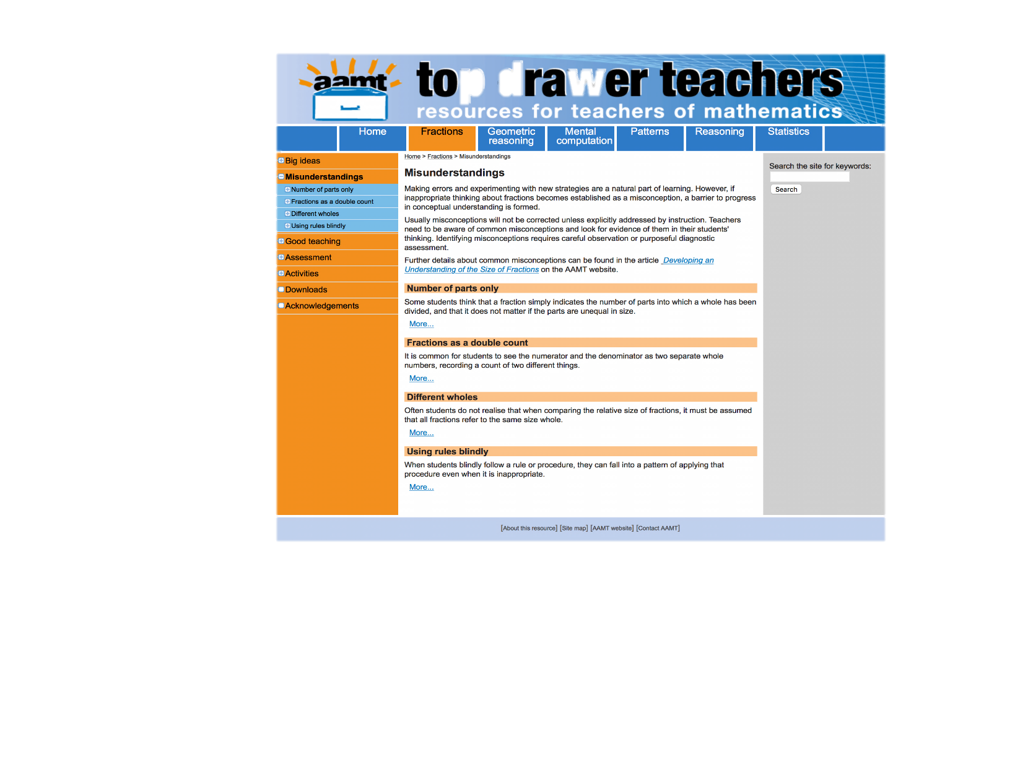
Misunderstandings in the Fractions drawer

Slide 13
1. Number parts only: unequal areas
This misconception occurs when students merely count the number of parts that an object is divided up into rather then ensuring the parts are all equal.
Students need to have an understanding of ‘fairness’ where every part of the object has to be the same size for the image of the object to be a true representation of the fraction.

Slide 14
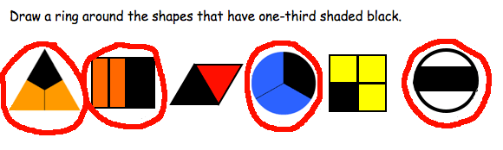
Recognising the misconception
View the article Developing an understanding of the size of fractions:
http://www.aamt.edu.au/Library/TDT-Readings/Fractions/tdt_F_gould1.pdf

Slide 15
“When asked to choose the shapes that show one-third, a student with the 'number of parts only' misconception has responded by selecting all the shapes that have three parts.”
Top Drawer Teachers, AAMT

Slide 16
Example
What fractions can you see in this drawing?

Slide 17
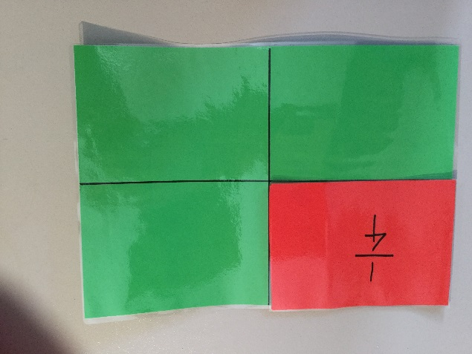
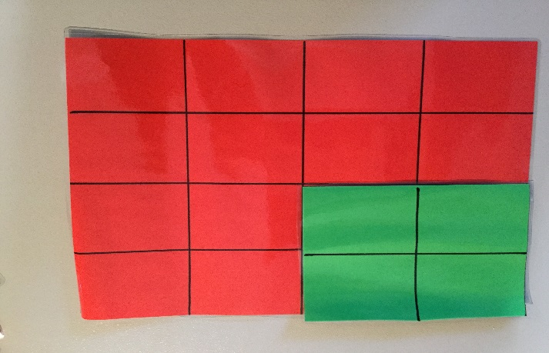
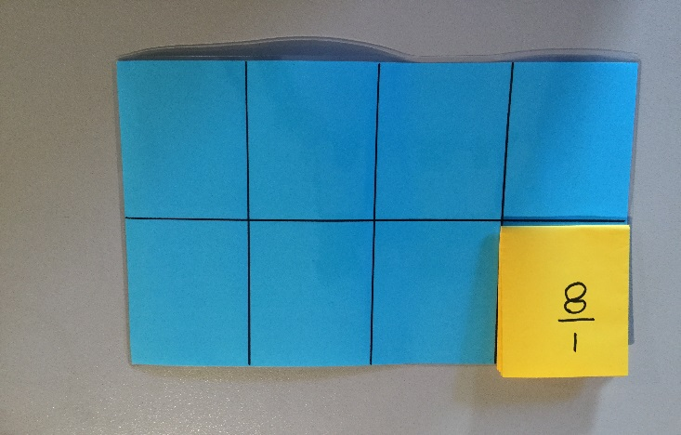
How to fix this misconception
Students need to understand that the parts have to be equal in size and quantity
Paper folding can help model equal parts

Slide 18
How to fix this misconception
What fraction is shaded orange?
Representations of fractions like this can be used both to recognise the misconception and to teach fractions as equal areas.

Slide 19
Teacher activity
Use your A4 coloured sheets of paper.
Fold one of the sheets in half and cut to produce two halves.
Fold another sheet in four and cut to form quarters.
Continue as above to form thirds, sixths and eighths.
Using the pieces demonstrate how they form the whole and that they are congruent shapes.

Slide 20
2. Fractions as a double count – wrong number
This is where students see a fraction as being two numbers compared, not a single number.
When asked to order fractions they look for larger numbers and mistake a larger denominator to be a larger value.
They also count the parts in a ratio rather than seeing it as a whole.

Slide 21
Recognising the misconception
What fraction of this group of shapes are stars?
(Incorrect response)

Slide 22
Recognising the misconception
Put these fraction cards in order from the smallest fraction to the largest.
(Incorrect response)

Slide 23
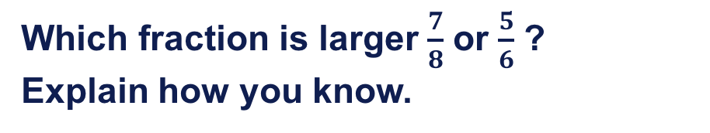
Recognising the misconception
Which fraction is larger $\frac{7}{8}$ or $\frac{5}{6}$ ?
Explain how you know.
“They are the same because both have just one more to make a whole.”
(Incorrect response)

Slide 24
Teaching tips to avoid double-counting with fractions
Say fractions as a single number instead of describing a part-whole relationship of numbers. For example, say 'two-thirds' rather than 2 out of 3.
Use a number line representation of fractions to accompany part-whole images.
Expand students understanding of fractions to include relative size. For example, use Fraction Wheel.

Slide 25
Teaching tips (cont.)
Use fractions of the same denominator to count in a sequence so to reinforce the idea that a fraction is a number. For example, use Sequencing and Counting.
Encourage students to perform sharing exercises to explore division as a fraction sub-construct. For example, use Dividing Pancakes.
Discuss and explore the real world applications of fractions.

Slide 26
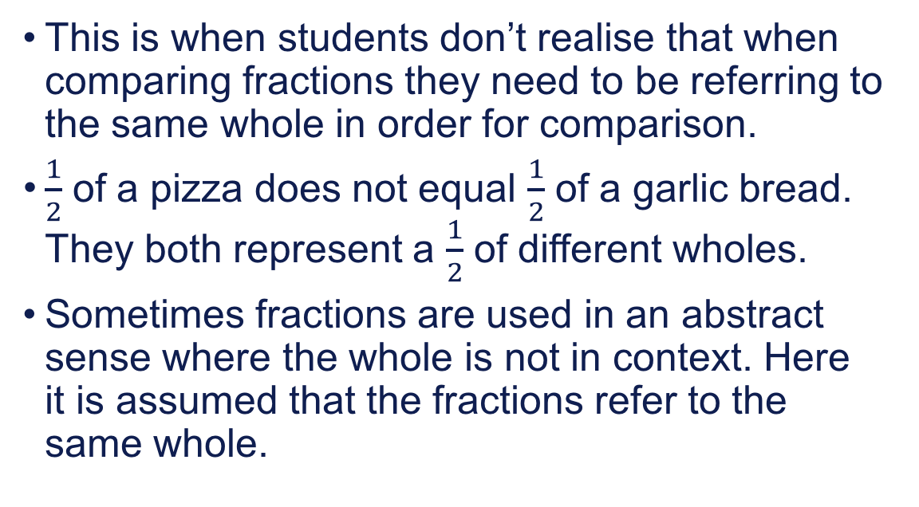
3. Different wholes
This is when students don’t realise that when comparing fractions they need to be referring to the same whole in order for comparison.
$\frac{1}{2}$ of a pizza does not equal $\frac{1}{2}$ of a garlic bread. They both represent a $\frac{1}{2}$ of different wholes.
Sometimes fractions are used in an abstract sense where the whole is not in context. Here it is assumed that the fractions refer to the same whole.

Slide 27

Teacher demonstration
Is a $\frac{1}{4}$ always a $\frac{1}{4}$ ?

Slide 28
How to fix this misconception
Allow students to collect or create models of the same fraction with different wholes.
Give a context for fractions to demonstrate different wholes.
Explicitly teach that when there is no context then the fractions represent a part of the same whole i.e., when representing fractions as a measure on a number line the whole is one unit.

Slide 29
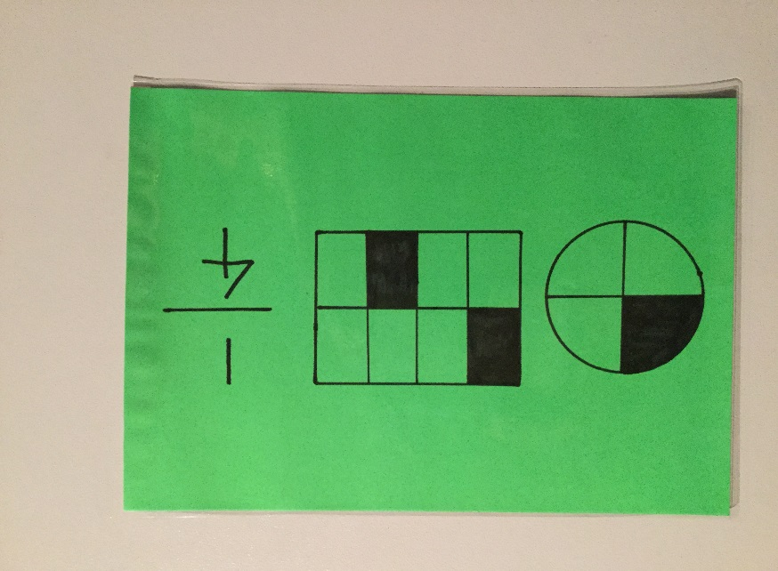
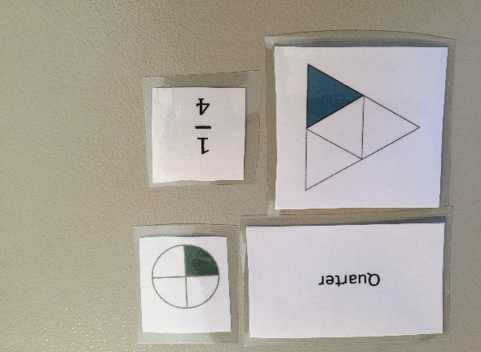
Representations of the same fraction with different wholes

Slide 30
Teacher activity
Cut and Find Activity
You will need:
Template of different shapes
Scissors
Marker
A3 paper

Slide 31
4. Using rules blindly
Students find it difficult knowing which strategy to use when. They develop an understanding of one method and then use it in other situations incorrectly.
“A common misconception is that the rule for comparing the relative size of unit fractions can also be used for comparing non-unit fractions.” Top Drawer Teachers, AAMT

Slide 32
What do students do?
Consider + and suggest some of the errors that students make when doing this problem.

Slide 33
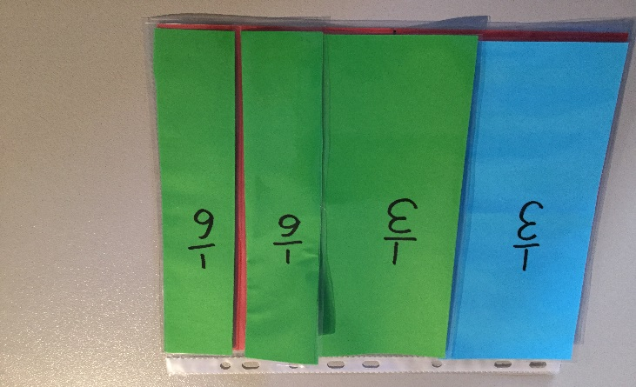
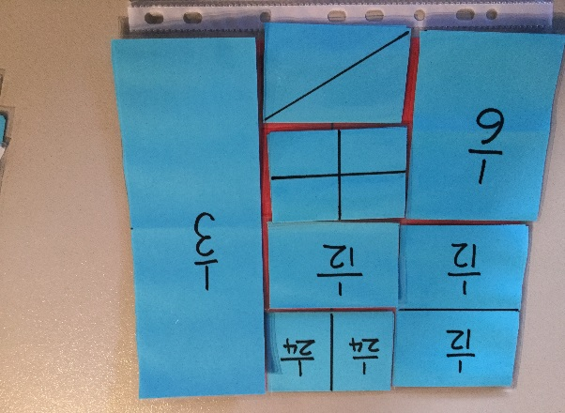
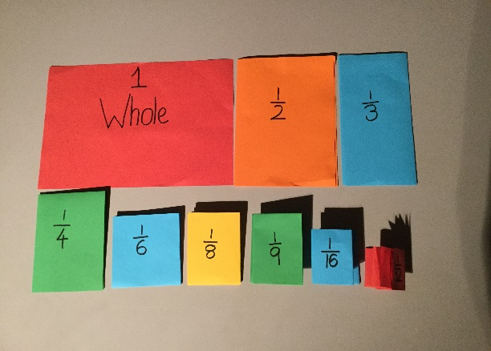
How to fix this misconception
Avoid students using old/learnt strategies in new situations without checking/testing their validity
Develop students notion of the relative size of fractions when compared to a whole

Slide 34
Teacher demonstration
Giving students a sense of size
TDT Sorting Fractions Cards

Slide 35
Topic 3: Misconceptions diagnostic test
Partitioning: The missing link in building fraction knowledge and confidence.
If students are not able to partition they will struggle with the concepts of fractions which will impact upon their ability to move into proportional reasoning.

Slide 36
Teacher activity
In groups discuss the findings you discovered when your students sat the misconceptions test.
Identify any common misconceptions.

Slide 37
Reflection
What have I learnt?
What will I do with this knowledge?
Is there anything I will do differently having attended this professional learning workshop?

Slide 38
Acknowledgements for Top Drawer Fractions
The Fractions drawer was designed and written by Dr Jennifer Way and reflects a long history of research and development in effective use of technologies in mathematics education.
The content of the drawer is supported by the extensive research into the learning of fractions carried out by several groups of researchers across Australia, some of which was published in a book edited by Dr Jennifer Way and A/Prof. Janette Bobis from The University of Sydney, titled Fractions: Teaching for Understanding (2011, AAMT).

