Slide 1
Opening the Top Drawer to Fractions
Module 3 of 4: Best Practice

Slide 2
AITSL Professional Standards for Teachers
Professional knowledge
Standard 1: Know students and how they learn
Standard 2: Know the content and how to teach it
Professional Practice
Standard 3. Plan for and implement effective teaching
and learning
Standard 5. Assess, provide feedback and report
on student learning
Professional Engagement
Standard 6. Engage in professional learning

Slide 3
Module objectives
To outline the AAMT standards for excellence in teaching mathematics and how it applies
to the teaching of fractions.
To provide teachers with research findings
into best practice for the teaching of fractions.
To provide teachers with ‘good teaching’ strategies for teaching fractions from TDT.

Slide 4
Topic 1: AAMT Standards for Excellence
The AAMT Standards for Excellence
in Teaching Mathematics in Australian Schools
were first adopted and published in 2002.
They were reprinted in 2006 with the text of
the Standards themselves unaltered, but the explanatory notes updated to reflect current educational policies.

Slide 5

Teacher activity
What is a good teacher?
In small groups discuss what being a "good mathematics teacher” means to you.
Metaphor Activity

Slide 6
Standards self assessment
What is it for?
This form of the AAMT Standards allows individuals or groups of teachers to reflect
on their practice in terms of the expectations against three scales:
  importance
  self-evaluation, and
  priority for improvement.

Slide 7
Teacher activity
Each participant is to complete the
Standards Self Assessment handout.

Slide 8
Key questions
Were there any you found hard to understand?
Did you work across or down? Why?
In the 'Importance' column, what was the most interesting response you had to make? (Hardest
to decide or surprising when you reflected on the ranking you gave it or ...)
What sort of things were most important? Least important?

Slide 9
Topic 2: Best practice
“Teachers should use multiple contexts when presenting rate, ratio and proportional problems. A key goal is getting students to understand the underlying similarities between similar problems that are presented in different contexts.”
Lisa Fazio & Robert Siegler
Teaching Fractions, 2011

Slide 10
Best practice in planning mathematics programs
To cater for all levels of understanding, preconceived misconceptions and prior knowledge a well developed teaching block should include activities that are;
  Diagnostic & Prescriptive
  Cumulative & Sequential
  Explicit, Systematic & Structural
  Multisensory
  Cognitive
  Direct
  Supportive
Esther White
Maths Australia

Slide 11
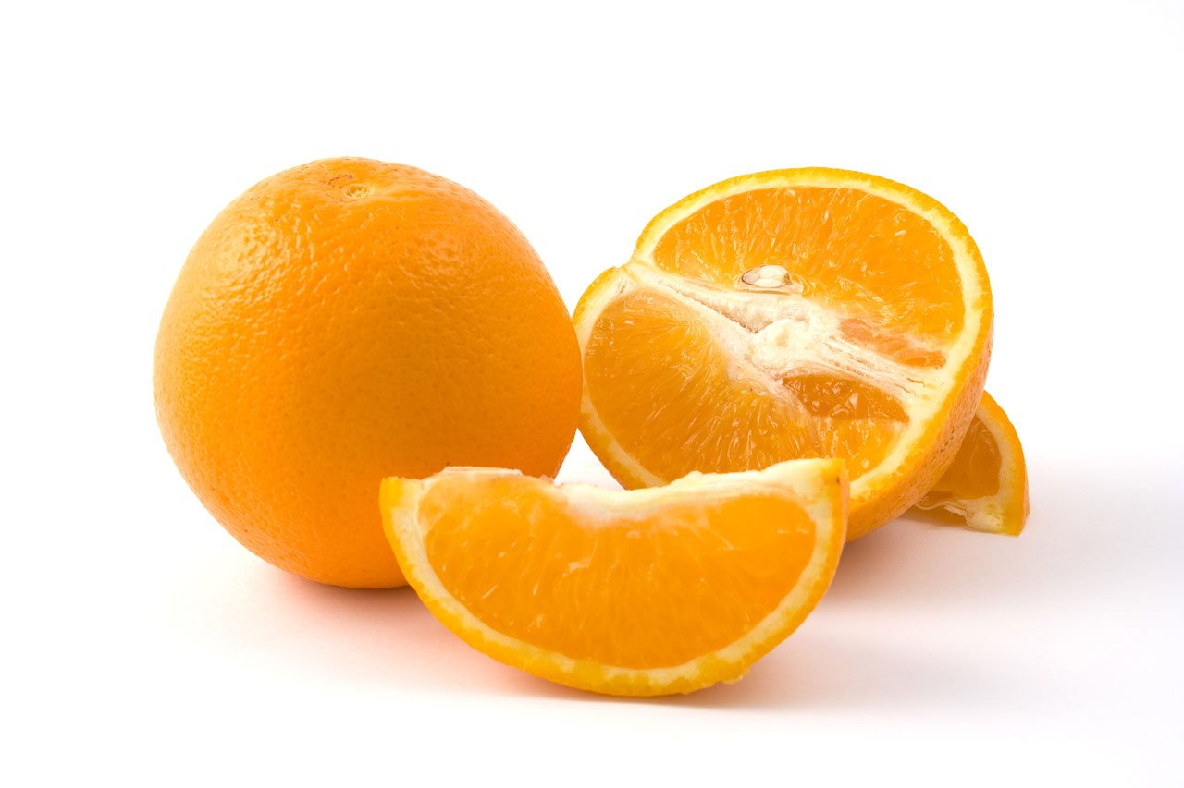
Best practice in teaching fractions
Develop students understanding of fraction sense and the five sub-constructs of fractions using
a variety of examples, models and activities.

Slide 12
Teacher activity
How many different ways
can you represent a quarter?

Slide 13
Best practice in teaching fractions
Assessment for learning strategies can assist
in identifying misconceptions early as well as assisting in differentiation.
Formative assessment strategies such as short quizzes, interviews, think pair share, leave passes and reasoning activities form an integral part in determining what learning has taken place.

Slide 14
Examples
KAHOOT
Padlet
Online Note Pad
Quizlet

Slide 15
Hinge point questions
One or two well constructed hinge point questions can provide crucial information
about where students are at and allow for future planning along with determining any misconceptions students may have developed.
What is a hinge point question video?

Slide 16
Best practice in teaching fractions
Ensure the key understandings of fraction sense, dividing, equivalence and addition and subtraction are developed through using the proficiencies in order for students to be able to progress into understanding the concepts associated with proportional reasoning and algebraic thinking.

Slide 17
Topic 3: Good teaching in the Fractions drawer
To develop a sound understanding of fractions, students need to explore the various meanings for fractions, as explained in TDT Big Ideas.
Emphasis should be placed on developing a deep conceptual understanding of fractions, rather than relying on learned procedures or rules.

Slide 18
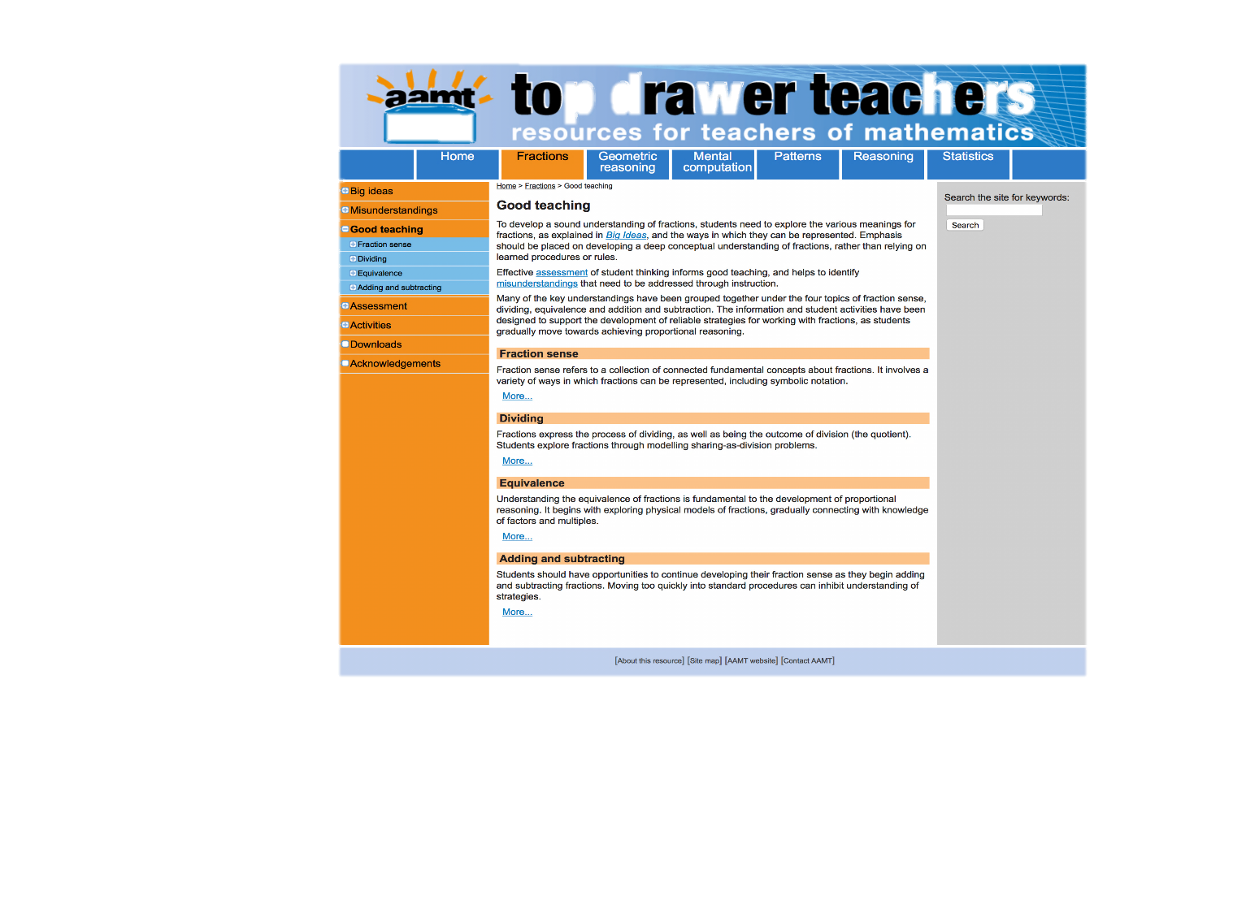
Good teaching in the Fractions drawer

Slide 19
Visualizing fractions
Students with insufficient fraction sense are not
able to visualise the whole,
or how many equal parts
are involved.
What fraction of a circle does this shape represent?

Slide 20
Multiple of representations
Conventionally we tend to use circles and other plain shapes divided into pieces and then shaded to represent fractions. It is good for students to see multiple different representations of shaded fractions to conceptualise it is the area of the shape shaded that represents the fraction and that this area doesn't have to be shaded in a conventional manner.

Slide 21
Example
What fraction do the following
shaded areas represent?

Slide 22
Teacher activity
Partner up into groups of 2 – 4.
Using the overlay grids provided, manipulate
the grids to create some equivalent fractions.
In your group discuss how you might use
these overlays with your students to assist
them in visualising and subsequently understanding equivalent fractions.

Slide 23
Fractions as numbers
Students with fraction sense:
Identify a fraction as a number and therefore have a position on a number line.
Understand fractions have a value and they can be measured.
Are able to count with fractions.
Are able to use fractions as they would any other number in applied contexts.

Slide 24


Fractions on a number line
0
$$\frac{1}{5}$$
1
Label end
of interval
0
1
$$\frac{1}{5}$$
Do not label
the space
Initially focus students attention to the fact that the distance between zero and one represents one whole.

Slide 25
Teacher activity
The participants with either a zero or a one on their card are to arrange themselves in front of
the room to represent a number line.
The remainder of the participants are to use
their fraction cards and arrange themselves in
the correct order to complete the number line.

Slide 26
Division and fractions
For students to understand the conceptual relationship between fractions and the operation
of division they need to be able to partition.
There are two concept areas to focus on;
Fractions of Collections
Sharing as Division

Slide 27
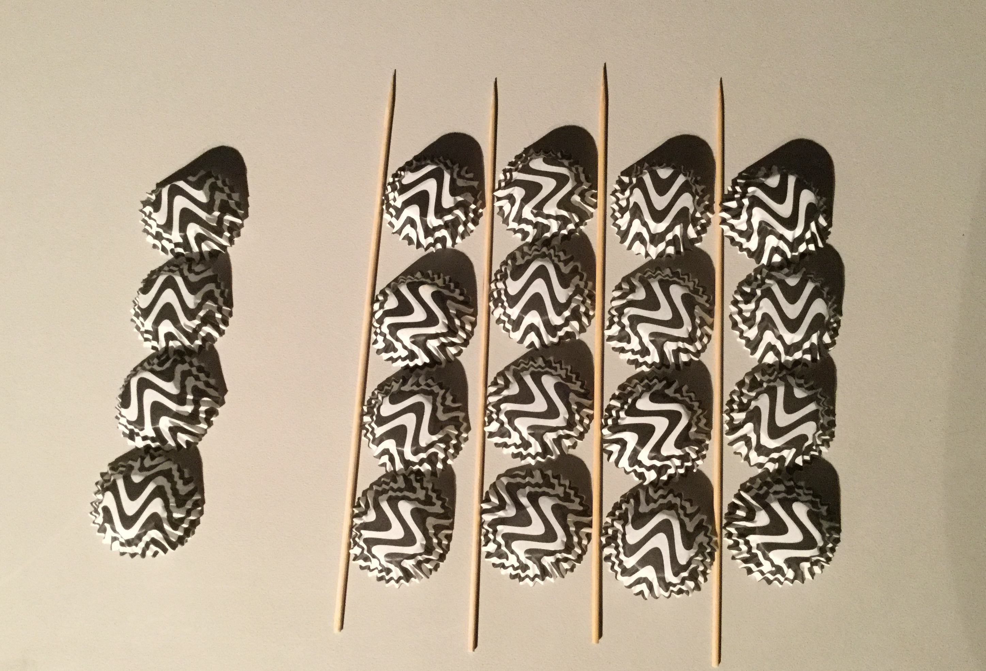
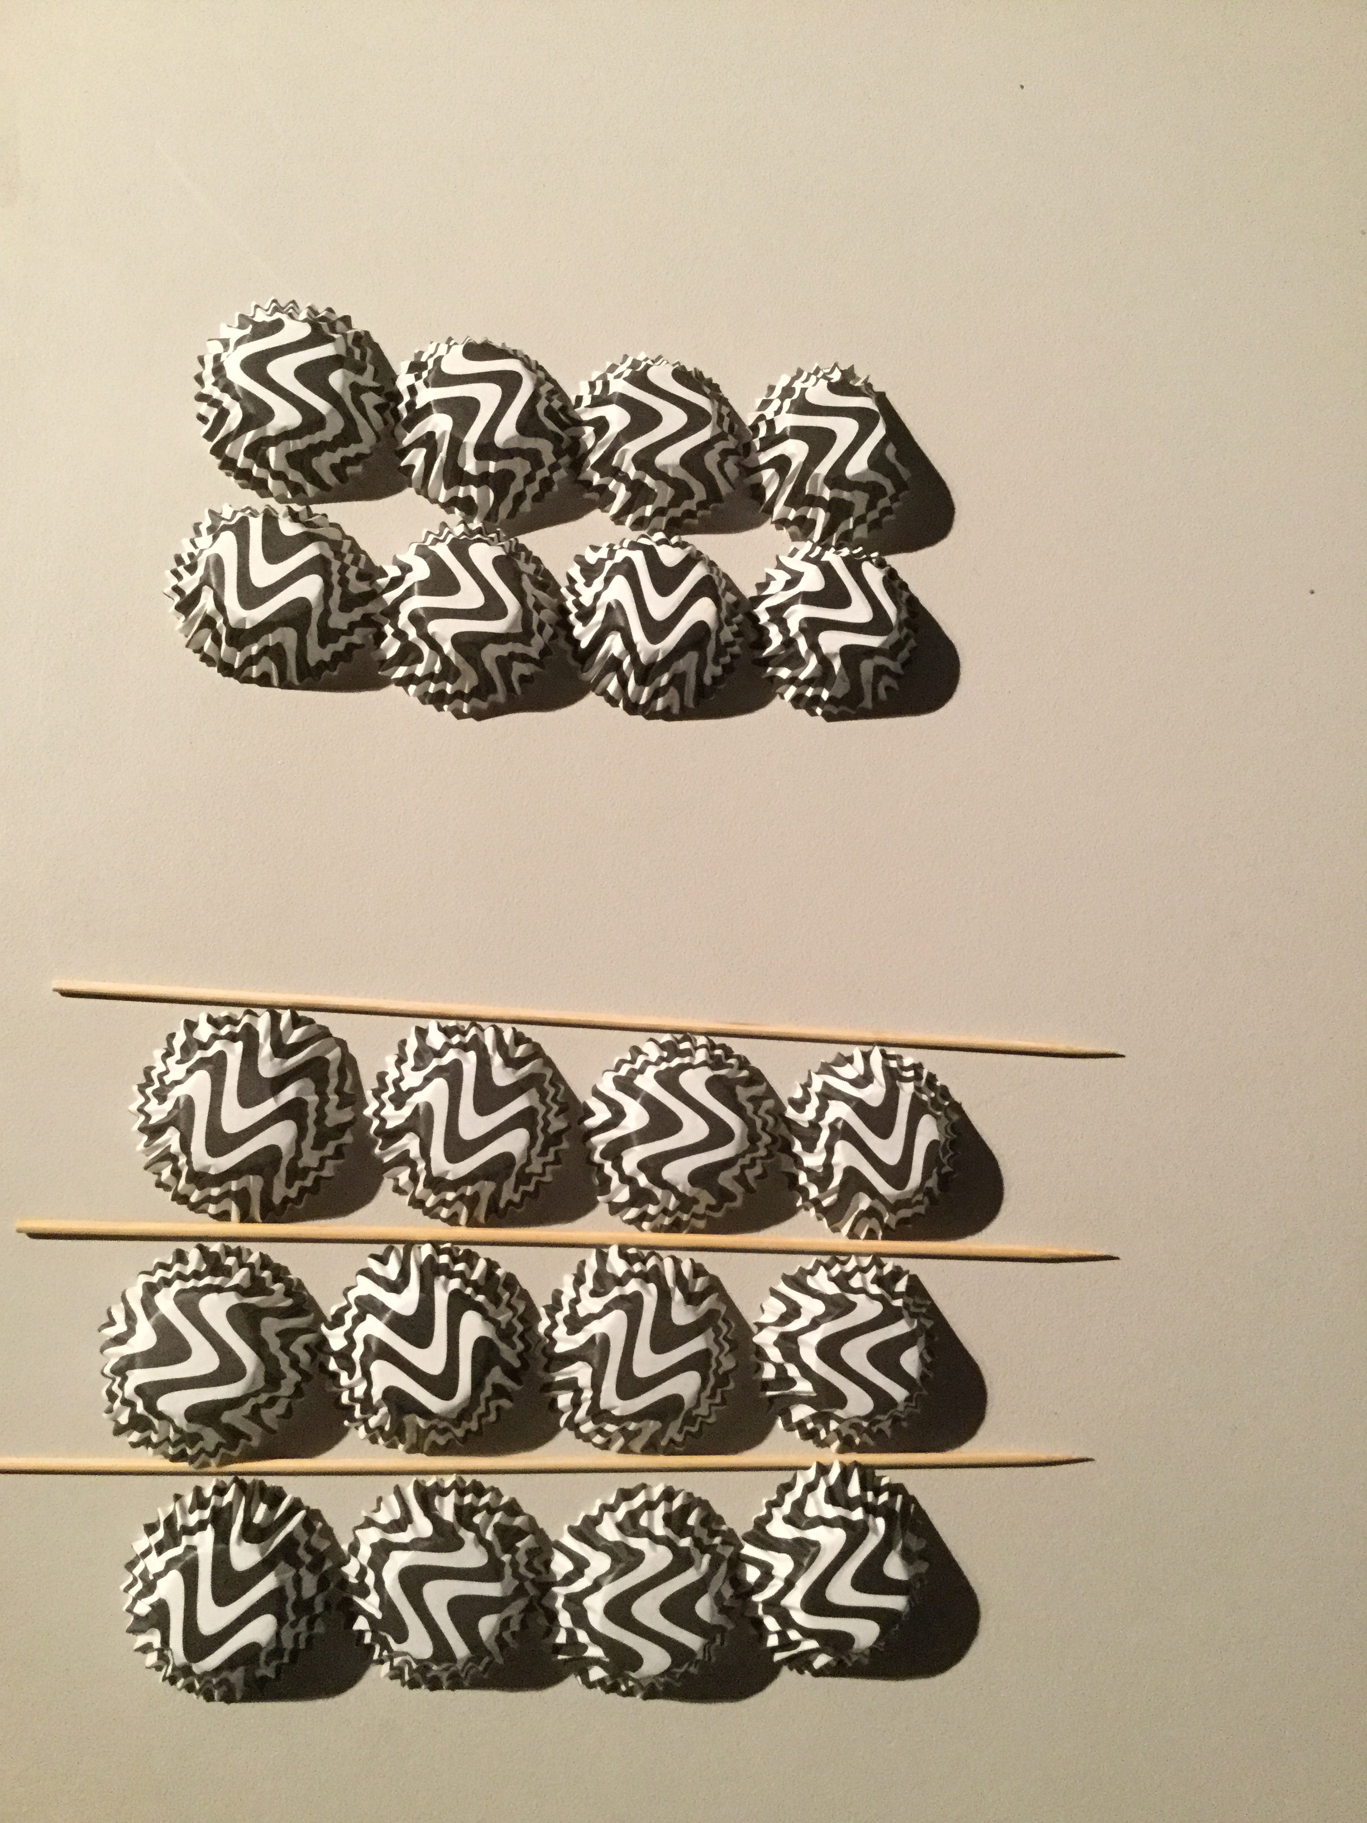
Examples

Slide 28
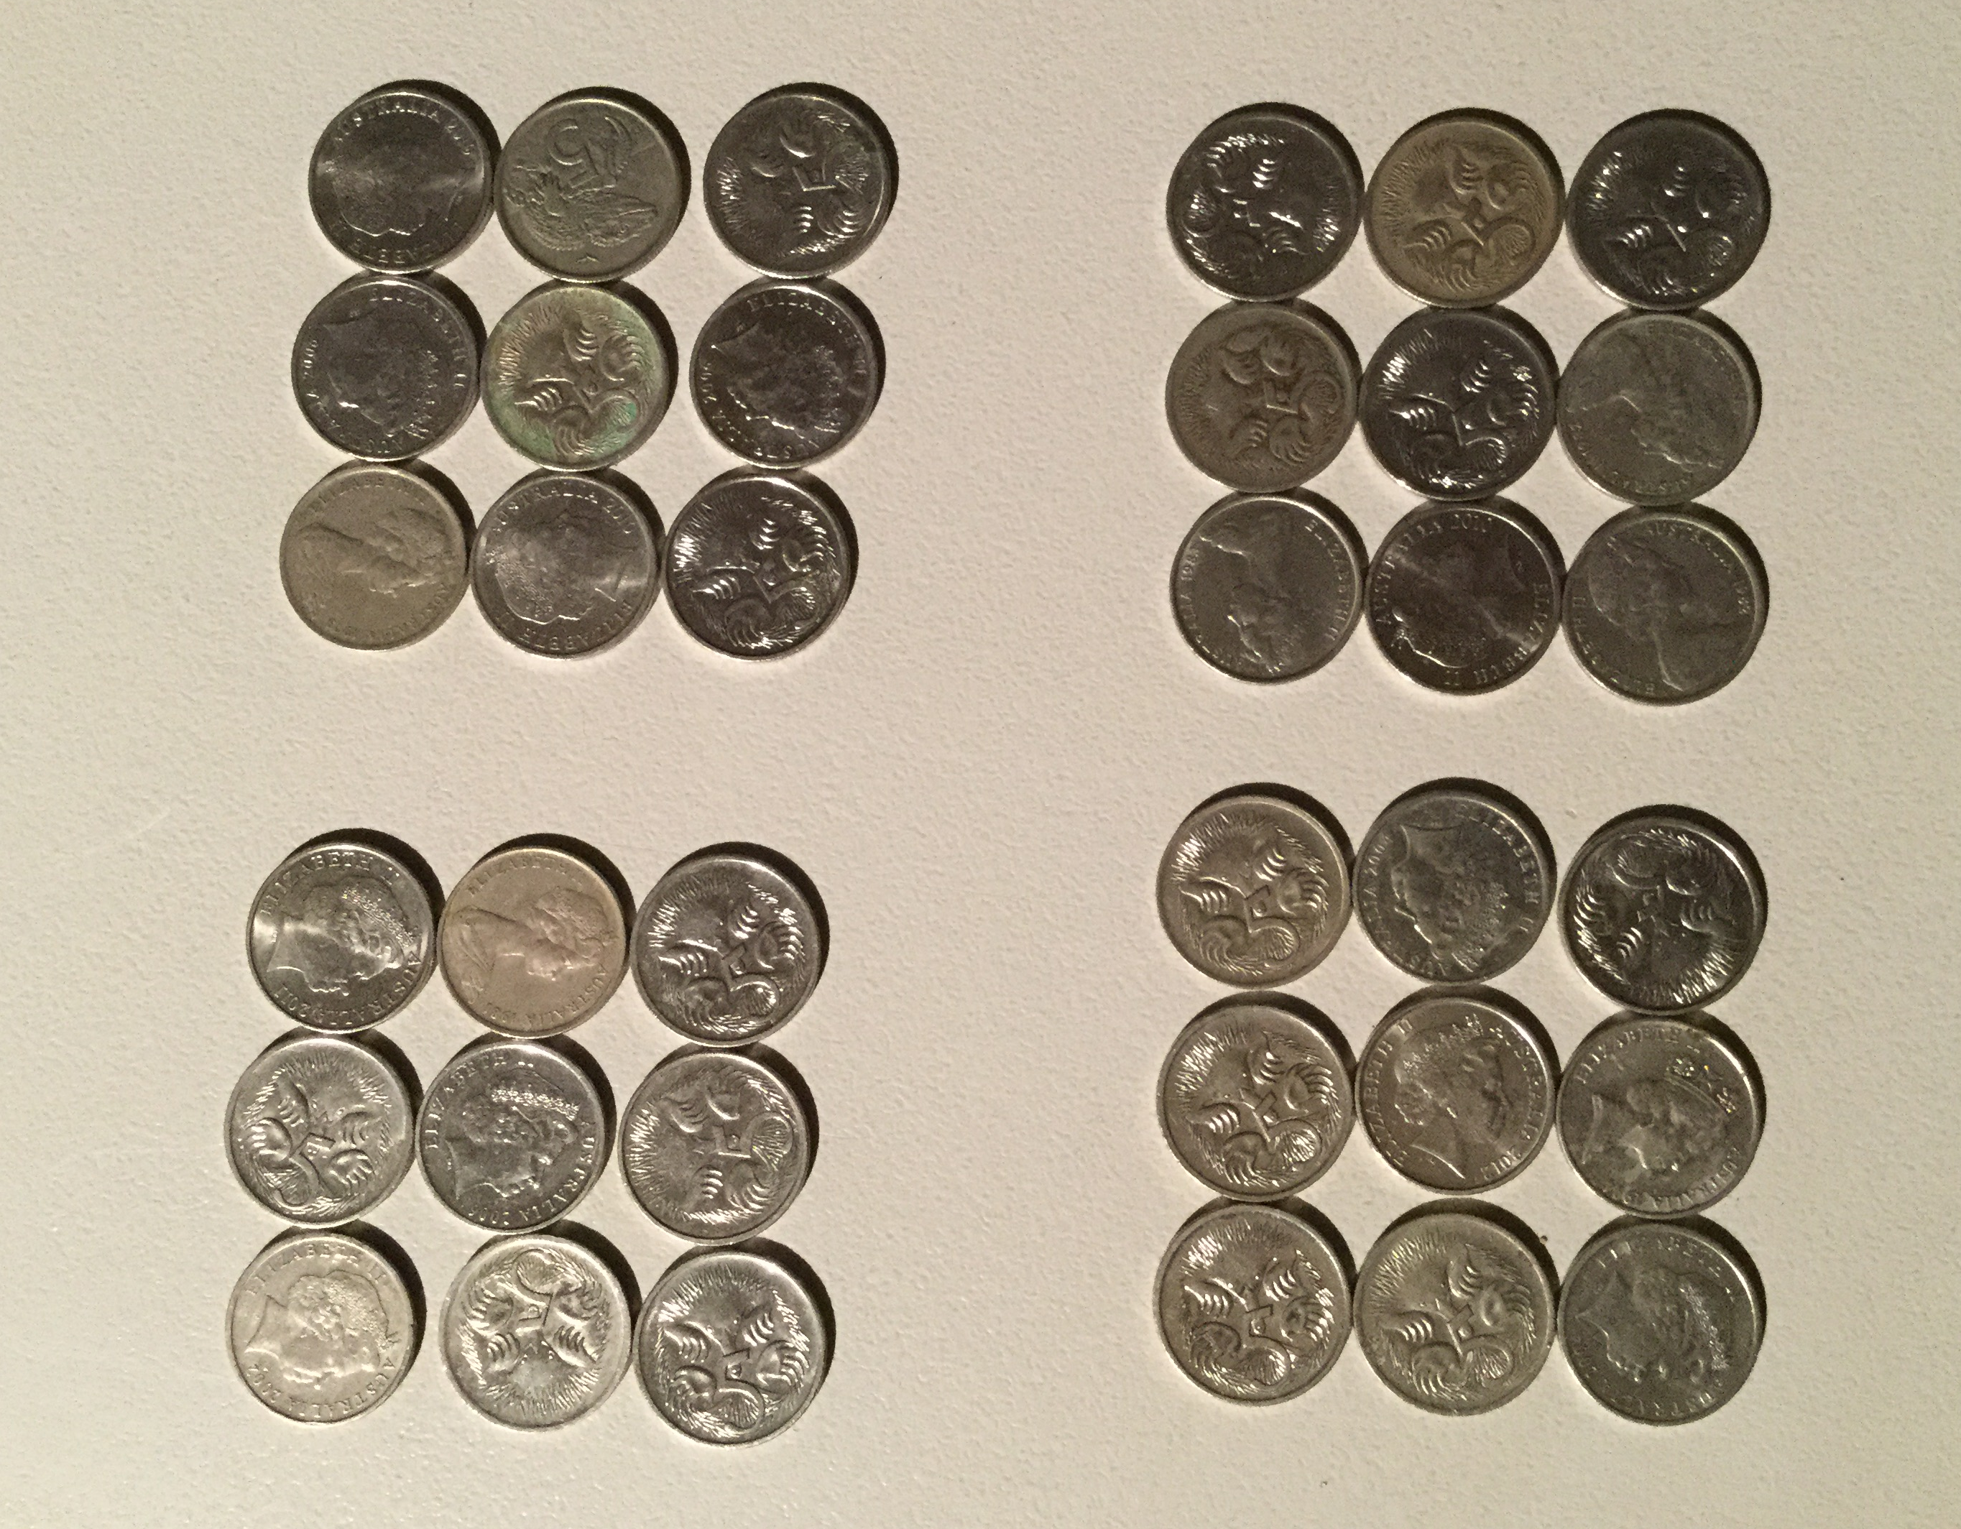
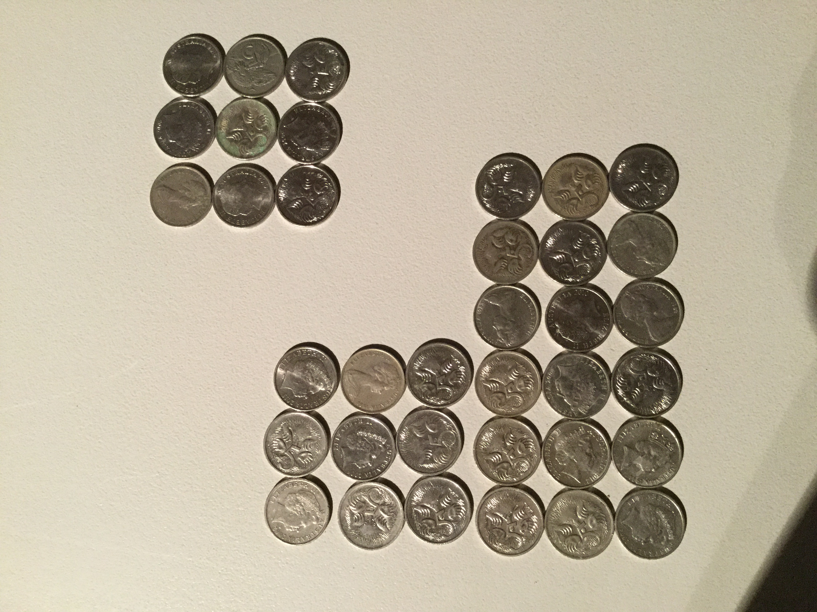
Examples

Slide 29
Teacher activity
In your groups, use your counters by arranging them into collections to model division and represent fractions.

Slide 30
Inquiry based learning with fractions
Using open ended ‘Inquiry based learning’ activities
can assist students in developing a deeper under-standing of the concepts associated with fractions. Through discovery they can formulate their own
beliefs and in doing so strengthen their conceptual grasp of curriculum content.

Slide 31
Teacher activity
In groups of four, open your task prompt.
  What interesting things do you notice?
  What concepts could you investigate
  using this prompt?
  What questions can you form for
  investigation?’

Slide 32
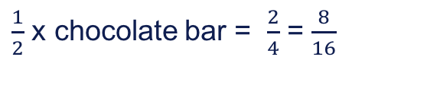
Equivalence
Use linear models,
grids and arrays to assist students in understanding that fractions can be equivalent to each other.
Their value is the same,
their representation
is different.
$\frac{1}{2}$ x chocolate bar = $\frac{2}{4}$ = $\frac{8}{16}$

Slide 33
Adding and subtracting
In order to perform addition and subtraction with fractions students need to have developed fraction sense.
They need to understand what makes the whole and if they have more than one whole what does it mean?

Slide 34
Same denominator
In years 4 and 5 they begin to model addition
and subtraction with same denominator fractions.
Getting students to skip count using fractions is
a good way to develop their skills.
Using contextual problems allows them to deepen their understanding of the purpose and relevance of adding and subtracting fractional amounts.

Slide 35
Related denominators
In year 6 students will need to progress to adding and subtracting fractions with related denominators.
This forms the conceptual basis for needing to convert fractions into equivalent fractions when performing addition and subtraction operations.

Slide 36
Grids and jumps
One method to consolidate this understanding with students is to combine a visual representation of a grid with the number line to represent addition and subtraction of related denominators.

Slide 37
Example

Slide 38
Unrelated denominators
In year 7 students will perform addition
and subtraction with fractions that have
non-related denominators.
Using overlays to find the equivalent fractions can assist students to visualize what it means to add fractions with unrelated denominators.

Slide 39
Example
because

Slide 40
Self reflection questions
Were the learning outcomes of this session achieved?
How do you know?
Do you need any more information?
What will you take from this session to
try and implement in your classroom?

Slide 41
Acknowledgements for Top Drawer Fractions
The Fractions drawer was designed and written by Dr Jennifer Way and reflects a long history of research and development in effective use
of technologies in mathematics education.

