Slide 1
Opening the Top Drawer to Fractions
Module 4 of 6: Assessment

Slide 2
AITSL Professional Standards for Teachers
Professional knowledge
Standard 1: Know students and how they learn
Standard 2: Know the content and how to teach it
Professional Practice
Standard 3: Plan for and implement effective teaching and learning
Standard 5: Assess, provide feedback and report on student learning
Professional Engagement
Standard 6: Engage in professional learning

Slide 3
Module objectives
To identify the purpose of assessment
To provide teachers with some assessment strategies that demonstrate students’ deeper understanding of fractions
To identify fractional content assessed in National and International numeracy testing.

Slide 4
Teacher activity
What is the purpose of assessment?
Working in groups, use the think board template provided.
Place the word assessment in the centre of the think board.
Working as a group complete the remainder of the page.

Slide 5
Assessment
Diagnostic assessment to determine what students know and can do
Formative assessment strategies to identify misconceptions and assist students/teachers in identifying where they are at
Summative assessment looking at consolidation and retention of skills and concepts, what did they learn

Slide 6
What should assessment do?
Identify student thinking and the strategies they have employed
Detect misconceptions and inappropriate strategies
Provide feedback to students on the progress of their learning and their understanding of the content being taught.

Slide 7
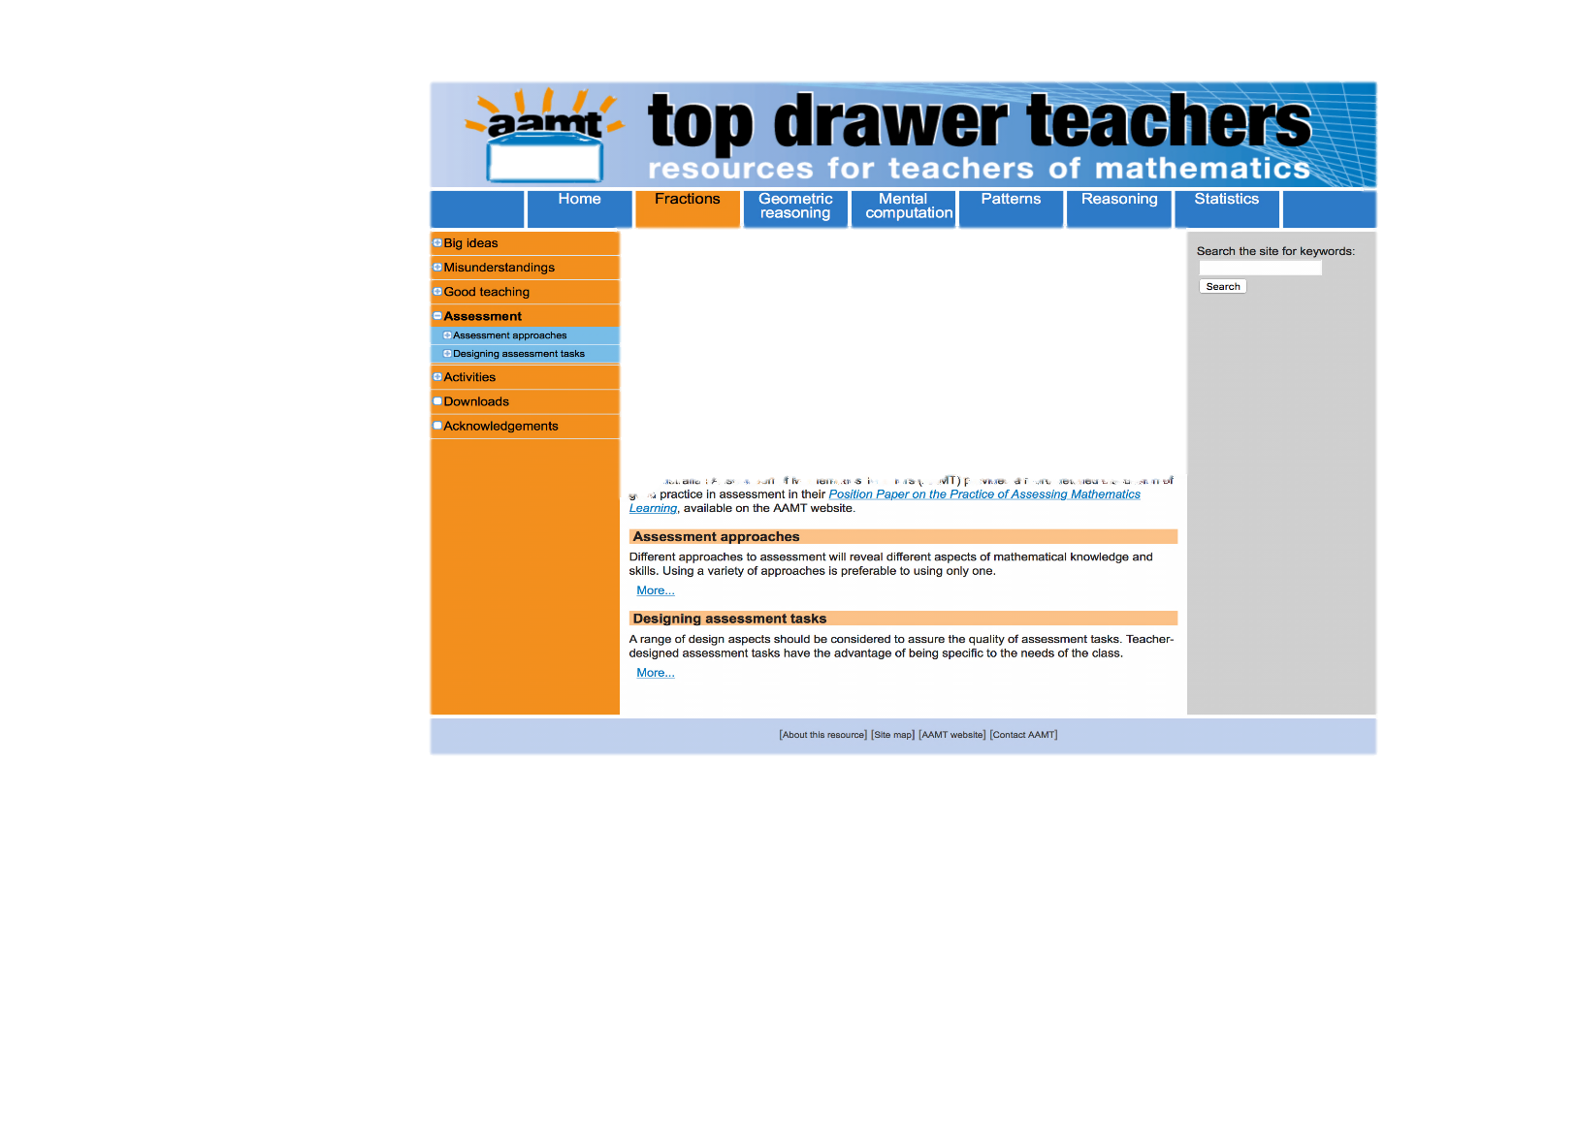
Assessment in the top drawer

Slide 8
Assessment approaches
“Useful information can be obtained through the assessment of a wide range of aspects of fractions learning, including:
mastery of particular skills or procedures
preferences for particular representations of concepts and processes
understanding of concepts
presence of misconceptions
use of mathematical language
application of knowledge and skills to solve problems
appropriateness of strategies
attitudes, confidence and engagement levels.”
Source: Top Drawer Teachers, AAMT

Slide 9
Qualitative assessment approaches
Observation
Student surveys
Task-based Interviews
Digital assessment tools

Slide 10
Planning for fractions assessment
Who am I assessing?
What am I assessing?
Why am I assessing?
How am I going to assess?
What am I going to use this assessment for?

Slide 11
What am I assessing for?
DIAGNOSTIC
What they already know and what misconceptions they might have?
FORMATIVE
What are they learning from this activity and what do I need to do if they are not learning what was intended?
SUMMATIVE
What have they learnt from doing this and have they developed any misconceptions? What can I learn from this?

Slide 12
Diagnostic assessment
Diagnostic assessment allows teachers to determine what the students’ weaknesses and strengths are, and is their level of prior knowledge and their assumed skill base sufficient for a particular content, prior to beginning instruction.
If the teacher can establish where students are at they can build in remediation if required or adjust the level of instruction to meet the class needs.
In some situations this could also mean extending students if required.

Slide 13
Teacher activity
Brainstorm some ideas on how you might diagnostically assess students knowledge of fractions prior to starting your lesson block.
Note: Diagnostic tests are aimed at assessing understanding not fluency.

Slide 14
Diagnostic assessment strategies
There are many different types of diagnostic assessment tools for example;
Pre-tests or quizzes
Self-assessments
Discussion board responses
Student Interviews
Designing visual infographics

Slide 15
Diagnostic assessment for planning
Assessment for planning
How do I need to differentiate the learning?
What prior knowledge do they have?
What skills will they need?
What skills and concepts can they recall?

Slide 16
Formative assessment
Formative assessment should be an integral part of the teaching and learning process.
It involves questioning, structured classroom observations and activities that actively provide crucial feedback to students about their ongoing progress.
It allows students to be actively involved in their learning through self and peer assessment.
It should also inform planning for instruction and shape future lesson structure.

Slide 17
Formative assessment strategies
There are many different types of formative assessment such as;
Classroom observations performed by the teacher during activities
Homework tasks
Reflective journals
Hinge point questions directed at the whole class
Class activities where a group presents their results to a question or task
Student feedback through pop quiz questions
Student self-evaluation of performance and progress

Slide 18
Formative assessment for learning
All educational achievement is acknowledged
Constructive rather than destructive
Promotes understanding
Allows students to own their own learning experience
Assessment for learning
Improves motivation
Focuses on the learning not the achievement
Creates a safe learning environment

Slide 19
Summative assessment
Summative assessment should take place at the end of the unit of learning. Normally this occurs when there is no further formal teaching and learning of the content planned.
It verifies the level of achievement for students and it enables reporting on this achievement.
Typically there is a predetermined standard of achievement by which a student’s learning can be judged or graded.

Slide 20
Summative assessment tasks
There are many types of summative assessment tools such as;
Examinations (NAPLAN, ATAR, School yearly exam)
Topic tests
Projects or investigations
Student portfolios
Student topic evaluations
Peer assessments

Slide 21
Summative assessment of learning
Assessment of learning
What feedback can I provide others based on this assessment
What didn’t they learn and how can I learn from this
What did they learn and what can I learn from this

Slide 22
Designing fraction assessment tasks
Ensure that different representations of fractions are used
Ensure that fractions are used in different ways
Use both open and closed tasks
Use both contextualized and non-contextualized problems
Probe for misconceptions
Allow students to demonstrate the strategies they have used.

Slide 23
Designing examples
Refer to the TDT Assessment Types PDF hand outs below
Choosing a Fraction Model
Closed or Open Tasks
Choosing the response type
With or without context

Slide 24
Teacher activity
In your group choose one of the fraction curriculum content descriptors applicable to your year level and design an assessment question using the hand outs as a guide.

Slide 25
National assessment program
ACARA assessment policies

Slide 26
Assessment of fraction sense in NAPLAN
Introduced in 2008 designed to test the standards of literacy and numeracy of students in years 3,5,7 & 9.
Teachers can review NAPLAN data to assess students’ performance in particular strands and make comparisons between student performance against their class, the school, the State and the National averages.
Part-whole relations, percentages and equivalence concepts are assessed across the year levels.
Misconceptions surrounding fractions can be identified by reviewing specific questions.

Slide 27
Example – Year 7 NAPLAN style
What fraction of this whole rectangle is shaded?

Slide 28
Example – Year 7 NAPLAN style
A school has 150 students. 80 of the students are girls. The fraction of students who are girls is closest to:
One-fifteenth One-eighth
One-quarter One-half

Slide 29
Example – Year 9 NAPLAN style
Sarah is painting a wall using three colours. If she paints of the wall grey, of the wall green and the rest blue, what fraction of the wall does she paint blue?

Slide 30
For further information on assessment
Mathematics Assessment in Primary Schools: Make it count
By R Callingham
The Practice of assessing mathematics learning (2008) AAMT position paper

Slide 31
Self reflection activity
Were the learning outcomes of this session achieved?
How do you know?
Do you need any more information about assessment of fractions?
What assessment strategies will you take from this session to try and implement in your classroom?

Slide 32
Acknowledgements for Top Drawer Fractions
The Fractions drawer was designed and written by Dr Jennifer Way and reflects a long history of research and development in effective use of technologies in mathematics education.
The content of the drawer is supported by the extensive research into the learning of fractions carried out by several groups of researchers across Australia, some of which was published in a book edited by Dr Jennifer Way and A/Prof. Janette Bobis from The University of Sydney, titled Fractions: Teaching for Understanding (2011, AAMT).

