Slide 1
Opening the Top Drawer to Fractions
Module 5 of 6: Year 7 strategies, classroom activities and resources

Slide 2
AITSL Professional Standards for Teachers
Professional knowledge
Standard 1: Know students and how they learn
Standard 2: Know the content and how to teach it
Professional Practice
Standard 3: Plan for and implement effective teaching and learning
Standard 5: Assess, provide feedback and report on student learning
Professional Engagement
Standard 6: Engage in professional learning

Slide 3
Module objectives
To provide Year 7 – 10 teachers with strategies to teach fractions
To provide teachers with classroom activities they can use to teach fractions
To provide resources and LINKS to assist in the delivery of fractions in the Year 7–10 Australian Curriculum: Mathematics.

Slide 4

Example: TIMSS style of question
Tom ate $\frac{1}{2}$ of a cake, and Jane ate $\frac{1}{4}$ of the cake, how much of the cake did they eat all together?

Slide 5

Pictorially
Tom ate $\frac{1}{2}$ of a cake, and Jane ate $\frac{1}{4}$ of the cake, how much of the cake did they eat all together?

Slide 6

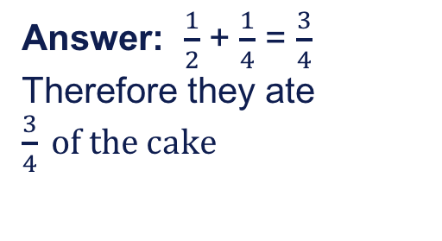
Pictorially
Tom ate $\frac{1}{2}$ of a cake, and Jane ate $\frac{1}{4}$ of the cake, how much of the cake did they eat all together?
Answer: $\frac{1}{2}$ + $\frac{1}{4}$ = $\frac{3}{4}$
Therefore they ate $\frac{3}{4} of the cake$

Slide 7
Using a variety of models
Traditionally circles are used pictorially to represent fractions and examples of real world applications are pizzas, cakes etc.
This representation can cause difficulties when using models to represent operations with fractions.

Slide 8
Using a variety of models
Using squares and rectangles to represent fractions can allow grids to be used and overlays to demonstrate equivalent fractions.

Slide 9
Singapore modelling method
It involves using simple but powerful models to assist in mathematics problem solving
In Singapore teachers use the Concrete–Pictorial–Abstract (CPA) sequence for teaching mathematics
Real world tangible examples
Pictorial diagrams
Abstract algorithms & notation
Based on Bruner’s Stages of Representation

Slide 10
Why Singapore mathematics?
Singapore students are achieving the best mathematics results in the world, on international assessments.
Singapore mathematics is focused on mastery not performance in assessments.
Singaporean students that are visual or audible learners are benefitting from the approach.

Slide 11
Research findings
Research has shown immediate improvement in all students using this approach to learning.
Research tells us that the more multimodal approaches we use to deliver conceptual content the more it is understood and retained.

Slide 12
CPA learning trajectory
Concrete
3D models, area, linear & set models
2D models, drawn or diagrammatic forms
Mental responses and formal algorithms
Pictorial
Abstract
Adapted from PDST Fractions Teacher’s manual

Slide 13

Comparing fractions using CPA
Find three equivalent fractions to the fraction $\frac{3}{5}$

Slide 14
Comparing fractions using CPA
Find three equivalent fractions to the fraction $\frac{3}{5}$
Whole
= $\frac{3}{5}$
= $\frac{6}{10}$
= $\frac{9}{15}$
= $\frac{12}{20}$

Slide 15

Addition of fractions using CPA
Find $\frac{1}{3}$ + $\frac{2}{4}$ =

Slide 16
Addition of fractions using CPA
Find $\frac{1}{3}$ + $\frac{2}{4}$ =
Whole
Whole
Whole

Slide 17
Subtraction of fractions using
Find

Slide 18
Subtraction of fractions using
Find
Whole
Whole
Whole

Slide 19
Multiplication of fractions using a pictorial representation

Slide 20

Multiplication of fractions using a pictorial representation
= (I have 8 fifths)
= $\frac{8}{5}$
= 1$\frac{3}{5}$

Slide 21
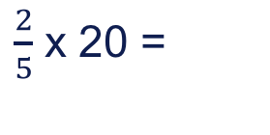
Singaporean bar method for multiplication
$\frac{2}{5}$ x 20 =

Slide 22



Singaporean bar method for multiplication
$\frac{2}{5}$ x 20 =
20
4 | 4 | 4
$$\frac{1}{5}$$
$$\frac{1}{5}$$
$$\frac{1}{5}$$
$$\frac{1}{5}$$
$$\frac{1}{5}$$
NB: Works best when the original number is divisible by the denominator

Slide 23

Multiplication using an array pictorial representation
$\frac{1}{3}$ x $\frac{3}{4}$ =

Slide 24
Multiplication using an array pictorial representation
$\frac{1}{3}$ x $\frac{3}{4}$ =

Slide 25
Division of fractions using CPA

Slide 26
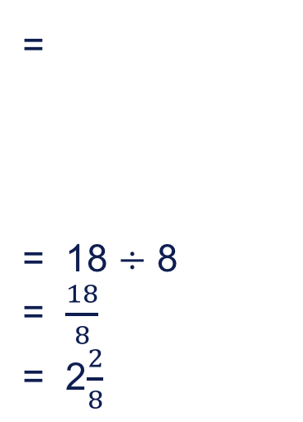
Division of fractions using CPA
=
= 18 $÷$ 8
= $\frac{18}{8}$
= 2$\frac{2}{8}$

Slide 27

Expressing one quantity as a fraction of another using CPA method
12 is $\frac{3}{4} of what number?$

Slide 28
Expressing one quantity as a fraction of another using CPA method
12 is $\frac{3}{4} of what number?$
x
12
x
4 | 4 | 4 | 4
X = 16 also

Slide 29
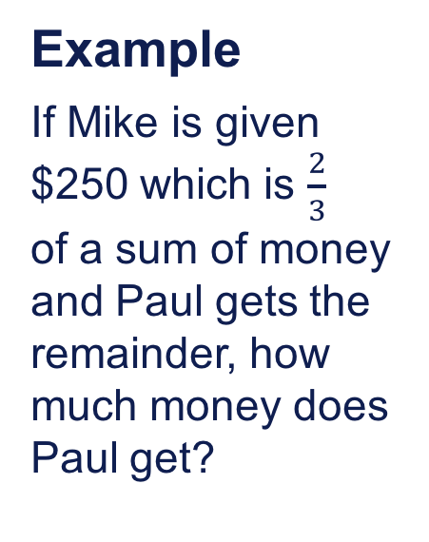

Problem solving using the Singapore bar method
Example
If Mike is given $250 which is $\frac{2}{3}$ of a sum of money and Paul gets the remainder, how much money does Paul get?
Total Sum of Money
$250
?
Answer $250 $÷$ 2 = $125
Paul gets $125

Slide 30
Example
of a group of adults were male. If there were 24 men, how many adults were there all together?

Slide 31
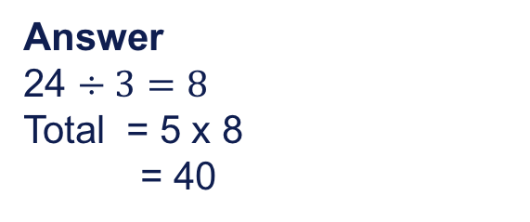
Example
3/5 of a group of adults were male. If there were 24 men, how many adults were there all together?
Total Number of Adults
Answer
24 $÷3=8$
Total = 5 x 8
= 40
24
?

Slide 32
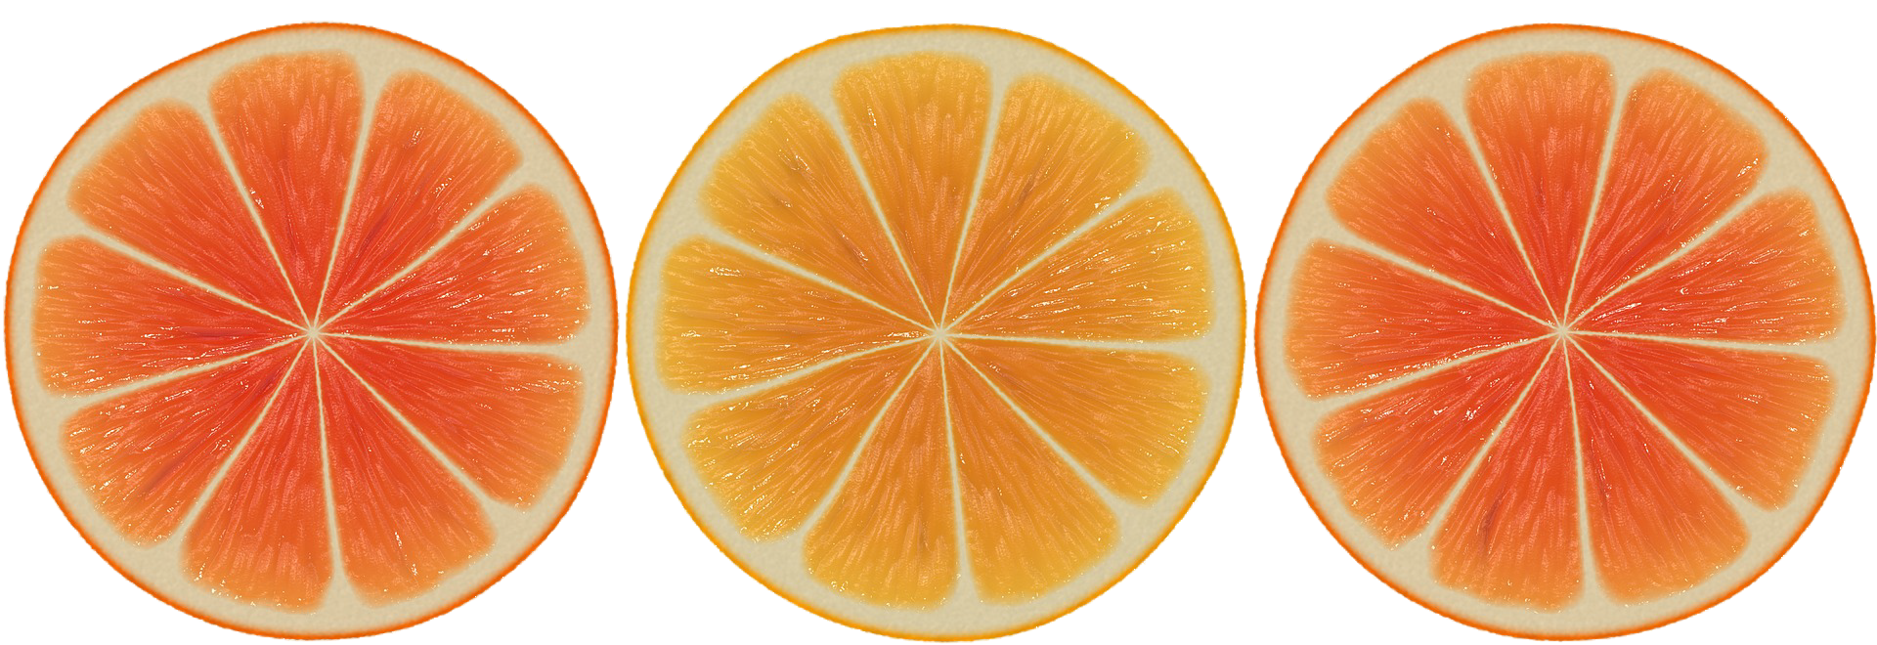
Year 7 fractions activities

Slide 33
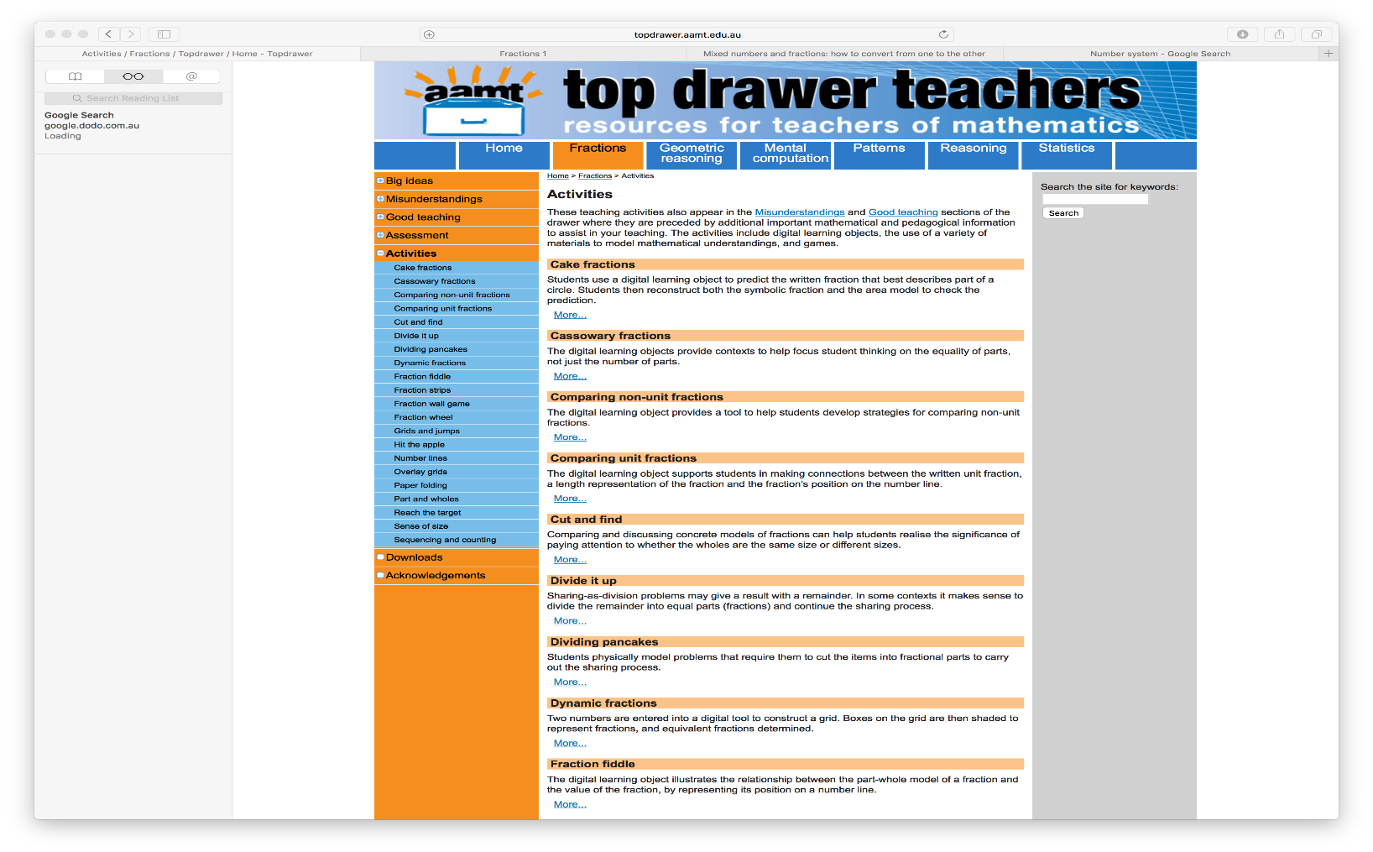
Activities in Top Drawer Teachers

Slide 34
Activities on fractions for year 7 students
Comparing non-unit fractions
Dynamic fractions
Fraction wall game
Grids and jumps
Overlay grids
Reach the target
Sense of size
All found in Top Drawer Fractions under Activities

Slide 35
Online resources and curriculum links
Maths is fun
IXL Fractions
Back to Front Maths – Tierney Kennedy
A4/POP Games Fact & Sheets - Paul Swan
Thinking Blocks Modelling Tool
AMSI: Supporting Australian Mathematics Project
Online Math Learning

Slide 36
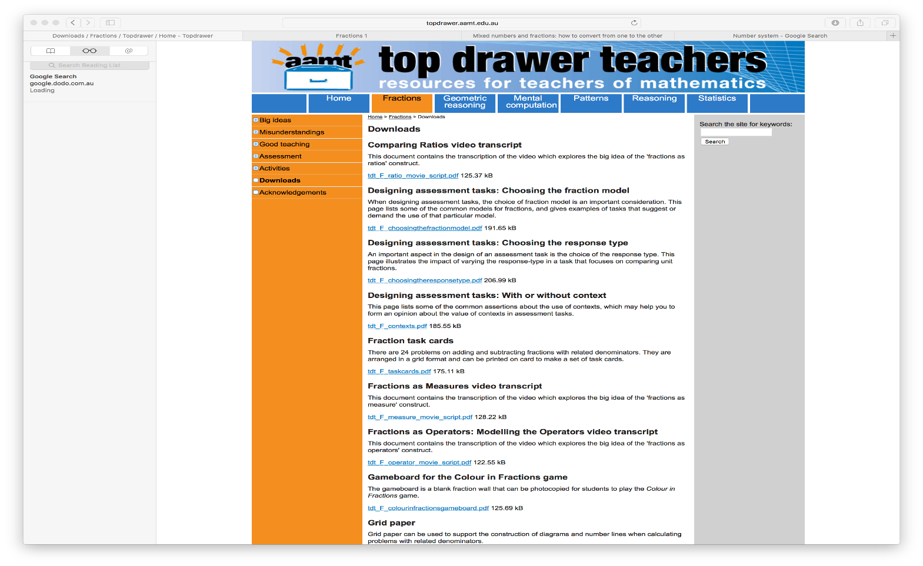
Downloads from the Top Drawer

Slide 37
Self reflection activity
Were the learning outcomes of this session achieved?
How do you know?
Do you need any more information about assessment of fractions?
What assessment strategies will you take from this session to try and implement in your classroom?

Slide 38
Acknowledgements for Top Drawer Fractions
The Fractions drawer was designed and written by Dr Jennifer Way and reflects a long history of research and development in effective use of technologies in mathematics education.
The content of the drawer is supported by the extensive research into the learning of fractions carried out by several groups of researchers across Australia, some of which was published in a book edited by Dr Jennifer Way and A/Prof. Janette Bobis from The University of Sydney, titled Fractions: Teaching for Understanding (2011, AAMT).

