Slide 1
Opening the Top Drawer to Fractions
Module 6 of 6: Primary strategies, classroom activities and resources

Slide 2
AITSL Professional Standards for Teachers
Professional knowledge
Standard 1: Know students and how they learn
Standard 2: Know the content and how to teach it
Professional Practice
Standard 3: Plan for and implement effective teaching
and learning
Standard 5: Assess, provide feedback and report
on student learning
Professional Engagement
Standard 6: Engage in professional learning

Slide 3
Module objectives
To provide teachers with some strategies to teach fractions
To provide teachers with some classroom activities they can use to teach fractions using the proficiencies of the Australian Curriculum: Mathematics
To provide resources and LINKS to assist in the delivery of fractions in the F – 6 Australian Curriculum: Mathematics

Slide 4
Example: TIMSS 2015 mathematics questions
Tom ate of a cake, and Jane ate of the cake, how much of the cake did they eat all together?
What strategies could you use to solve this question?

Slide 5

Pictorially
Tom ate $\frac{1}{2}$ of a cake, and Jane ate $\frac{1}{4}$ of the cake, how much of the cake did they eat all together?
Jane
Students to
draw a picture
Tom

Slide 6
Pictorially
Tom ate of a cake, and Jane ate of the cake, how much of the cake did they eat all together?
Answer:
Therefore they ate of the cake.

Slide 7
Using a variety of models
Traditionally circles are used pictorially to
represent fractions and examples of real
world applications are pizzas, cakes etc.
This representation can cause difficulties
when using models to represent operations
with fractions.

Slide 8
Using a variety of models
Using squares and rectangles to represent
fractions can allow grids to be used and
overlays to demonstrate equivalent fractions.

Slide 9
Singapore modelling method
It involves using simple but powerful models to assist in mathematics problem solving
In Singapore teachers use the Concrete–Pictorial–Abstract (CPA) sequence for teaching mathematics
Real world tangible examples
Pictorial diagrams
Abstract algorithms
& notation
Based on Bruner’s Stages of Representation

Slide 10
Why Singapore mathematics?
Singapore students are achieving the best mathematics results in the world on international assessments.
Singapore mathematics is focused on mastery not performance in assessments.
Singaporean students that are visual or audible learners are benefitting from the approach.

Slide 11
Research findings
Research has shown immediate improvement
in all students using this approach to learning.
Research tells us that the more multimodal approaches we use to deliver conceptual
content the more it is understood and retained.

Slide 12
CPA learning trajectory
Concrete
3D models, area, linear & set models
2D models, drawn or diagrammatic forms
Mental responses and formal algorithms
Pictorial
Abstract
Adapted from PDST Fractions Teacher’s manual

Slide 13

The bar method
Uses a bar (rectangle) to represent the whole
The bar is then divided up into equal parts equivalent to the denominator in the fraction
being represented
Whole
$$\frac{1}{4}$$

Slide 14
Comparing fractions using CPA
Find three equivalent fractions to the fraction
Whole

Slide 15
Mapping to a number line
0 1

Slide 16
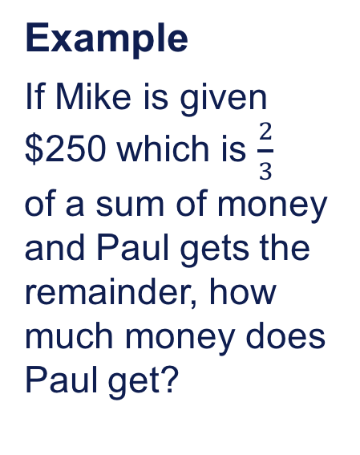
Problem solving using the Singapore bar method
Example
If Mike is given $250 which is $\frac{2}{3}$
of a sum of money and Paul gets the remainder, how much money does Paul get?

Slide 17
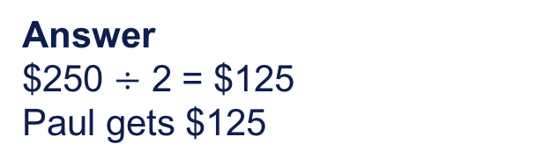
Problem solving using the Singapore bar method
Example
If Mike is given $250 which is $\frac{2}{3}$
of a sum of money and Paul gets the remainder, how much money does Paul get?
Total Sum of Money
$250
?
Answer
$250 $÷$ 2 = $125
Paul gets $125

Slide 18
Example
of a group of adults were male. If there were 24 men, how many adults were there all together?

Slide 19
Example
of a group of adults were male. If there were 24 men, how many adults were there all together?
Total Number of Adults
Answer:
24
?

Slide 20
Teacher activity
Think–Pair–Share activity: Using the CPA approach try to generate a problem that can be solved using the Singapore bar model that is suitable for your particular year level.

Slide 21
Reasoning with fractions
Example
What do you notice?

Slide 22
Reasoning with the bar model
Example
What do you notice?

Slide 23
Reasoning with the bar model

Slide 24
Reasoning with the bar model
Example
How many different ways could I divide up $24
so that each person receives an equal amount?

Slide 25
Reasoning with the bar model
$24

Slide 26

Topic 2: F–6 fractions activities

Slide 27
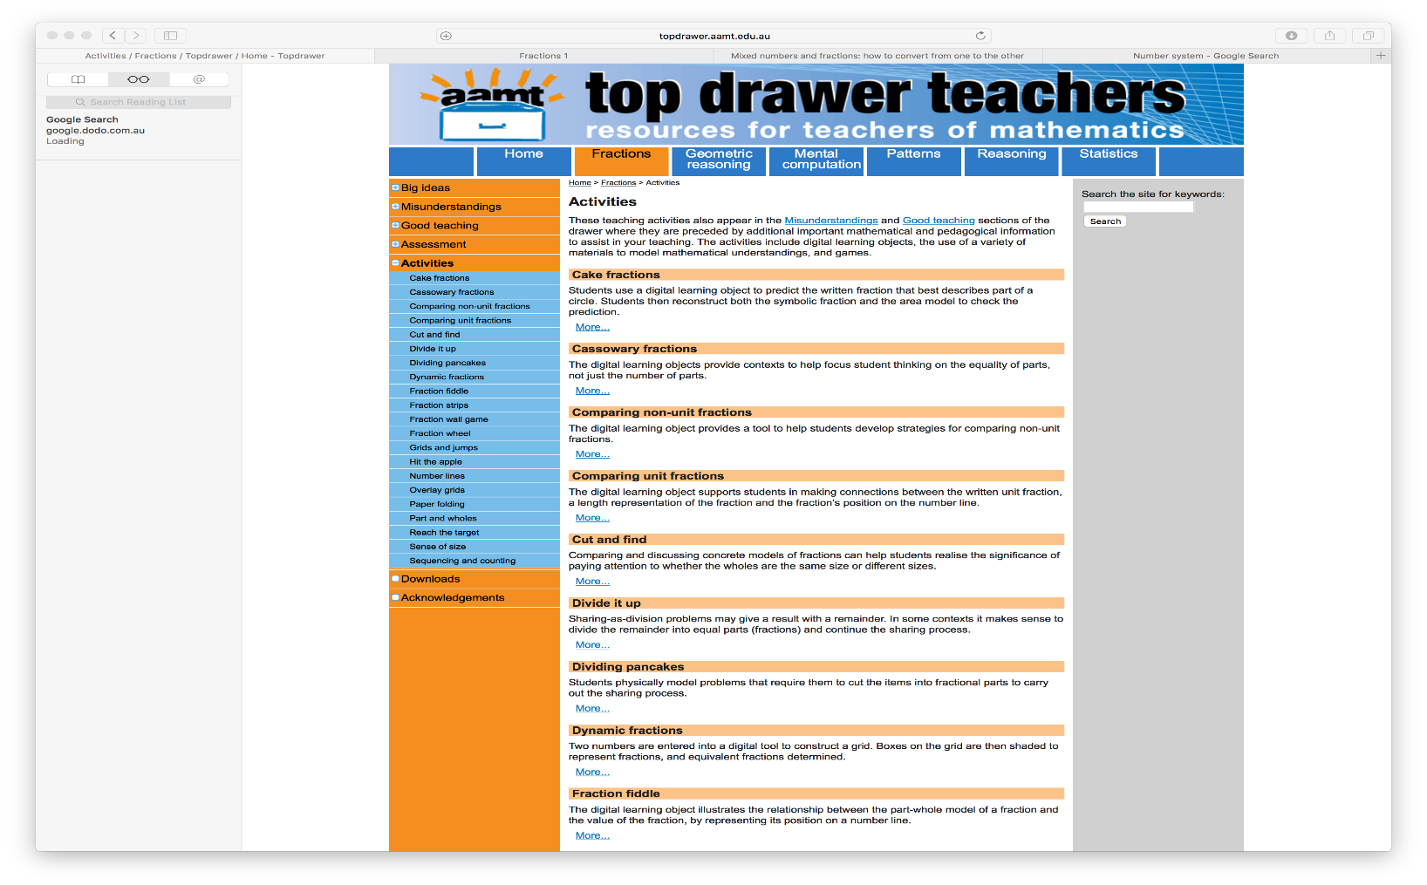
Activities in Top Drawer Teachers

Slide 28
Topic 3: Online resources and curriculum links
Maths is fun
http://www.mathsisfun.com/fractions-menu.html
IXL Fractions
https://au.ixl.com/math/fractions
Back to Front Maths – Tierney Kennedy
http://www.backtofrontmaths.com.au/wp-content/uploads/2012/04/Fractions-book-sample-only.pdf
A4/POP Games Fact & Sheets - Paul Swan
http://www.drpaulswan.com.au/#!downloadables/h8rw3

Slide 29
(cont.)
Thinking Blocks Modelling Tool
http://www.mathplayground.com/ThinkingBlocks/thinking_blocks_modeling%20_tool.html
https://youtu.be/_11SEY-P_h0
AMSI: Supporting Australian Mathematics Project
http://amsi.org.au/ESA_middle_years/Year7/Year7_md/Year7_1d.html
Online Math Learning
http://www.onlinemathlearning.com/fractions-word-problems.html

Slide 30
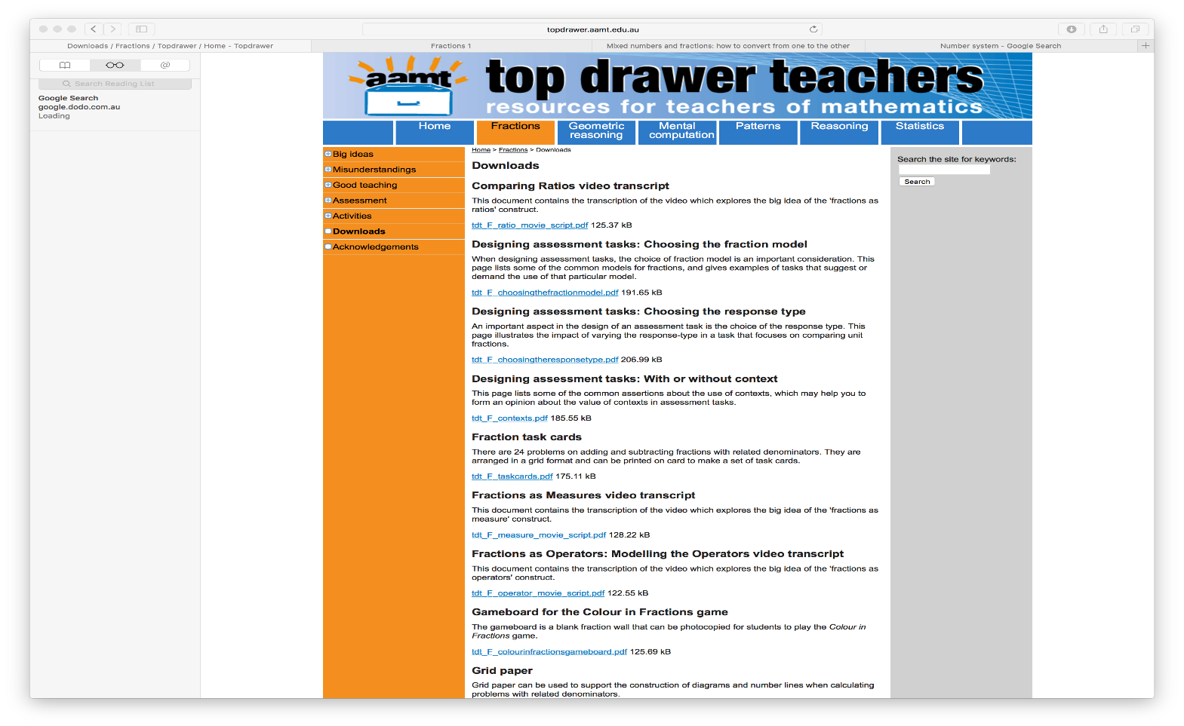
Downloads from Top Drawer Teachers

Slide 31
Self reflection activity
Were the learning outcomes of this session achieved?
How do you know?
Do you need any more information
about fraction classroom activities?
What assessment strategies will
you take from this session to try
and implement in your classroom?

Slide 32
Acknowledgements for Top Drawer Fractions
The Fractions drawer was designed and written by
Dr Jennifer Way and reflects a long history of research and development in effective use of technologies in mathematics education.
The content of the drawer is supported by the extensive research into the learning of fractions carried out by several groups of researchers across Australia, some
of which was published in a book edited by Dr Jennifer Way and A/Prof. Janette Bobis from The University of Sydney, titled Fractions: Teaching for Understanding (2011, AAMT).

