Slide 1
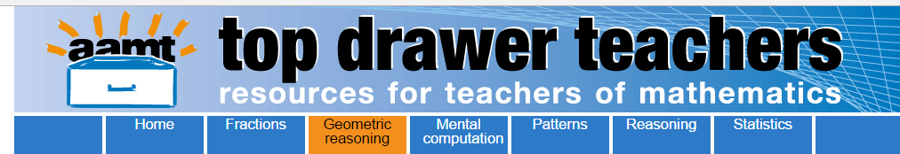
Opening the Top Drawer to Geometric Reasoning
Module 1 of 4: Plane Shapes
Designed and written by Ann Ruckert

Slide 2
There are five Big Ideas in the Geometric Reasoning Top Drawer
Plane Shapes (F – 8)
Congruence (Year 8)
Similarity (Year 9)
Geometric Proof (Years 7 & 10)
Circle Geometry (Year 10A)

Slide 3
Big Ideas: Plane Shapes
Learning outcome
Understand how to make systems used for naming and classifying plane shapes meaningful for students so that they realise they are simple and logical.

Slide 4
Australian Curriculum links
Foundation: Sort, describe and name familiar two dimensional shapes and three dimensional objects in the environment. ACMMG009
Year 1: Recognise and classify familiar two dimensional shapes and three dimensional objects using obvious features. ACMMG022
Year 5: Describe translations, reflections and rotations of two dimensional shapes. Identify line and rotational symmetries. ACMMG114
Year 7: Classify triangles according to their side and angle properties and describe quadrilaterals. ACMMG165
Year 8: Establish properties of quadrilaterals using congruent triangles and angle properties, and solve related numerical problems using reasoning. ACMMG202

Slide 5
Focus question
“How can we make systems used for naming and classifying plane shapes meaningful for students so that they realise they are simple and logical?”
Notes:
Ensure that all participants understand what the focus question is asking, especially what is meant by the term ‘systems’ as used here.
Ask participants to discuss what they do currently to help students to name and classify plane shapes.
Do they feel their students benefit from what is being done currently in the classroom?

Slide 6

Introductory plane shape activity
On a sheet of paper record everything you can about a square. Use any way of recording this with which you are comfortable.
Put your piece of paper to one side to refer to towards the end of this module.
Notes:
Give each participant a sheet of A4 paper on which to records their response(s) to the instruction to “record everything they can about a square”.
Allow participants 5 – 10 minutes to complete the introductory activity and then put it to one side.
This will be revisited towards the end of the presentation for participants to consider whether the activities in which they engaged today have altered/refined their response.
No need for discussion, move straight into the next activity once everyone has completed this one.

Slide 7

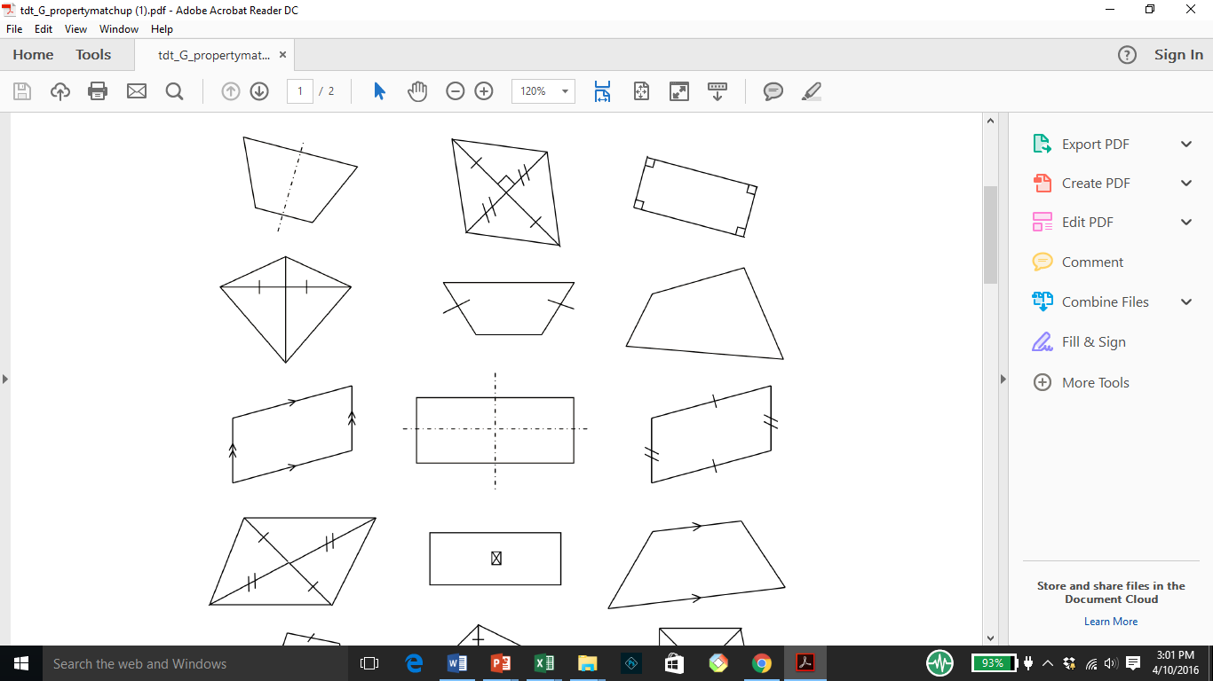
Plane shape activity: Property match-up
Collect a copy of each of Quadrilateral Properties and Property Match-up: Student Worksheet.
Match each written property to the appropriate image.
Notes:
This activity contains a collection of diagrams which students then have to match to the appropriate property.
It illustrates that the use of the English language can be inefficient compared with the diagrams and symbols used in plane geometry.

Slide 8

Discussion point
With your colleagues discuss:
How might you implement this activity in your classroom?
What student outcomes might you expect to observe?
In what ways is this a worthwhile activity to use with your students?
How might you adapt this to suit your students?
Notes:
You may prefer participants to work through this individually or in pairs (depending on their mathematical confidence). Give them sufficient time to work through the activity and then lead a discussion around:
How they might implement the activity in their classroom.
What student outcomes might they expect to observe?
Do they feel that this is a worthwhile activity to use with their students?
How might they adapt it to suit their students? etc…

Slide 9
Plane shape activity: Quadrilateral property quiz
I am a trapezium
Make a copy of me then cut me out so you can fold and measure me.
What properties do I possess?
Trapezium

Slide 10

Plane shape activity:
Quadrilateral property quiz
You might also find the Interactive Quadrilaterals page on the Maths is Fun website useful to manipulate digital versions of the same quadrilaterals.
Note that the US 'trapezoid' is equivalent to Australia's 'trapezium'.
Notes:
This activity gives students the opportunity to use concrete and dynamic representations of the shapes. Using dynamic software, students can morph them into different versions of the same shape. They can see, for example, that the diagonals of a rhombus are always perpendicular. They may also realise that it is possible to morph a trapezium, for example, into a parallelogram, then a rectangle, then a square.
At the completion of this activity, students will have a discovered a list of properties for each of the six special quadrilaterals. The final page of the quiz enables students to summarise all their findings in a table that can be retained for future use.

Slide 11
Discussion point
With your colleagues discuss:
How might you implement this activity in your classroom?
What student outcomes might you expect to observe?
In what ways is this a worthwhile activity to use with your students?
How might you adapt this to suit your students?
Notes:
This activity gives students the opportunity to use concrete and dynamic representations of the shapes.
Lead a discussion as to the effectiveness of this activity (as for the previous activity).

Slide 12
Plane shape activity:
Quadrilateral flowchart puzzle
Collect the Quadrilateral Flowchart Puzzle and work through the activity, cutting out the shapes (if they have not already been cut out for you).
Create a flowchart depicting the hierarchy of the special quadrilaterals starting with the quadrilateral with no special properties.
Photograph your flowchart as a record.
Notes:
Students cut out eight arrows, each labelled with a quadrilateral property, and seven different quadrilaterals.
The activity begins with a quadrilateral with no special properties.
If that quadrilateral is then found to have one pair of parallel sides, the quadrilateral can now be called a trapezium.
This is indicated by connecting the quadrilateral to the trapezium with one of the coloured arrows labelled 'one pair of parallel sides'.
In the finished flowchart, the quadrilateral is at the top and the square is at the bottom, because the square has the greatest number of properties.
This is designed to help students overcome the confusion that can arise when they learn that a square is also a rectangle—and a rhombus and a parallelogram and a kite and a trapezium.
It may be helpful for students to have an idea of what the finished product will look like.

Slide 13
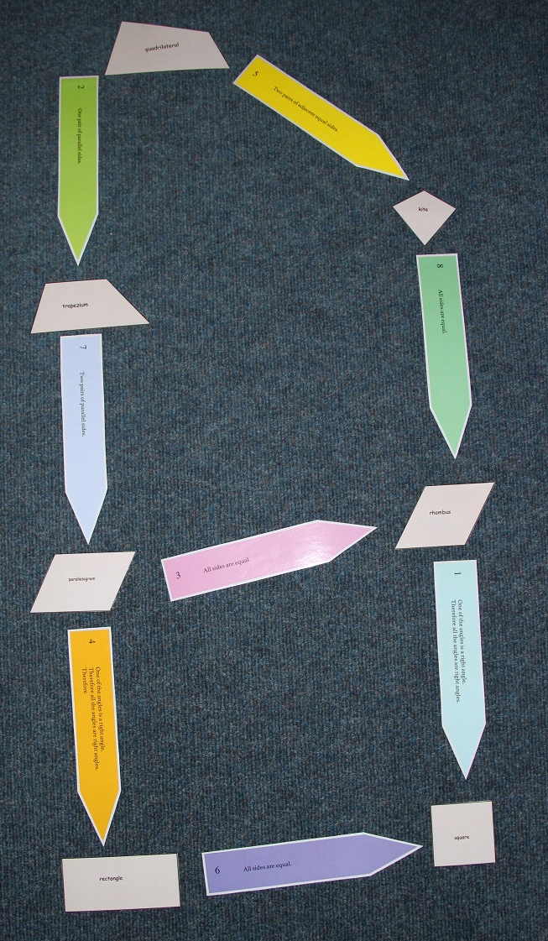
A suggested solution

Slide 14
Discussion point
With your colleagues discuss:
How might you implement this activity in your classroom?
What student outcomes might you expect to observe?
In what ways is this a worthwhile activity to use with your students?
How might you adapt this to suit your students?
Notes:
Ensure that you are familiar with this activity and have attempted it before the presentation as you may have to clarify some concepts while participants are engaged with the activity.
Take photographs of their final flowcharts and compare them; this could result in a profitable discussion.
Lead a discussion around how to implement this activity in the classroom and how it might support student learning.

Slide 15
Plane shape activity: Milli makes magical measurements
In a group of 3 to 4 people, work through Milli makes magical measurements: Student worksheet to determine the minimum conditions which determine a square.
Record your ideas and conjectures using diagrams.
If you have access to dynamic geometry software use it to help (e.g.,Geogebra).
Notes:
This challenging problem is best suited for collaborative work in small groups of 3–4 students. Students will need to be familiar with the classification and properties of quadrilaterals.
When working with the problem, students will make conjectures and then explore the validity of their ideas using diagrams.
At times, the discussions can become quite complex and simple hand-drawn diagrams may not be sufficiently convincing. Make sure that they can access dynamic geometry software if needed.

Slide 16
Plane shapes: Conclusion
When you are satisfied with your result for the previous activity, check what you have learned today against your original sheet of paper where you recorded everything you knew about a square.
How did you go?
Notes:
Having completed a number of activities related to naming and classifying plane shapes, especially the definitions of quadrilaterals, participants should now reflect on their original response where they recorded everything they knew about a square.
Have they discovered further properties that they can use to describe a square?
Did the activities undertaken today help them to do this? How?
Was it worthwhile?

Slide 17
Do the activities in which you have participated today help you to answer the focus question at the beginning of the presentation?
Focus question
“How can we make systems used for naming and classifying plane shapes meaningful for students so that they realise they are simple and logical?”
Notes:
Now that everyone has completed this module, consider the focus question posed at the beginning of the presentation.
Ask everyone to share their thoughts, ideas, wonderings with each other and record responses for dissemination amongst the group.
This might act as a stimulus to help them alter the way in which the idea of plane shapes is taught.

Slide 18
Final thoughts
Did we achieve the learning outcome?
How do we know?
Do we need any more information?
Where will we go to get it?
What will you try in your classroom?

Slide 19
Acknowledgements
The Geometric Reasoning Drawer was written by a team from the Mathematical Association of New South Wales led by Nikky Vanderhout, Professional Learning Consultant.
Nikky Vanderhout was responsible for the conceptual design of the drawer and wrote much of the material, with significant contributions from Stuart Palmer, Patrick Parker, Gavin Sinclair, Karen McDaid, Katrina Simms, Lauren James and Christine Horley.
The Mathematical Association of New South Wales also acknowledges the professional advice and support of Judy Anderson, Peter Gould and Ann Thomas.

Slide 20
Copyright information
© The Australian Association of Mathematics Teachers (AAMT) Inc. 2017
This work is licensed under a Creative Commons Attribution-NonCommercial-NoDerivatives 4.0 International License (CC BY-NC-ND 4.0) except where otherwise indicated. See https://creativecommons.org/licenses/by-nc-nd/4.0/
Australian Professional Standards for Teachers © Australian Institute for Teaching and School Leadership Limited (AITSL) 2013
Australian Curriculum © Australian Curriculum, Assessment and Reporting Authority (ACARA) 2010 to present

