Slide 1
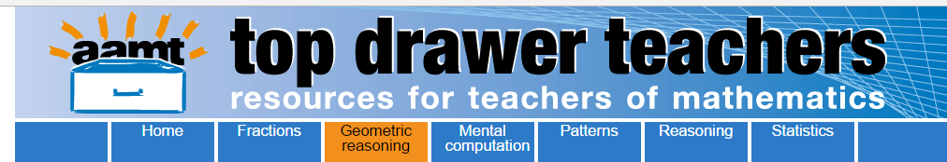
Opening the Top Drawer
to Geometric Reasoning
Module 2 of 4: Congruence & Similarity
Designed and written by Ann Ruckert

Slide 2
There are five Big Ideas in the
Geometric Reasoning Top Drawer
  Plane Shapes (F – 8)
  Congruence (Year 8)
  Similarity (Year 9)
  Geometric Proof (Years 7 & 10)
  Circle Geometry (Year 10A)

Slide 3
Learning outcomes
Participants will:
  Be able to explain why congruency and similarity are powerful ideas in geometry.
  Be able to identify figures as being congruent or similar, explain the difference between congruent and similar figures and construct congruent and similar figures.
Notes:
Please emphasise that:
Knowing that two figures are congruent is important as it becomes the means by which we can prove many geometric results.
Similarity relates enlargement, scale factor, area growth, indirect measurement, and projective geometry.

Slide 4
Australian Curriculum links
Year 8: Define congruence of plane shapes using transformations.
ACMMG200
Year 8: Develop the conditions for congruence of triangles.
ACMMG201
Year 9: Use the enlargement transformation to explain similarity
and develop the conditions for triangles to be similar.
ACMMG220
Year 9: Solve problems using ratio and scale factors in similar figures.
ACMMG221

Slide 5
Focus question
“Will exploring the minimum conditions required for triangles to be congruent or similar, help students to develop a better understanding of the nuances/subtleties of the tests for congruency and similarity?”

Slide 6

Congruency: What is it?
Discuss with your colleagues what is meant by the term, ‘congruency’.
Share how it has been defined by the members of your group.
Do you have any examples of congruency
in the ‘real world’ to share?

Slide 7

Congruency: What is it?
These two shapes have matching angles equal but their matching sides are not equal and so they are not congruent.
They are the same shape but not the same size.

Slide 8
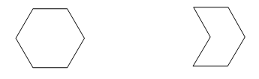
Congruency: What is it?
These two polygons have matching sides equal but their matching angles are not equal and so they are not congruent.
They are different shapes even though the sides are the same size.

Slide 9
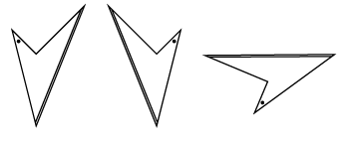
Congruency: What is it?
Plane shapes are congruent when they have the same shape and are the same size.
They can be superimposed on each other by:
Rotation
Translation
Reflection
Or a combination of
these transformations.

Slide 10

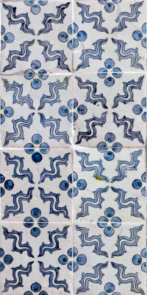
Congruency in design
Congruent shapes are used extensively in design.
  Explore real life patterns such as those in tiling
  and patchwork.

Slide 11
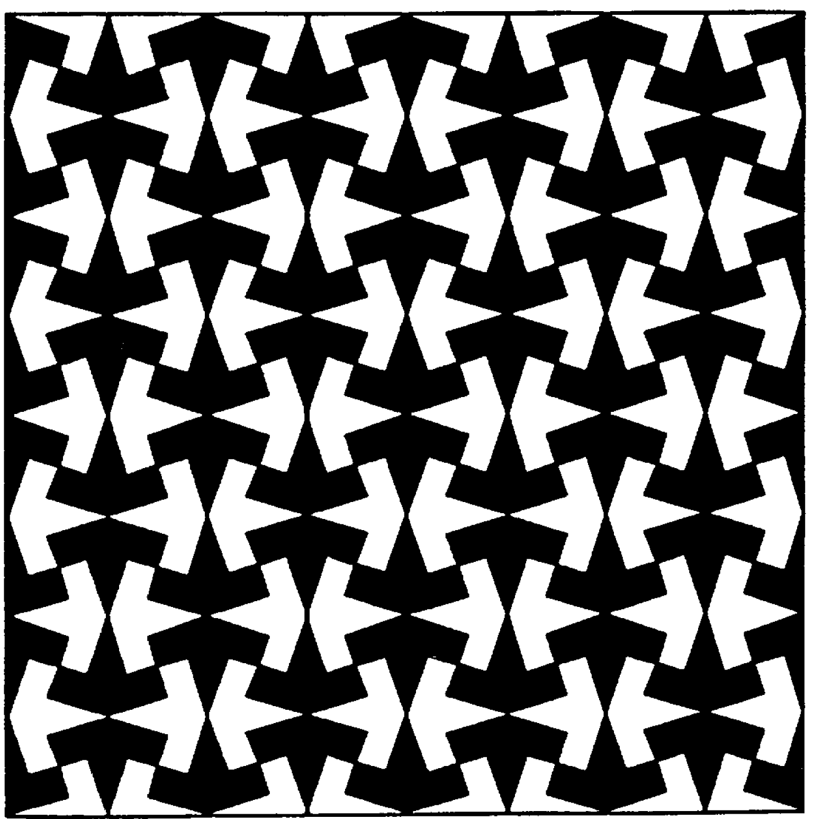
Congruency in design
This tiling pattern may be found in the Alhambra palace in Granada, Spain.
  How would you describe this pattern to someone who cannot see it?
  Describe how individual tiles may have been designed.
Courtesy Bruce White, UniSA; taken from Swan and Crust (1993) Mathematics Programmes of Study, Inset for Key Stages 3 and 4, National Curriculum Council, York

Slide 12

Congruency in design

Slide 13
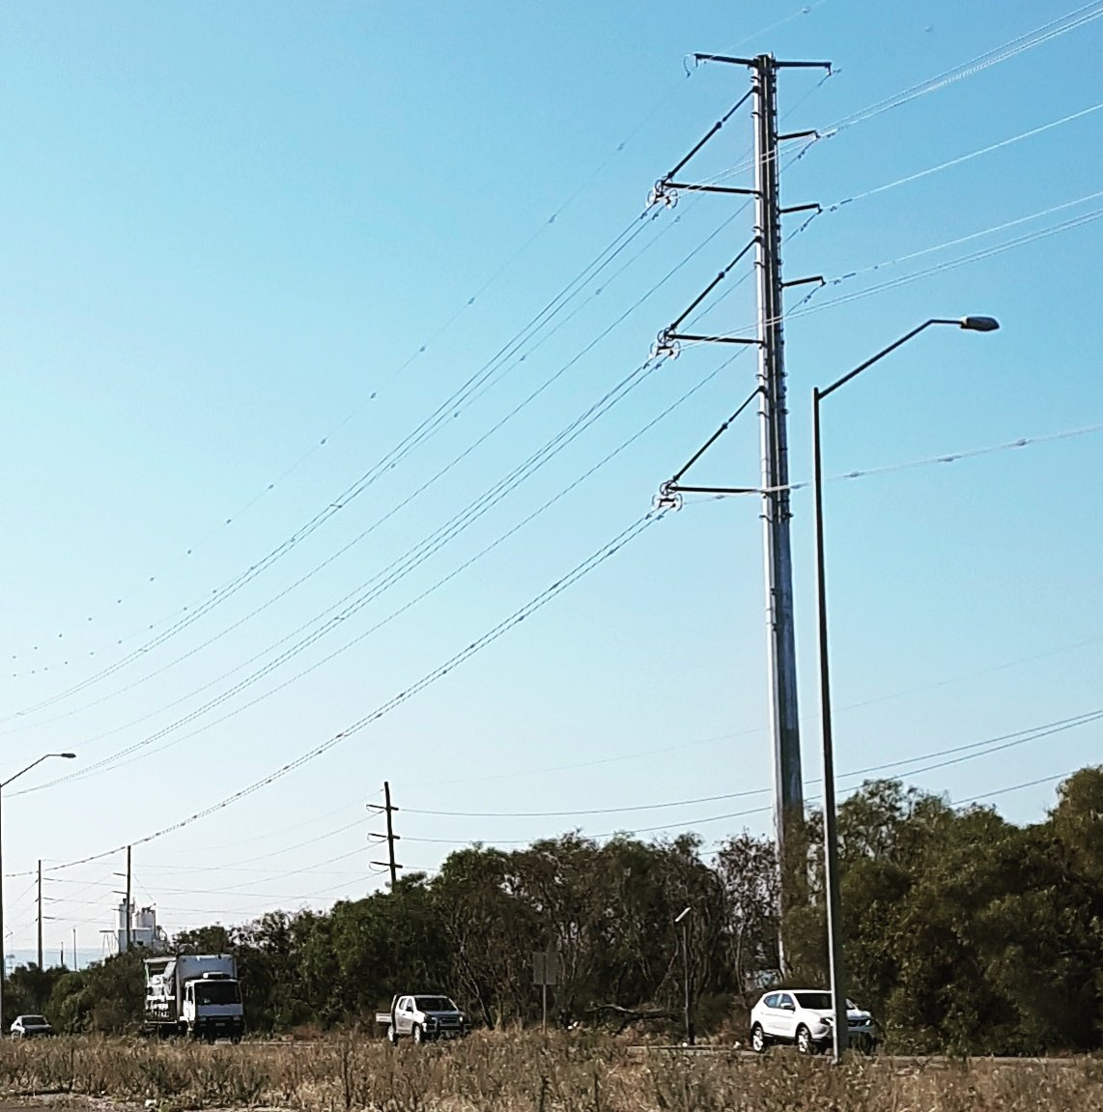
Congruency in construction
Congruent triangles are used
in construction to reinforce structures so that they are strong and stable and do not bend or buckle in strong winds or when under load.
Examples
  Sydney Harbour Bridge
  Parkes Radio Telescope
Courtesy Rachael Whitney-Smith

Slide 14

Activity: Paper, pencil and protractor
Collect a copy of Paper, pencil and protractor: Student worksheet.
Working in a group of three or four:
  Individually construct all the possible triangles which have three given measurements.
  Compare your results with the other members of your group.

Slide 15
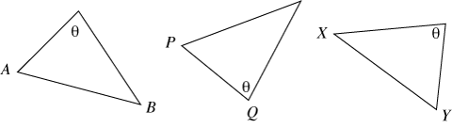
Congruency Quick Quiz (a):
Which sides match?
Within the congruence tests, reference is made
to matching sides.
  Matching sides are opposite equal angles.
  Which sides match?
Notes:
Hand out congruent triangles sheet

Slide 16
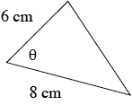
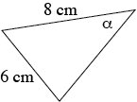
Congruency Quick Quiz (b):
Which angle is included?
Within the congruence tests, reference is made
to included angles.
  Included angles are formed by the equal sides. Which angle is included?

Slide 17
At this point you may wish to stop the presentation and continue it at another time, or you may wish to continue.

Slide 18
Similarity: what is it?
Discuss with your colleagues what is meant by the term, ‘similarity’.
Share how it has been defined by the members of your group.
Do you have any examples of similarity
in the ‘real world’ to share?

Slide 19
Similarity
If one plane figure can be enlarged so that it is congruent to the other plane figure, they are similar.
One can be mapped to the other by a sequence
of translations, rotations, reflections and enlargements.
Similar figures have the same shape, but not
necessarily the same size.

Slide 20

Using a centre of enlargement
Investigate the effect of the changing proportion
of sides for similar shapes with the learning object L11103: Using a centre of enlargement.
You will need to log into Scootle to access this learning resource and widget.

Slide 21

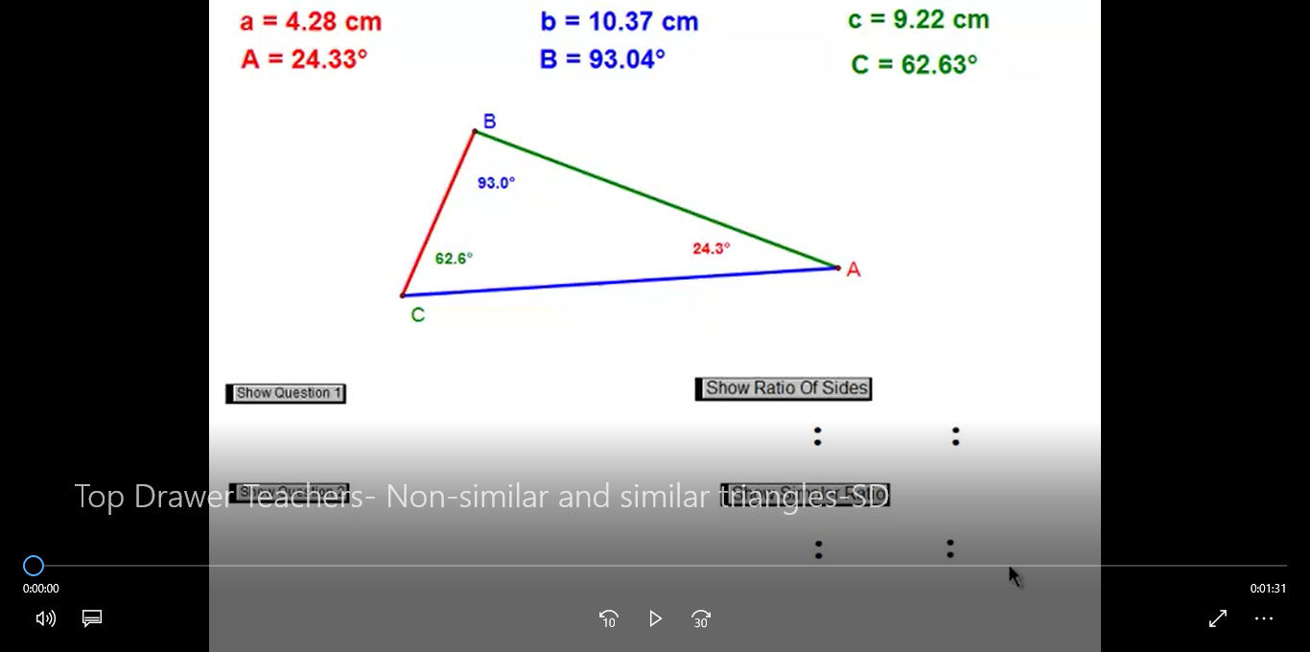
Non-similar and similar triangles

Slide 22
Similarity
All congruent shapes are similar because all matching angles are equal and the matching sides are in proportion (in the ratio 1:1).
However, the reverse is not true.
Pairs of triangles are similar if they meet the conditions of any one of four standard tests. Make sure you are familiar with these tests.

Slide 23
The similar-congruent house
Download The Similar-Congruent House - https://www.superteacherworksheets.com/geometry/congruent-house_TZNMW.pdf
Answer the 9 questions on the sheet.
This worksheet allows students to decide whether each pair of shapes is congruent or similar, without having to prove their answers.

Slide 24
Looking beyond the lines
Visualising shapes that are embedded in diagrams can be difficult as students may be distracted by
other lines.
Colour (and transformations) can highlight the embedded shapes.
This helps students visualise angle and length relationships.

Slide 25
Looking beyond the lines
The following eight slides demonstrate how to assist students to visualise the shapes embedded in diagrams.

Slide 26
Where are the similar triangles?
A
x
◆
D
c
b
y
•
a
B
C

Slide 27
A
A
x
x
◆
◆
D
D
c
b
y
b
•
•
a
B
C
C

Slide 28
A
A
x
x
◆
◆
D
D
c
b
y
b
•
•
a
B
C
C

Slide 29
A
x
◆
D
c
b
y
•
a
B
C

Slide 30
A
x
◆
D
D
c
y
b
y
•
•
a
a
B
C
B
C

Slide 31
A
x
◆
◆
D
D
c
y
b
y
•
•
a
a
B
C
B
C

Slide 32
A
A
x
x
◆
◆
D
D
D
c
y
b
y
b
•
•
◆
•
◆
•
a
a
B
C
B
C
C

Slide 33
A
A
x
x
◆
◆
◆
D
D
D
c
y
b
y
b
•
•
◆
•
◆
•
a
a
B
C
B
C
C

Slide 34
Activity: Pentakite
Working individually or in pairs, access http://nrich.maths.org/1938 on the internet
and work through the Pentakite task.
This task entails geometrical reasoning involving angles and similar triangles.
A diagram is not provided in the task,
thereby encouraging you to draw your own.

Slide 35
Conclusion
Do the activities in which you have participated today help you to answer the focus question at the beginning of the presentation?
Focus question
“Will exploring the minimum conditions required for triangles to be congruent or similar, help students to develop a better understanding of the nuances of the tests for congruency and similarity?”

Slide 36
Conclusion: The take-away
Did we achieve the learning outcomes?
How do we know?
Do we need any more information?
Where will we go to get it?
What will I try in my classroom?

Slide 37
Acknowledgements
The Geometric Reasoning Drawer was written by a team
from the Mathematical Association of New South Wales
led by Nikky Vanderhout, Professional Learning Consultant.
Nikky Vanderhout was responsible for the conceptual design
of the drawer and wrote much of the material, with significant contributions from Stuart Palmer, Patrick Parker, Gavin Sinclair, Karen McDaid, Katrina Simms, Lauren James
and Christine Horley.
The Mathematical Association of New South Wales also acknowledges the professional advice and support of
Judy Anderson, Peter Gould and Ann Thomas.

Slide 38
Copyright information
© The Australian Association of Mathematics Teachers (AAMT) Inc. 2017
This work is licensed under a Creative Commons Attribution-NonCommercial-NoDerivatives 4.0 International License
(CC BY-NC-ND 4.0) except where otherwise indicated.
See https://creativecommons.org/licenses/by-nc-nd/4.0/
Australian Professional Standards for Teachers © Australian
Institute for Teaching and School Leadership Limited (AITSL) 2013
Australian Curriculum © Australian Curriculum, Assessment and Reporting Authority (ACARA) 2010 to present

