Slide 1
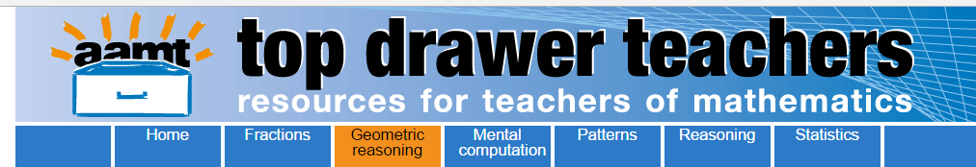
Opening the Top Drawer to Geometric Reasoning
Module 3 of 4: Geometric proof
Designed and written by Ann Ruckert

Slide 2
Big ideas
There are five Big Ideas in the Geometric Reasoning Top Drawer
Plane Shapes (F – 8)
Congruence (Year 8)
Similarity (Year 9)
Geometric Proof (Years 7 & 10)
Circle Geometry (Year 10A)

Slide 3
Learning outcomes
Participants will be able to:
Explain the difference between experimental verification of geometrical statements and geometric proof.
Scaffold the process of writing geometric proofs for their year 7 and 10 students.

Slide 4
Australian Curriculum links
Year 7: Demonstrate that the angle sum of a triangle is 180° and use this to find the angle sum of a quadrilateral.
ACMMG166
Year 10: Apply logical reasoning, including the use of congruence and similarity, to proofs and numerical exercises involving plane shapes.
ACMMG244

Slide 5
Focus question
“Could disturbing students’ beliefs about experimental verification of geometrical statements, by establishing classroom activities and discussions, help to make deductive proof meaningful for them?”

Slide 6
What is a proof?
A proof is a written account of the complete thought process that is used to reach a conclusion.
Each step of the process is supported by a theorem, postulate or definition verifying why the step is possible.

Slide 7

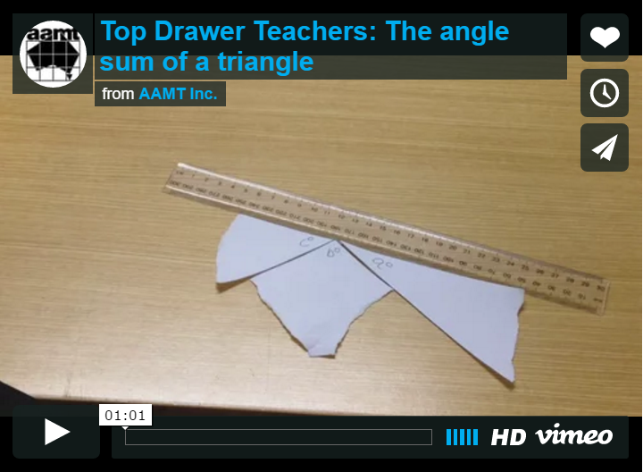
Experimental verification is not proof

Slide 8
Convince me
In contrast to experimental verification, a geometric proof needs to be an orderly progression of statements, which link previously established facts, each supported with reasons.
The following slide presentation demonstrates this.

Slide 9
Prove that x + y + z = 180°
The angle sum of a triangle
A
x
y
B
z
C

Slide 10
Construct PQ through A so that PQ||BC
P
A
x
Q
y
B
z
C

Slide 11
∠PAB = y° (alternate angles, PQ||BC)
P
A
y
x
Q
y
B
z
C

Slide 12
∠QAC = z° (alternate angles, PQ||BC)
P
A
y
z
x
Q
y
B
z
C

Slide 13
Now PAQ is a straight line
P
A
y
z
x
Q
y
B
z
C

Slide 14
x + y + z = 180° (PAQ is a straight line)
P
A
y
z
x
Q
y
B
z
C

Slide 15
x + y + z = 180°
A
x
y
B
z
C

Slide 16
The angle sum of a triangle is 180°
A
x
y
B
z
C

Slide 17
Prove that x + y + z = 180°
A different proof for the same result
A
x
y
B
z
C

Slide 18
Produce BC to P
A
x
y
B
z
C
P

Slide 19
At C construct CQ||BA
A
x
Q
y
B
z
C
P

Slide 20
∠ACQ = x° (alternate angles, PQ||BC)
A
x
Q
y
B
z
x
C
P

Slide 21
∠PCQ = y° (corresponding angles, PQ||BC)
A
x
Q
y
B
z
x
y
C
P

Slide 22
Now BCP is a straight line
A
x
Q
y
B
z
x
y
C
P

Slide 23
x + y + z = 180° (BCP is a straight line)
A
x
Q
y
B
z
x
y
C
P

Slide 24
x + y + z = 180°
A
x
y
B
z
C

Slide 25
The angle sum of a triangle is 180°
A
x
y
B
z
C

Slide 26

Activity: Angle sum of a triangle
Collect a copy of Angle Sum of a Triangle: Student Worksheet.
Work through the sheet, using the previous slide presentation to help, if needed.
Share your thoughts with your group on the validity of this task as a way of introducing geometric proof to Year 7 students.

Slide 27
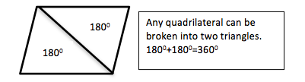
Why 360 degrees?
Why is the sum of the angles of a quadrilateral 360°?
Any quadrilateral can be divided into two triangles.
The angle sum of a triangle is 180°
180° + 180° = 360°

Slide 28
Deductive geometry toolkit
Developing a resource bank of the foundational concepts learnt in geometry over the preceding years, provides students with a toolkit to support the development of their proof writing skills.
Collect a copy of the geometry toolkit student worksheet.
Work with your group to complete the reasons for each theorem and to develop abbreviations which will be accepted as evidence of knowledge of the appropriate theorem.

Slide 29
Starting a congruence or similarity proof, part 1
Initially add any information contained in the text of the problem to the diagram.
Identify the different triangles by highlighting them in different colours or re-draw the triangles at the side of the main diagram if visualisation is difficult.
The naming of corresponding vertices, angles and sides in the two triangles is critical.

Slide 30
Starting a congruence or similarity proof, part 2
List the four tests. Then systematically eliminate the inappropriate tests by looking for:
a right angle
side relationships
angle relationships.

Slide 31
Starting a congruence or similarity proof, part 3
Once the correct test has been selected, write a structured proof.
Introduce the two triangles.
State the facts in the order required by the test.
Conclude with a statement of congruence or similarity, writing the vertices in matching order.

Slide 32
Geometric proof
Remember that a proof is incorrect if there is:
an error in the underlying assumptions
a flaw in the logic of the reasoning.

Slide 33

Dissected proof
Working in pairs, collect a set of cards for Proving Pythagoras' theorem (holding either one line of the proof or a reason) and a half-page which has the enunciation of Pythagoras' theorem and the necessary diagrams.
Use similarity to prove Pythagoras' theorem, matching the cards appropriately.
Check your proof against Pythagoras' similarity proof.
Discuss how this activity might assist your year 10 students to better understand how to write a geometric proof.

Slide 34
Activity: Complete the congruence proof
Collect a copy of Proving congruence: Student worksheet.
Work through some (or all) of the 9 questions.
Notice that the questions progress from being highly scaffolded to ones in which students write the complete proof without prompts.
Discuss with your group whether this process would aid your Year 10 students’ understanding of the process.

Slide 35
Activity: What is wrong with this proof?
When assessing similarity and congruence proofs, an awareness of some common sources of error will help you quickly recognise when they have been made.
Collect a copy of Geometry checkups: Sample answers containing two sample proofs for congruence, both of which contain conceptual errors.
How would you mark this work and what feedback would you give to the student?
Notes:
This activity contains a collection of diagrams which students then have to match to the appropriate property.
It illustrates that the use of the English language can be inefficient compared with the diagrams and symbols used in plane geometry.

Slide 36
What is wrong with this proof?
One method to provide individual feedback (formative assessment) is to regularly give your students a single problem to complete and submit for correction.
Correcting their work and providing timely feedback is a valuable learning experience for your students.
Asking for only one proof to be completed is also a more manageable teaching strategy for you.

Slide 37
Conclusion
Do the activities in which you have participated today help you to answer the focus question at the beginning of the presentation?
Focus question
“Could disturbing students’ beliefs about experimental verification of geometrical statements by establishing classroom activities and discussions help to make deductive proof meaningful for them?”

Slide 38
Acknowledgements
The Geometric Reasoning Drawer was written by a team from the Mathematical Association of New South Wales led by Nikky Vanderhout, Professional Learning Consultant.
Nikky Vanderhout was responsible for the conceptual design of the drawer and wrote much of the material, with significant contributions from Stuart Palmer, Patrick Parker, Gavin Sinclair, Karen McDaid, Katrina Simms, Lauren James and Christine Horley.
The Mathematical Association of New South Wales also acknowledges the professional advice and support of Judy Anderson, Peter Gould and Ann Thomas.

Slide 39
Copyright information
© The Australian Association of Mathematics Teachers (AAMT) Inc. 2017
This work is licensed under a Creative Commons Attribution-NonCommercial-NoDerivatives 4.0 International License (CC BY-NC-ND 4.0) except where otherwise indicated. See https://creativecommons.org/licenses/by-nc-nd/4.0/
Australian Professional Standards for Teachers © Australian Institute for Teaching and School Leadership Limited (AITSL) 2013
Australian Curriculum © Australian Curriculum, Assessment and Reporting Authority (ACARA) 2010 to present.

