Slide 1
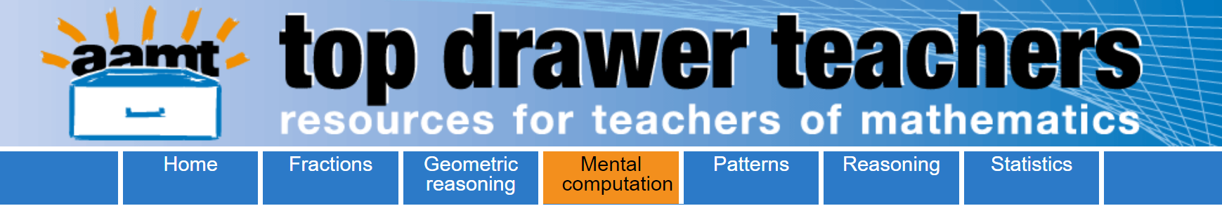
Opening the Top Drawer to Mental Computation
Module 2 of 3: Noticing patterns and relationships
Developed by Ann Ruckert
Notes:
Prior to presenting the PowerPoint, distribute the pre-reading, Mardjetko, E. & Macpherson, J. (2007). Is your classroom mental? Australian Primary Mathematics Classroom, 12 (2), 4-9; available as a download with this module.
In this article, Emilia Mardjetko and Julie Macpherson put a strong case for an emphasis on developing mental calculation strategies with students and suggest helpful teaching approaches to achieve this.
Ask participants to read the article before attending the professional learning presentation.

Slide 2
The content in the Mental Computation Top Drawer will be addressed in three modules
What is mental computation? Why is it important?
Noticing patterns and relationships
Using manipulatives and representations to support mental computation

Slide 3
Learning outcomes:
Participants should be able to:
Determine how exploring patterns can lead students to generalise relationships.
Describe how noticing patterns and relationships will help students to make connections between mathematical ideas and within different contexts.

Slide 4
Generalising patterns and relationships
The ability to recognise patterns and relationships is a key aspect to developing known facts by association.
For example:
When two odd numbers are added together, the answer is even.
When a number is divisible by 9, it is also divisible by 3.

Slide 5

Discussion: Generalising
Discuss other examples that participants have observed in their classrooms, where the recognition of patterns and relationships has resulted in the development of known facts by association by their students.

Slide 6

Properties of operations
Important generalisations including:
Commutative property for addition & multiplication
Identity property for the four operations
Associative property for addition & multiplication
Distributive property for multiplication over addition
Inverse relationships between addition and subtraction, and multiplication and division.

Slide 7
Activity: Properties of operations
Understanding the properties of operations leads to transfer of the principles to more complex problems.
For example:
The understanding that
9 x 3 = (10 x 3) – (1 x 3)
Leads to an understanding that
99 x 3 = (100 x 3) – (1 x 3)

Slide 8
Activity: Properties of operations
Either individually or in groups, think of more examples where students’ understanding of properties of operations results in them be able to use the principles in more complex problems.
Share these examples with all participants and discuss.

Slide 9
Commutative property
An understanding of the commutative property of addition and multiplication reduces the number of facts to be learned.
For example:
3 x 6 = 18, so 6 x 3 = 18

Slide 10
Commutative property for addition
Also known as the ‘turn around’ property, as the order of adding or multiplying the numbers does not affect the answer.
Which would be easier for your students to calculate?
4 + 7 = ? or 7 + 4 = ?
5 x 7 = ? or 7 x 5 = ?
Why?

Slide 11

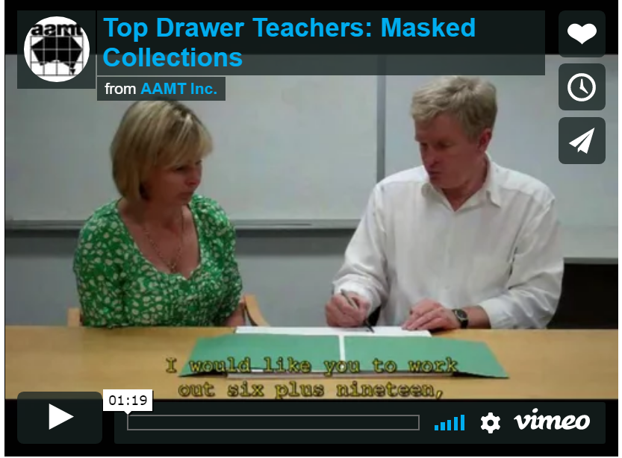
Video: Masked collections
Notes:
The image in this slide contains the hyperlink to Vimeo (URL is https://vimeo.com/65120386). I suggest that you download the Vimeo and save it to your hard drive prior to working with this module (and then change the hyperlink to your saved copy of the Vimeo video) to reduce the likelihood of problems associated with possible internet outages.
You can download the “Masked collections” video transcript from http://topdrawer.aamt.edu.au/content/download/21538/285955/file/tdt_MC_maskedcollections_movie_script.pdf

Slide 12
Commutative property for multiplication
This is not as intuitively obvious as that of addition, particularly when using the set model.
That is:
When we write 4 x 3 = 12 we are representing that the result of multiplying a set of four by a set of three is a set of twelve objects.

Slide 13
How many marbles
The seven slides that follow demonstrate the commutative property for multiplication using an animation.

Slide 14
How many marbles?
There are 7 marbles in each bag.

Slide 15
How many marbles?
There are 7 marbles in each bag.
There are 99 bags.

Slide 16
How many marbles?
There are 7 marbles in each bag.
There are 99 bags.
How many marbles are there altogether?

Slide 17
How many marbles?
There are 99 marbles in each bag.

Slide 18
How many marbles?
There are 99 marbles in each bag.
There are 7 bags.

Slide 19
How many marbles?
There are 99 marbles in each bag.
There are 7 bags.
How many marbles are there altogether?

Slide 20
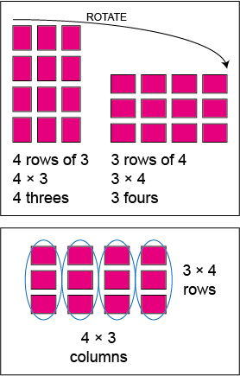
Commutative property for multiplication using arrays
The rectangular array model can help students to see the connection (the pattern) and recognise why they have the same product.

Slide 21

Activity: What do I know?
In this activity, students build up a list of facts they can recall automatically. They discuss some possible strategies to deal with those that they do not know or need to use additional thinking to work out.
Developing an understanding of the properties of multiplication (such as the properties of 0, 1, commutativity) reduce the number of facts students need to remember.
Notes:
In this activity, students build up a list of facts they can recall automatically. They discuss some possible strategies to deal with those that they do not know or need to use additional thinking to work out.
Developing an understanding of the properties of multiplication (such as the properties of 0, 1, commutativity) reduce the number of facts students need to remember.
What do I know?
Materials: Blank multiplication grid and two 10-sided (0-9) dice per pair, coloured pencils.
In pairs, students take turns to roll the dice and generate a multiplication fact. For example, player A rolls (5, 3) and player B says "5 threes are 15, and 3 fives are 15".
Player B records 15 in the appropriate cells on the grid, using a coloured pencil.
If a player takes a long time to work out the product, it is recorded in the cell with a circle around it. If a player does not know then a cross is put in the cell.
Play continues until all the cells are filled. Students should record the facts for 10 as they cannot be generated using the dice.
Students discuss and list some of the strategies used for the facts that were tricky to work out.
Those cells left uncoloured might include some square numbers and some threes, six and seven facts. Discuss the strategies the students might use to assist them to remember these facts.

Slide 22
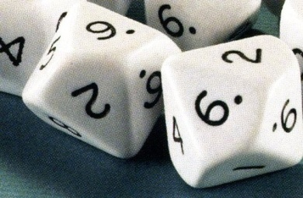
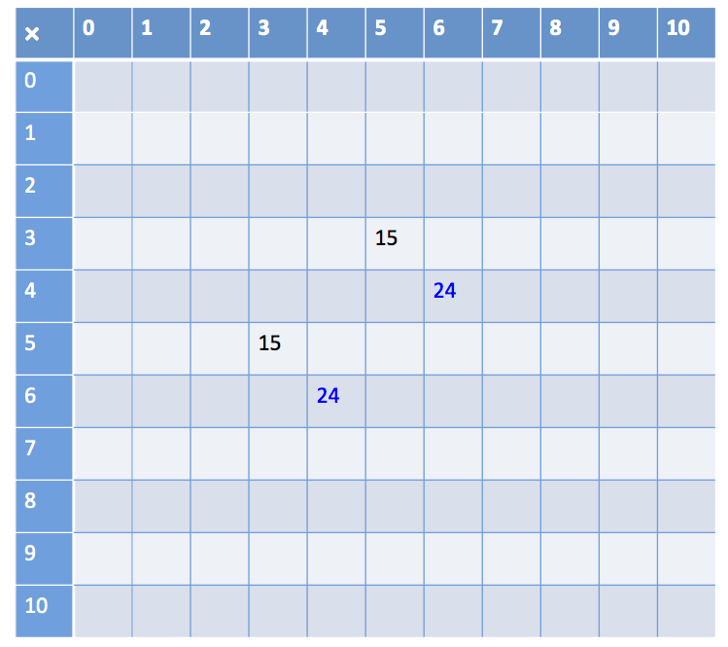
Instructions
Materials: Blank multiplication grid and two 10-sided (0-9) dice per pair, coloured pencils.
In pairs, players take turns to roll the dice and generate a multiplication fact. For example, player A rolls (5, 3) and player B says “5 threes are 15, and 3 fives are 15”.
Player B records 15 in the appropriate cells on the grid using a coloured pencil.

Slide 23
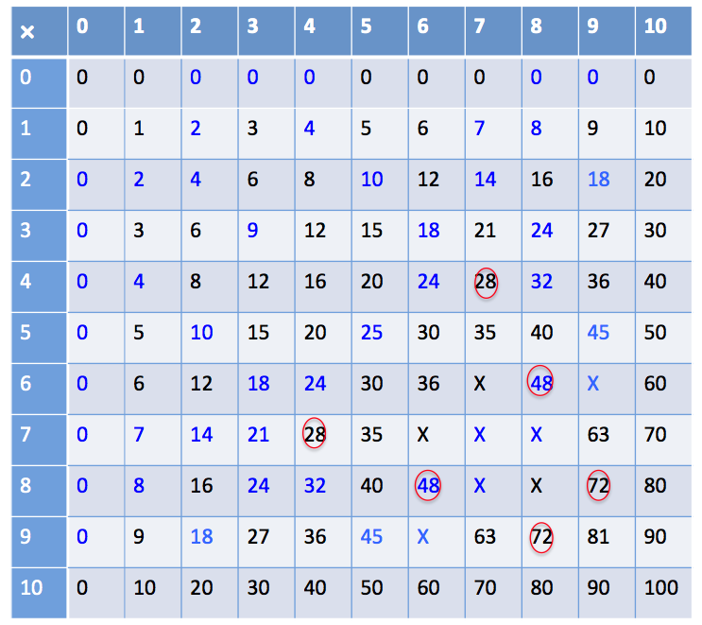
Instructions
What do I know?
If a player takes a long time to work out the product, it is recorded in the cell with a circle around it.
If a player does not know then a cross is put in the cell.

Slide 24
Instructions
What do I know?
Play continues until all the cells are filled. They can record the facts for 10 as they cannot be generated using the dice.
Players discuss and list some of the strategies used for the facts that were tricky to work out. For example, using 4 × 4 and doubles to work out 8 × 4.

Slide 25
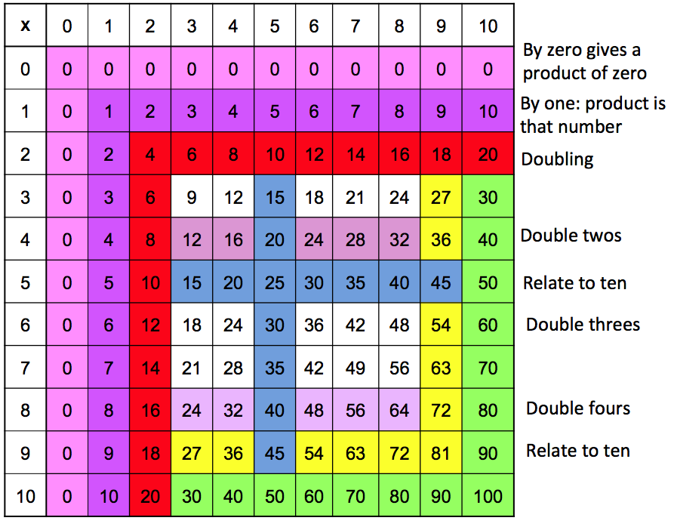
Multiplication facts
What do I know?

Slide 26
Associative property of addition and multiplication
This can be used when adding or multiplying more than two numbers.
Determine the easiest strategy to calculate each of the following:
13 + 18 + 2 = ?
4 x 6 x 5 = ?
Notes:
To work out 13 + 18 + 2 it is easier to add 18 + 2 first than proceed from left to right.
To work out the product of 4 × 6 × 5 it is easier to calculate the 6 × 5 part first then multiply 30 by 4 (or to calculate 4 x 5 first, then multiply 20 by 6).

Slide 27
Distributive property of multiplication
The distributive property for multiplication splits one or both of the factors into two or more parts which can be multiplied separately and the partial products then added.
For example:
To work out 6 × 8, split the 8 into 5 and 3 and then multiply each by 6. The equation would be (6 × 5) + (6 × 3), giving a product of 48 which is the same as for the original 6 × 8.

Slide 28
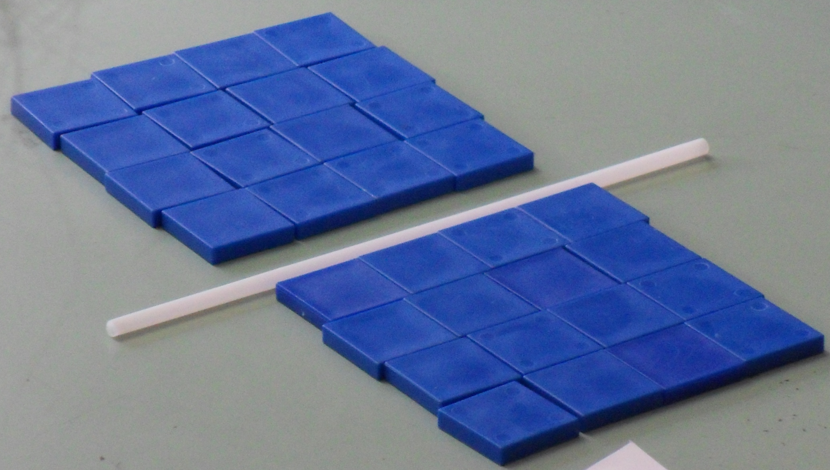
Distributive property of multiplication
8 × 4 = (4 × 4) + (4 × 4)
How might you split this array to work out 4 × 8?

Slide 29
One of the two factors in a product can be split into two or more parts.
Example: 6 × 8 =

Slide 30
One of the two factors in a product can be split into two or more parts.
Example: 6 × 8 =
6 × 5

Slide 31
One of the two factors in a product can be split into two or more parts.
Example: 6 × 8 =
6 × 5
6 × 3

Slide 32
One of the two factors in a product can be split into two or more parts.
Example: 6 × 8 =
6 × 5
6 × 3

Slide 33
One of the two factors in a product can be split into two or more parts.
Example: 6 × 8 = (6 × 5) + (6 × 3)
6 × 5
6 × 3

Slide 34
One of the two factors in a product can be split into two or more parts.
Example: 6 × 8 = (6 × 5) + (6 × 3)
6 × 5
6 × 3
Each part is multiplied separately and the partial products are then added.

Slide 35
One of the two factors in a product can be split into two or more parts.
Example: 6 × 8 = (6 × 5) + (6 × 3)
6 × 5 = 30
6 × 3
Each part is multiplied separately and the partial products are then added.

Slide 36
One of the two factors in a product can be split into two or more parts.
Example: 6 × 8 = (6 × 5) + (6 × 3)
6 × 5 = 30
6 × 3 = 18
Each part is multiplied separately and the partial products are then added.

Slide 37
One of the two factors in a product can be split into two or more parts.
Example: 6 × 8 = (6 × 5) + (6 × 3) = 30 + 18
6 × 5 = 30
6 × 3 = 18
Each part is multiplied separately and the partial products are then added.

Slide 38
What is another way to split the array to make it easier to work out 6 x 8 ?
Example: 6 × 8 =

Slide 39
What is another way to split the array to make it easier to work out 6 x 8 ?
Example: 6 × 8 =
5 × 8

Slide 40
What is another way to split the array to make it easier to work out 6 x 8 ?
Example: 6 × 8 =
5 × 8
1 × 8

Slide 41
What is another way to split the array to make it easier to work out 6 x 8 ?
Example: 6 × 8 =
5 × 8
1 × 8

Slide 42
What is another way to split the array to make it easier to work out 6 x 8 ?
Example: 6 × 8 = (5 × 8) + (1 × 8)
5 × 8
1 × 8

Slide 43
What is another way to split the array to make it easier to work out 6 x 8 ?
Example: 6 × 8 = (5 × 8) + (1 × 8)
5 × 8 = 40
1 × 8

Slide 44
What is another way to split the array to make it easier to work out 6 x 8 ?
Example: 6 × 8 = (5 × 8) + (1 × 8)
5 × 8 = 40
1 × 8 = 8

Slide 45
What is another way to split the array to make it easier to work out 6 x 8 ?
Example: 6 × 8 =
(5 × 8) + (1 × 8)
= 40 + 8
5 × 8 = 40
1 × 8 = 8

Slide 46
Distributive property
The distributive property is also useful for mentally calculating the product of a multi-digit computation.
For example:
8 x 16 can be thought of as (8 x 10) + (8 x 6)

Slide 47
Inverse operations
Recognising the inverse relationships between the operations equips students with greater flexibility in working with numbers than if the facts are learned in isolation.
For example:
Students should recognise that for a fact such as 3 + 4 = 7 there are three other facts:
4 + 3 = 7 7 − 3 = 4 7 − 4 = 3.

Slide 48
Inverse operations: addition
Knowing this relationship can assist students to think 'addition' when presented with a situation such as 15 – 6 = ? which can be thought of as ? + 6 = 15.
Knowing such relationships can also assist with addition and subtraction of multi-digit numbers.

Slide 49
Inverse operations: multiplication
The same thinking applies to multiplication and division.
For example, the numbers 4, 5 and 20 have four related facts: 4 × 5 = 20, 5 × 4 = 20, 20 ÷ 5 = 4 and 20 ÷ 4 = 5.
Knowing inverse relationships can assist students: 48 ÷ 6 = ? can be thought of as 6 × ? = 48 or ? × 6 = 48.
Rectangular arrays are a useful tool to assist students to see these relationships.

Slide 50
Pattern and structure
Pattern is a regularity or consistency.
Students who detect patterns see both similarity and difference in situations.
Structure is the way the pattern is organised.
There are structured connections in mental computation:
Addition and subtraction, multiplication and division.

Slide 51
Pattern and structure
Example:
A situation involving equal sharing among three people – equal sharing is a pattern.
Anticipating the results of a sharing by asking “How many threes are in…?”
This structure is the connection between:
Sharing (partitive) and
Measuring (quotitive).

Slide 52
Pattern and structure
Examples of structured connections:
The commutative property can be generalised by noticing patterns in addends and factors (e.g. 3 x 8 = 8 x 3)
Multiplication and division are inverse operations, i.e. one undoes the other. Students apply this property when they check their division calculations by multiplication.

Slide 53
Further links to patterns
Further links to, information about and resources around patterns can be found in the dimensions website and also in the Top Drawer teachers website at:
http://topdrawer.aamt.edu.au/Patterns

Slide 54
Acknowledgements
The Mental Computation drawer was written by a team from the Mathematics Teaching and Learning Research Centre of the Australian Catholic University, led by the centre’s Director, Prof. Doug Clarke.
The Mental Computation drawer is an outcome of the extensive program of research and work with schools across Australia carried out by the MTLRC over a number of years by Clarke and his colleagues.
A/Prof. Vince Wright, Dr Ann Downton and Prof. Doug Clarke, were responsible for the conceptual design of the drawer. Vince and Ann wrote most of the material.

Slide 55
Copyright information
© The Australian Association of Mathematics Teachers (AAMT) Inc. 2017
This work is licensed under a Creative Commons Attribution-NonCommercial-NoDerivatives 4.0 International License (CC BY-NC-ND 4.0) except where otherwise indicated. See https://creativecommons.org/licenses/by-nc-nd/4.0/
Australian Professional Standards for Teachers © Australian Institute for Teaching and School Leadership Limited (AITSL) 2013
Australian Curriculum © Australian Curriculum, Assessment and Reporting Authority (ACARA) 2010 to present

