Slide 1
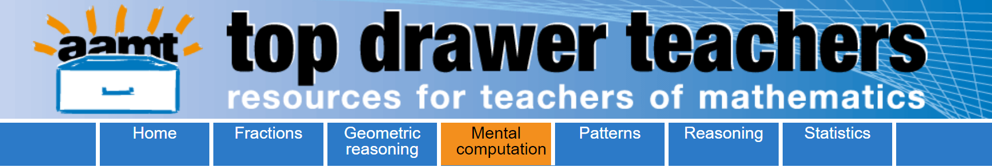
Opening the Top Drawer to Mental Computation
Module 3 of 3: Using manipulatives to support mental computation
Developed by Ann Ruckert
Notes:
Prior to presenting the PowerPoint, distribute the pre-reading, Heirdsfield, A. (2002). Mental Methods Moving Along Australian Primary Mathematics Classroom, 7 (1), 4-8; available as a download with this module.
In this article, Ann Heirdsfield explores the issue of how we can encourage students to take ownership of their own mental strategies, especially in relation to students making sense of numbers using their own natural skills.
Ask participants to read the article before attending the professional learning presentation and to take special note of the importance of using manipulatives and representations to support mental computation.

Slide 2
The content in the Mental Computation Top Drawer will be addressed in three modules
What is mental computation? Why is it important?
Noticing patterns and relationships
Using manipulatives and representations to support mental computation

Slide 3
Learning outcomes:
Participants should be able to:
Describe how manipulatives and representations can be used to support mental computation.

Slide 4
What are manipulatives?
Manipulatives are physical objects that are used as teaching tools to engage students in the hands-on learning of mathematics. They can be used to introduce, practise, or remediate a concept.
Notes:
Accessed from https://www.teachervision.com/using-manipulatives

Slide 5
Mental load
It is generally accepted that a human brain can hold between five and nine pieces of information in working memory.
The load placed on working memory is dependent on:
the choice of strategy
the familiarity of the knowledge needed for the chosen strategy.

Slide 6
Should mental computation involve the use of manipulatives?
Students who calculate mentally are able to visualise problems and work them out in their heads.
To do so, however, they require practical experiences and models that can help them apply these problems to the real world.
Notes:
Accessed from http://www.sunrisesd.ca/ServicesPrograms/NTK12/Documents/September%202016.pdf

Slide 7
Students should be provided with appropriate resources that they can use to observe the problem, apply the strategy, and visualise the solution.
Such resources include coins, counting sticks, number cubes, base-10 blocks, interlocking cubes, counters, number lines, 100-squares, bead strings, place-value cards, diagrams of shapes divided into fractional parts, paper-folding, etc.
Interactive whiteboards are also useful, as they allow students to manipulate images and thereby visualise a solution.
Notes:
Accessed from http://www.sunrisesd.ca/ServicesPrograms/NTK12/Documents/September%202016.pdf

Slide 8
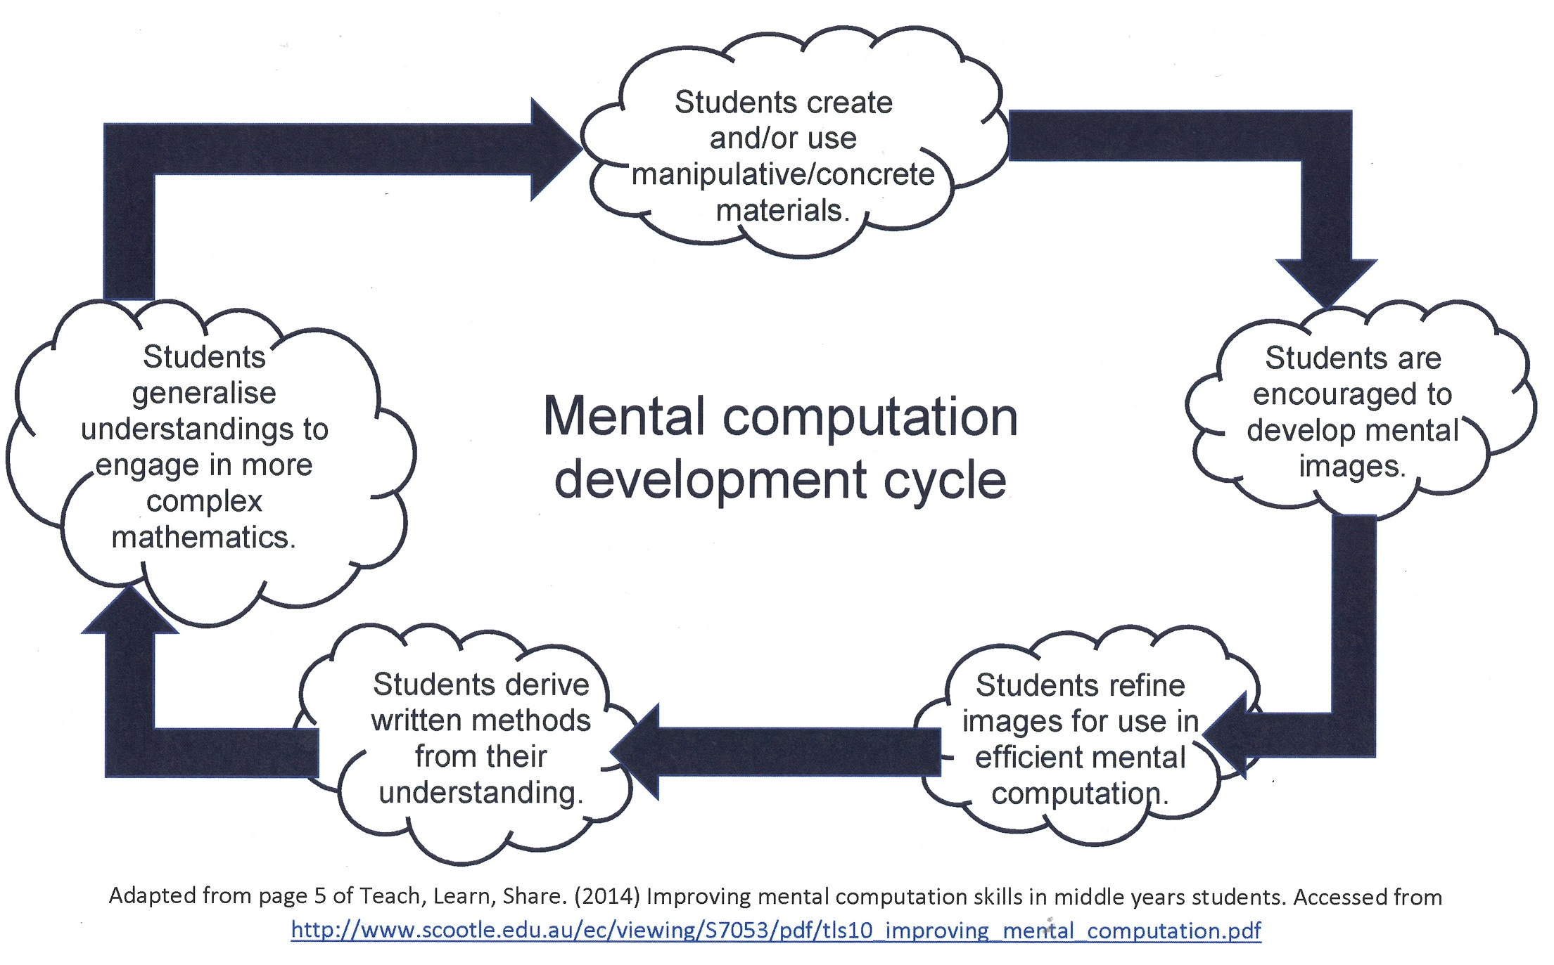
Notes:
Adapted from http://www.scootle.edu.au/ec/viewing/S7053/pdf/tls10_improving_mental_computation.pdf

Slide 9
We learn by moving from the concrete to the abstract and structured apparatus such as Dienes (base-10 blocks) can be helpful for learning about place value or number bonds.
However the meaning isn’t in the manipulatives themselves – it has to be constructed by children over a period of time, through playing around with them and connecting them directly to mental and recorded calculation.
McClure 2014
Notes:
McClure, L. (2014). Developing Number Fluency – What, Why and How? Accessed from https://nrich.maths.org/10624

Slide 10
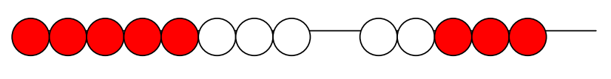
Bead strings
Use of bead strings can assist in developing an understanding of counting on and counting back as a precursor to the use of number lines.
For example:
8 + 5 = 13

Slide 11
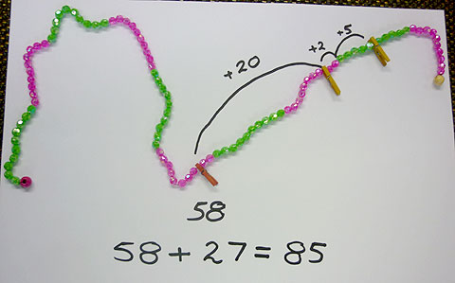
Adding with a bead string
A string of beads, alternating every ten beads from green to pink. The problem is to add 27 to 58.
First peg is at 58 with a jump of 20 to reach 78, then a jump of 2 to reach 80, then a jump of 5 to reach the answer of 85.

Slide 12
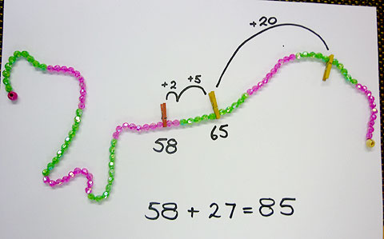
Adding with a bead string
A second method to add 58 + 27.
First peg is at 58 with a jump of 2 to reach 60, then a jump of 5 to reach 65, then a jump of 20 to reach the answer of 85.

Slide 13
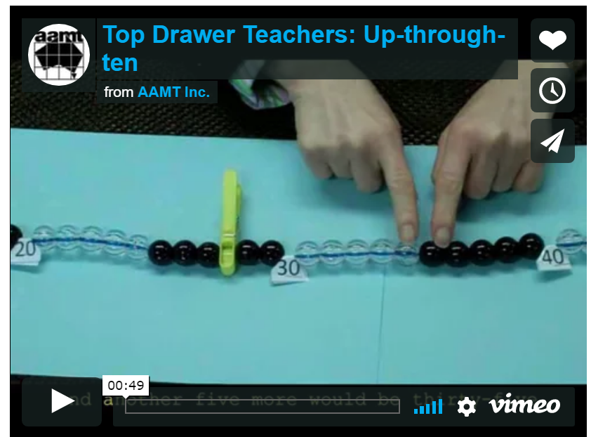
Notes:
The image in this slide contains the hyperlink to Vimeo (URL is https://vimeo.com/64689008). I suggest that you download the Vimeo and save it to your hard drive prior to working with this module (and then change the hyperlink to your saved copy of the Vimeo video) to reduce the likelihood of problems associated with possible internet outages.
You can download the “Up-Through-Ten” video transcript from http://topdrawer.aamt.edu.au/content/download/21461/285298/file/tdt_MC_upthroughtens_movie_script.pdf

Slide 14
Ten frames, cube stacks and finger patterns
Basic number facts are best developed through a process of noticing patterns and relationships.
Tens frames, cube stacks and finger patterns are all useful representations for learning these facts.

Slide 15
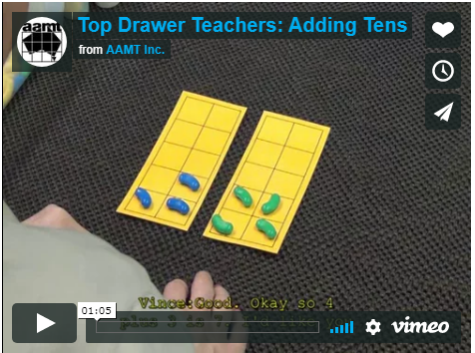
Notes:
The image in this slide contains the hyperlink to Vimeo (URL is https://vimeo.com/64691633). I suggest that you download the Vimeo and save it to your hard drive prior to working with this module (and then change the hyperlink to your saved copy of the Vimeo video) to reduce the likelihood of problems associated with possible internet outages.
You can download the “Adding Tens” video transcript from http://topdrawer.aamt.edu.au/content/download/21445/285138/file/tdt_MC_addingtens_movie_script.pdf

Slide 16
Using cube stacks to learn doubles
2 + 2 = 4

Slide 17
Doubles
3 + 3 = 6

Slide 18
Doubles
4 + 4 = 8

Slide 19
Doubles
5 + 5 = 10

Slide 20
Doubles
How many cubes did I take away?

Slide 21
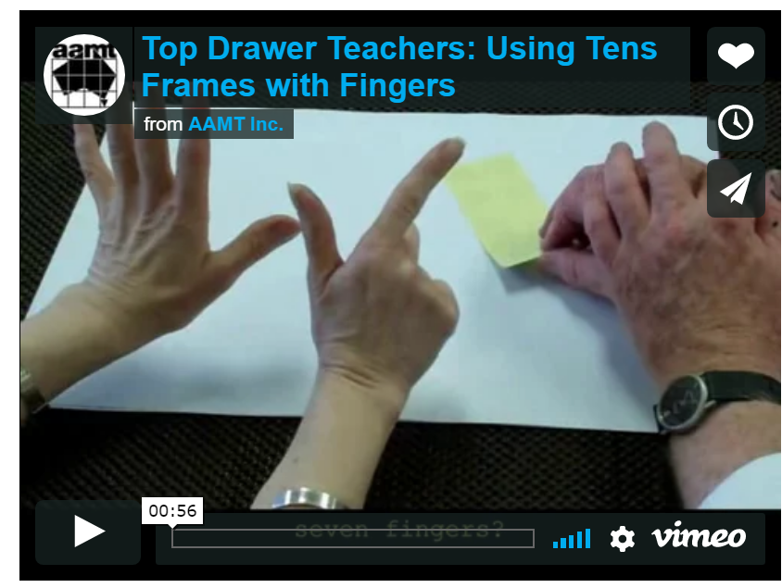
Notes:
The image in this slide contains the hyperlink to Vimeo (URL is https://vimeo.com/64858419). I suggest that you download the Vimeo and save it to your hard drive prior to working with this module (and then change the hyperlink to your saved copy of the Vimeo video) to reduce the likelihood of problems associated with possible internet outages.
You can download the “ Using Tens Frames with Fingers” video transcript from http://topdrawer.aamt.edu.au/content/download/21458/285268/file/tdt_MC_tensfingers_movie_script.pdf

Slide 22
Using cube stacks to bridge ten

Slide 23
How many cubes?
Here is a stack of 8 cubes and a stack of 6 cubes.
What ways can you think of to find out how many cubes?

Slide 24
How many cubes?
I can make 7 + 7 = 14.

Slide 25
How many cubes?
I can make 10 + 4 = 14.

Slide 26
How many cubes?
I can make 6 + 6 + 2 = 14.

Slide 27
Manipulatives and representations to support multiplication and division facts
Students can be assisted to see patterns and relationships among the multiplication and division facts by using visual tools such as:
1 – 100 grids
multiplication fact grids
rectangular arrays
Notes:
1 – 100 grids and Multiplication fact grids are both available as handouts, and are available with this module in dimensions.
When students investigate patterns on a 1–100 chart or on a multiplication fact grid, it assists their understanding of properties (e.g. the identity and commutative properties).
Display the multiplication fact grid and give the participants a few minutes to discuss in pairs any patterns they notice.
List students' ideas on the board (e.g. the first row and column in the unshaded section are all zeros, the second row and column are counting by ones, each column has a corresponding row that is the same).
Use a 1–100 number grid in a 10 by 10 shape to explore sequences of multiples by shading each multiple in a different colour.
This can lead to generalisations, such as every second multiple of 2 in the twos' sequence (2, 4, 6, 8, 10, 12…) is also a multiple of 4.
Students could see if the same relationship exists for any other multiples (e.g. threes and sixes; fives and tens).
Identifying the patterns that exist within the multiplication facts can assist students to identify and generalise divisibility patterns. For example, a number is divisible by five if it ends in a five or zero.
An activity that participants may like to use with their students to reveal the patterns found in 1 – 100 grids is the Sieve of Eratosthenes. Available from a number of places, one source is: http://www.doe.virginia.gov/testing/solsearch/sol/math/5/mess_5-3a.pdf.
Good teaching of mental calculation of multiplication and division uses physical models and a variety of learning experiences including games, everyday contexts and opportunities for students to build connections.
Visualising arrays
Rectangular arrays help students see the multiplicative structure. Rectangular arrays also show the commutative nature of multiplication.
An array is a rectangular arrangement of objects in equal rows (horizontal) and equal columns (vertical).
Everyday examples of arrays include a muffin tray and an egg carton.
An array of eggs.
An array of juice boxes.
An array of chocolates.
Partial arrays
Array structures are ways to represent factors. In this activity, students are given the number of tiles in each row and column and are asked to find the total number of tiles needed to construct the rectangle.
Factors are pairs of counting numbers that multiply to give another counting number. They can be represented by arrays.
Make a partial array on the board (e.g. 6 by 5). Ask the students to predict the number of tiles they think were used to make the complete array and how they might work it out.
Students play a game of 'How many tiles do I need to pave the floor?'
For example, ask students to generate as many arrays for 12 as they can, either using concrete materials or shading in grid paper. Record each of the facts. In pairs, students can discuss any connections or patterns they notice in what they have recorded.
Visual representation of the arrays can assist students to see connections such as commutativity, and doubling and halving of the factors. This can lead to generalisation.

Slide 28

Activity: making arrays
For this activity you will need a set of tiles.
I made an array with 24 tiles. What might it look like?
Close your eyes and picture it. Open your eyes and make what you saw.
I wonder how many different arrays you can make for 24.
Record all your thinking and the different arrays on paper.
What are some interesting things you notice?
How do you know if you have them all?
Notes:
This activity has been written as though it were to be presented to a class of students. Ask participants to work through it, then lead a discussion in which they can share their responses to the activity. How might they use this with their students?
Do they recognise that by rotating the structure they generate another arrangement?
Students share the different possibilities and draw them on the board or interactive whiteboard.
What is the same about all the arrays?
What is different?
What do you notice about the number of rows and number of tiles in each row?
Pose extension problems such as:
I wonder if another number such as 36 would have as many different possible arrays as 24?
One of the activities in the Sieve of Eratosthenes pdf (http://www.doe.virginia.gov/testing/solsearch/sol/math/5/mess_5-3a.pdf) relates to this slide as well.

Slide 29
Activity: splitting arrays
Partitioning or splitting arrays into known parts assists students to develop fluency and flexibility with basic number facts. It also introduces students to the distributive property.
For this activity you will need 2 ten-sided dice. Work in pairs.
One person generates two single-digit numbers by rolling 2 ten-sided dice (or two six-sided dice with faces of 4, 5, 6, 7, 8, 9 and 5, 6, 7, 8, 9, 10).
This person records a fact (e.g. 6 × 7) and constructs a partial or complete array.
The partner looks for other related facts by splitting the array (e.g. 6 × 5 + 6 × 2).
Notes:
In the classroom students can work together to find another way to split the array using known facts. Opportunities arise for noticing square numbers, and doubling and halving connections. This is a useful way to develop flexibility and strategic choice.
A blank 10 by 10 grid can be downloaded and used to record the splits. Using different colours makes the connections clear.
Encourage participants to generate a list of multiplication facts that students find difficult, and consider how they might partition them to make the mental calculation easier.
Make a group chart of the different strategies.
This activity can be extended in class so students mentally calculate the product of a two-digit and a one-digit number using partitioning strategies to make the calculation easier.
Once participants have worked through the activity, lead a discussion in which they can share their responses to the activity. How might they use this with their students?

Slide 30
Developing number sense using manipulatives
Connect words, symbols and physical or diagrammatic representations.
Use representations that reflect the manipulations performed on symbols.
For example:
Use place value materials that are based on bundling of ones, tens and hundreds before using non-proportional materials like money.

Slide 31
Place value understanding
Organising objects into groups of ten, one hundred, etc. is an easy way to keep track of counting a set.
Students need experiences of bundling individual objects (such as counters or pop-sticks) and linking the number of bundles and the extras to the written form of symbols.
Place value is a multiplicative system and working with bundling objects helps to solidify this in students’ minds.
Notes:
It is important to understand that the structure of the place value system is based on grouping in tens. The additive and multiplicative nature of the system is useful in developing a sense of flexibility with numbers.
Use of an empty number line can make students' thinking visible and represent different strategies used.
Understanding the place value system is necessary when:
multiplying by powers of 10
multiplying multi-digit numbers by a single digit using the distributive property.
Students' understanding of place value reflects their understanding of counting, as well as their thinking about the operations of addition, subtraction, multiplication and division.

Slide 32
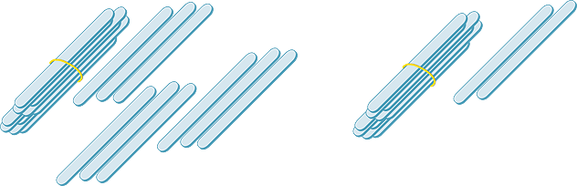
Bundling pop-sticks
12 pop-sticks gives us one bundle of ten and two sticks.
19 pop-sticks gives us one bundle of ten and nine sticks.
Notes:
Progress in mental calculation involves a transition from counting to additive thinking to multiplicative thinking.
There are key indicators of increased efficiency in mental calculation strategies.
Counting based strategies start with treating sets as collections of ones. Students solve problems by counting every object. This includes joining sets (addition and multiplication) and separating a set (subtraction). Sharing is done one object at a time.
Additive strategies involve treating sets as collections that can be partitioned and combined. The first evidence of this is counting on and back to solve addition problems, and skip counting to solve multiplication problems. When students learn that collections can be partitioned and recombined they use their knowledge of number facts to work out new results and solve more difficult problems.
Multiplicative thinking involves using the properties of multiplication and division. Students distinguish which of the four operations to apply to situations.

Slide 33
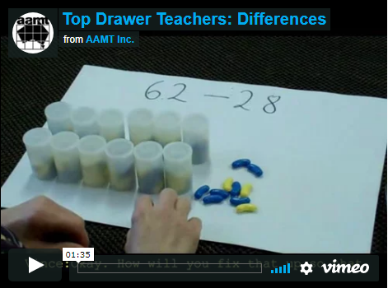
Notes:
The image in this slide contains the hyperlink to Vimeo (URL is https://vimeo.com/64700076). I suggest that you download the Vimeo and save it to your hard drive prior to working with this module (and then change the hyperlink to your saved copy of the Vimeo video) to reduce the likelihood of problems associated with possible internet outages.
You can download the “Differences” video transcript from http://topdrawer.aamt.edu.au/content/download/21449/285178/file/tdt_MC_differences_movie_script.pdf

Slide 34
Conclusion
The preceding slides shared information, videos and slide presentations from Top Drawer Teachers Mental computation resources.
There are many more examples to be found at http://topdrawer.aamt.edu.au/Mental-computation as well as the manipulatives and representations found in schools and designed by teachers and their students.
Use them wisely to support student learning and understanding, and mental computation.

Slide 35
Student activities that appear in other parts of the drawer have been collected in the ‘Activities’ section of Mental Computation, found at:
http://topdrawer.aamt.edu.au/Mental-computation/Activities
If you have time now, take a look at an activity from this website.

Slide 36
Further links to other mathematical concepts
The following document offers excellent support to the teaching of mental computation:
http://www.education.vic.gov.au/Documents/school/teachers/teachingresources/discipline/maths/assessment/lafcomparativ.pdf
The information in this document describes the eight zones within the Learning and Assessment Framework for Multiplicative Thinking (LAF), developed by Professor Dianne Siemon through the Scaffolding Numeracy in the Middle Years (SNMY) project.
Notes:
Further information about this project is available at: http://www.education.vic.gov.au/school/teachers/teachingresources/discipline/maths/assessment/Pages/scaffoldnum.aspx

Slide 37
Acknowledgements
The Mental Computation drawer was written by a team from the Mathematics Teaching and Learning Research Centre of the Australian Catholic University, led by the centre’s Director, Prof. Doug Clarke.
The Mental Computation drawer is an outcome of the extensive program of research and work with schools across Australia carried out by the MTLRC over a number of years by Clarke and his colleagues.
A/Prof. Vince Wright, Dr Ann Downton and Prof. Doug Clarke, were responsible for the conceptual design of the drawer. Vince and Ann wrote most of the material.

Slide 38
Copyright information
© The Australian Association of Mathematics Teachers (AAMT) Inc. 2017
This work is licensed under a Creative Commons Attribution-NonCommercial-NoDerivatives 4.0 International License (CC BY-NC-ND 4.0) except where otherwise indicated. See https://creativecommons.org/licenses/by-nc-nd/4.0/
Australian Professional Standards for Teachers © Australian Institute for Teaching and School Leadership Limited (AITSL) 2013
Australian Curriculum © Australian Curriculum, Assessment and Reporting Authority (ACARA) 2010 to present

