Slide 1
Working with Top Drawer Teachers: The big ideas of patterns
Module 1 of 5: Patterns are everywhere
Designed and written by: D. Samojlowicz

Slide 2
Big idea: Patterns are everywhere
Module overview
It should take 45 minutes to 1 hour to complete this module.
AITSL Standards
Syllabus Reference
Good Teaching
Familiar situations
Activities and Resources

Slide 3
AITSL standards
Standard 1: Know students and how they learn
1.2 Understand how students learn
Standard 2: Know the content and how to teach it
2.1 Content and teaching strategies of the teaching area
2.5 Literacy and numeracy strategies
Standard 6: Engage in professional learning
6.2 Engage in professional learning and improve practice

Slide 4
Australian Curriculum
Patterns and their applications in the Australian Curriculum: Mathematics
Number and Algebra | Measurement and Geometry | Statistics and Probability
Number and place value (F–8) | Using units of measurement (F–10) | Chance (1–10)
Fractions and decimals (1–6) | Shape (F–7) | Data representation and interpretation (F–10)
Real numbers (7–10) | Geometric reasoning (3–10) | N/A
Money and financial mathematics (1–10) | Location and transformation (F–7) | N/A
Patterns and algebra (F–10) | Pythagoras and trigonometry (9–10) | N/A
Linear and non-linear relationships (7–10) | N/A | N/A
Source: Australian Curriculum: Mathematics
Notes:
Big ideas
Patterns and algebra is a substrand of the Number and Algebra strand of the Australian Curriculum: Mathematics. However, patterning ideas arise in other substrands of this strand, and also in the Measurement and Geometry and the Statistics and Probability strands. Many of the substrands can be approached from the ideas of patterns. You can look at a list of content descriptions from the Foundation year through to year 3 in Patterns and their Applications in the Australian Curriculum: Mathematics.
Review and/or distribute the Australian Curriculum: Mathematics document that contain reference to patterns or in which a pattern approach can be usefully applied.

Slide 5
5 Big Ideas in the Patterns Top Drawer
Patterns are everywhere
Mathematical patterns are regular
Repeating patterns
Growing patterns
Patterns in shapes
Notes:
Big ideas
We are going to look at the big ideas of patterns that thread through the various substrands of the curriculum. The big ideas included in the Patterns drawer embrace a large proportion of the separate content descriptions for each year level. So each big idea helps in thinking about many topics in the curriculum.
Focussing on the big ideas can also help integrate the different strands. In particular, patterns can link many ideas in number and geometry.

Slide 6
Focus question
In what ways can we build learners knowledge and experiences that lead them to recognise that patterns are everywhere?
Notes:
Patterns can be found in a wide variety of situations, both in the classroom and outside. Students enjoy looking for patterns around them.
Have participants consider this question both now and as they progress through the module.
Have a discussion about the types of patterns that the participants already know about.
This question will be asked at the end of the module for participants to share how their thoughts and ideas have progress.

Slide 7
View the YouTube video Patterns Are Everywhere
Click here to view
Notes:
There are many patterns in both natural and constructed environments. For some beautiful examples that you can use as an introduction to this theme, look at this YouTube video showing that patterns are everywhere.
Have participants view the Patterns Are Everywhere video (TDT) and then identify and discuss opportunities within your students’ school context, and their home context, that would be relevant examples to them. Brainstorm a list of questions that would explore the elements of these patterns.
Patterns also occur frequently in many school activities. Some examples are:
* skip counting (e.g. 5, 10, 15, 20…)
* block building
* decorative patterns (e.g. potato stamping, butterfly patterns)
* musical rhythm and melodic repetition
* rhyming in poetry
* playground games.
There many more.

Slide 8

Notes:
Tartans and nursery rhymes
A tartan is a textile design that comes from Scotland. Ask participants if they can describe the pattern in this tartan.
The tartan consists of a pattern of black, yellow and red horizontal rows and the same pattern of black, yellow and red vertical columns. The colour changes where the rows and columns intersect. Also, the rows and columns make squares and rectangles of various colours.
Find your own examples of Scottish tartans. You will have to look online to find some.
What patterns do they have?

Slide 9
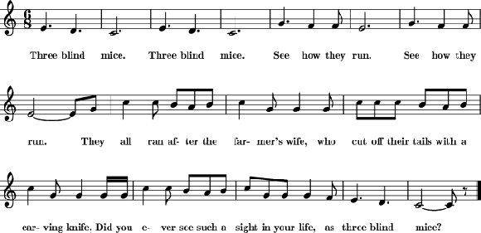
Notes:
Here is a well-known nursery rhyme:
One way of looking for patterns is to ask students these questions about the words.
* Is there any grouping?
* Is there any repetition?
* Is there any repetition with variation?
What do you notice?
Now look at the notes (do not try to sing them). What patterns do you see now?
Now sing the song. Do you notice any further patterns?
When you have finished puzzling over these questions, look at A Pattern Analysis of 'Three Blind Mice'.
Then repeat the exercise with other children's songs, such as 'Frère Jacques' or 'Hot Cross Buns'.

Slide 10

© mouse
by Helm42 2015-02-04
Notes:
Review and/or distribute the pattern analysis of ‘The Three Blind Mice’.
Click on a mouse to download the patterns analysis sheet.

Slide 11
The words
The pattern in the words can be analysed as
A1–A1–A2–A2–B1–B2–B3–A1, where:
A1 = “Three blind mice”
A2 = “See how they run”
B1 = “They all ran after the farmer’s wife”
B2 = “who cut off their tails with a carving knife”
B3 = “Did you ever see such a sight in your life”
A1 and A2 are similar in that they are both short and repeated. B1, B2, and B3 are similar in that they are all the same length (but linger than A1 and A2), show a similar (but not identical) rhythm, and rhyme (wife-knife-life).
Notes:
Review and/or distribute the pattern analysis of ‘The Three Blind Mice’.
Click on a mouse to download the patterns analysis sheet.

Slide 12
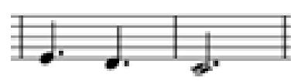

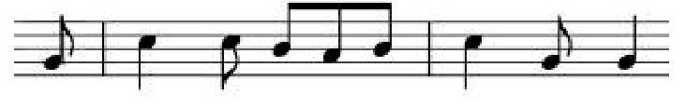
The notes
The visual pattern in the notes can be analysed as C1–C1–C2–C2–D–D–D–C1, where:
C1 =
C2 =
D =
C2 has the same falling pattern as C1, but it is higher and has a slightly different rhythm. The three repetitions of D are all slightly different in order to fit the words, but not different enough to warrant different numbering.

Slide 13
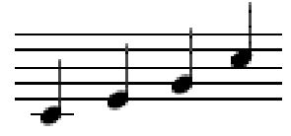
The music
When you sing the song, you will notice that it is rather static: it all revolves around four notes.
These notes form a major chord, a basic structure in Western music.
Because of its structure, ‘Three Blind Mice’ can be easily sung as a round by four people or groups of people.
Try it!
Notes:
These notes form a major chord, a basic structure in Western music. (play then on the piano, separately and then together, if you do not know this term). Because of its structure, ‘Three Blind Mice’ can be easily sung as a round by four people or groups of people: one group starts at the beginning and repeats the song as often as they like. The second group also starts at the beginning but waits until the first group has sung “Three blind mice” twice; and so on with the other two groups. Although the four groups are singing different music, it all fits together to make a pleasant harmonic whole. Try it!

Slide 14

MC: Look and Listen
MC: Missing Monsters
MC: Making Patterns
Patterns around us
Musical number patterns: musical counter
Musical number patterns: music maker
Notes:
Scootle has a number of resources that reinforce the concept that patterns are everywhere.
If time allows, have participants explore some or all of the Scootle resources. They may like to make a note of these to include in their future lesson planning. Participants will need to enter their login details to access the resources.
This activity will require each participant to have their own device or be in a computer lab. A good follow-up might be to discuss the merits of each and how they might be used in the classroom.

Slide 15
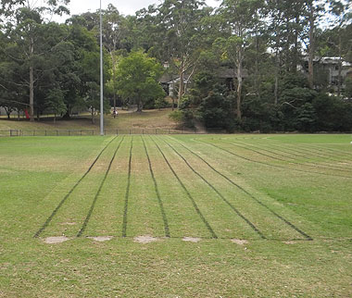
TDT Sports Day activity
Notes:
Explore the TDT Sports Day activity to help explain that patterns can be found everywhere.
School events frequently contain patterns. Finding repeating and other patterns in an upcoming sports day could make a splendid whole-school project. Activities can be designed that are suitable for children of all ages.
Here are some questions students might explore.
How often does your school hold a sports day? Do these dates form a repeating pattern?
Does your school sports day have a sack race? If so, how does the movement of each competitor make a repeating pattern?
Look at the running lanes for a 100 m race. How are they designed? How do they form a repeating pattern?
Look at the running lanes for a 400 m race. What pattern do they form?
Look at the best results for a race that is run by different year groups (e.g. times for a 50 m race in years 1–6). Do these numbers form a pattern? If so, describe the pattern.
Find the number of points won by each house or year group. Do these numbers form a pattern? If so, describe the pattern.

Slide 16

View the ABC Splash video What Comes Next In Line?
Click here to view
Notes:
Splash ABC has a video which explores patterns at Year Level F-1.
Dodly and Flynn find out what a pattern is, and look at different patterns around them. They work out what comes next by continuing the patterns. They make and continue patterns with fruit, shells, steps and singing.
Teachers of students in these year levels could use this video and work through the following:
Before Viewing
What is a pattern? Can you find some patterns around you? Why is each a pattern?
As You View
Look at the patterns found. Can you continue each pattern? Dodly’s first pattern is pineapple, coconut, pineapple, coconut, pineapple, coconut. What goes next? What is repeated?
After Viewing
Talk about the patterns found in the clip. Can you continue each pattern?
Can you make a colour pattern?
Can you make a fruit pattern? How about a stepping pattern or a singing pattern?
Next Steps
Find some patterns around you. Draw the patterns and try to continue the patterns by working out what comes next.
Use coloured blocks to make your patterns snake. Then draw the snake. Can others work out your pattern? Do they know what comes next?

Slide 17
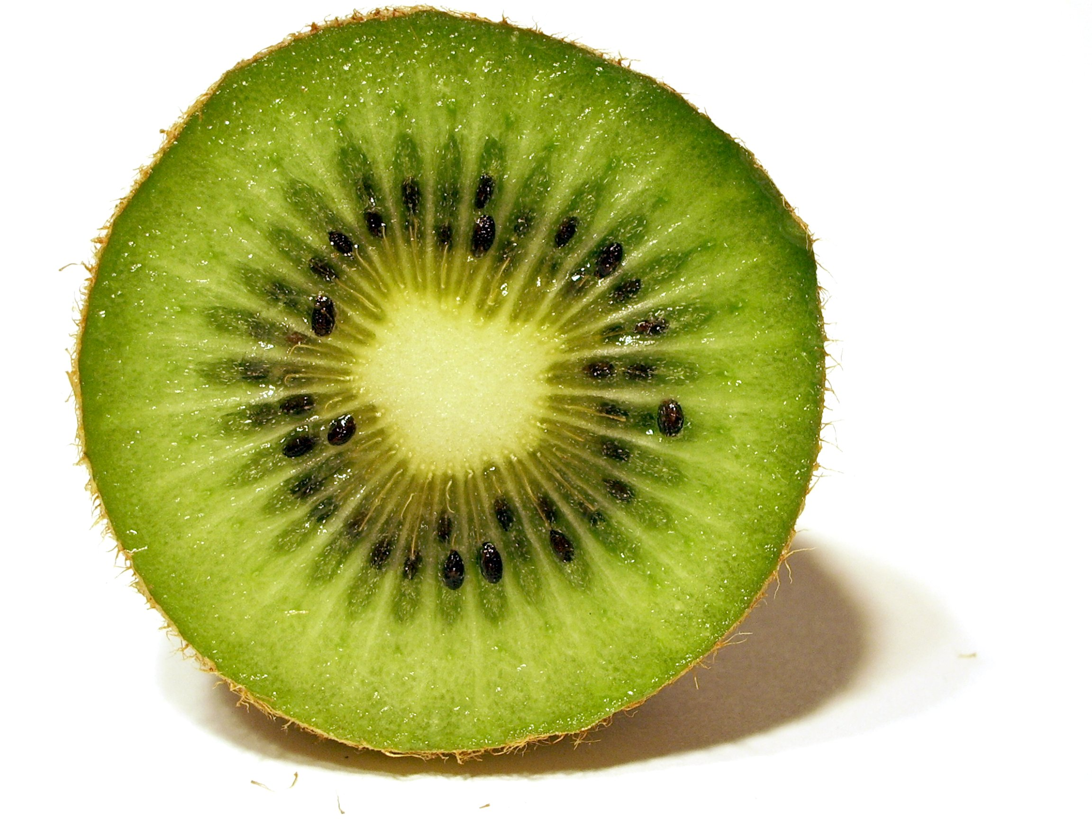
© Nicolas Marchildon
Notes:
Patterns can be found in artworks too. Identify and describe patterns in the following images. All images are sourced from openphoto.net under a Creative Commons license
M. C. Escher’s Day and Night image is also another good image but is not licensed to be used.

Slide 18

© Dani
Notes:
Patterns can be found in artworks too. Identify and describe patterns in the following images. All images are sourced from openphoto.net under a Creative Commons license
M. C. Escher’s Day and Night image is also another good image but is not licensed to be used.

Slide 19

© Sarah Klockars-Clauser
Notes:
Patterns can be found in artworks too. Identify and describe patterns in the following images. All images are sourced from openphoto.net under a Creative Commons license
M. C. Escher’s Day and Night image is also another good image but is not licensed to be used.

Slide 20
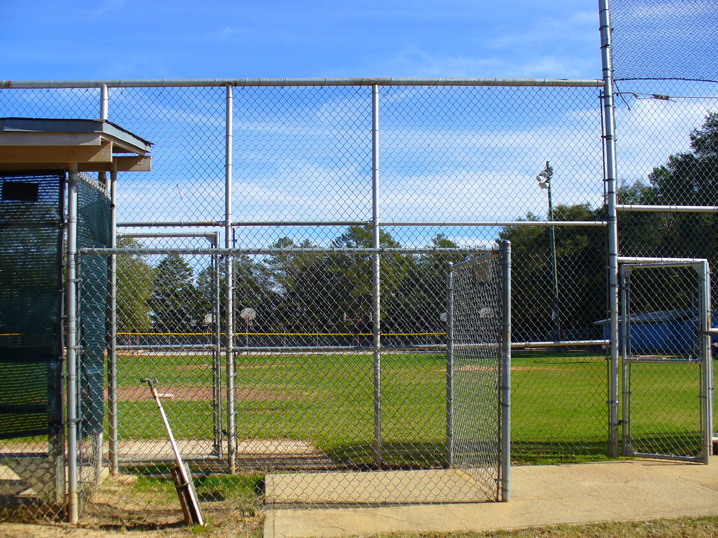
© Wolfgang Palmer
Notes:
Patterns can be found in artworks too. Identify and describe patterns in the following images. All images are sourced from openphoto.net under a Creative Commons license
M. C. Escher’s Day and Night image is also another good image but is not licensed to be used.

Slide 21
Focus question
In what ways can we build learners knowledge and experiences that lead them to recognise that patterns are everywhere?
Notes:
Now that you have completed this module, consider this question that was posed to you at the beginning. Either in small groups or as a whole share your thoughts, ideas and wonderings with each other in beginning to answer this questions.

Slide 22
Acknowledgements for Top Drawer Patterns
The Patterns drawer was written by a team from the Faculty of Human Sciences, Macquarie University led by A/Prof. Michael Mitchelmore, School of Education.
The Patterns drawer is an outcome of the extensive research into the role of pattern and structure in early mathematics learning carried out at Macquarie University over the past ten years by Mulligan, Papic, Mitchelmore and others.
A/Prof. Michael Mitchelmore and A/Prof. Joanne Mulligan, School of Education, were responsible for the conceptual design of the drawer. Michael wrote most of the material, assisted by Joanne and colleagues Dr Kate Highfield, Institute of Early Childhood, Ms Jennie Marston, School of Education and Dr Kristy Goodwin, Director, Every Chance to Learn, Sydney.

Slide 23
© The Australian Association of Mathematics Teachers (AAMT) Inc. 2017 This work is licensed under a Creative Commons Attribution-NonCommercial-NoDerivatives 4.0 International License (CC BY-NC-ND 4.0) except where otherwise indicated. See https://creativecommons.org/licenses/by-nc-nd/4.0/
Top Drawer Teachers © Education Services Australia Ltd & The Australian Association of Mathematics Teachers (AAMT) Inc. 2013
Australian Professional Standards for Teachers © Australian Institute for Teaching and School Leadership Limited (AITSL) 2013
Australian Curriculum © Australian Curriculum, Assessment and Reporting Authority (ACARA) 2010 to present

