Slide 1
Working with Top Drawer Teachers:
The big ideas of patterns
Module 2: Mathematical patterns are regular
Developed by D. Samojlowicz

Slide 2
Big idea: Mathematical patterns are regular
Module overview
It should take 45 minutes to 1 hour to complete this module.
    AITSL Standards
    Syllabus Reference
    Good Teaching
      Familiar situations
    Activities and Resources

Slide 3
AITSL standards
Standard 1: Know students and how they learn
1.2 Understand how students learn
Standard 2: Know the content and how to teach it
2.1 Content and teaching strategies of the teaching area
2.5 Literacy and numeracy strategies
Standard 6: Engage in professional learning
6.2 Engage in professional learning and improve practice

Slide 4
Australian Curriculum
Patterns and their applications in the
Australian Curriculum: Mathematics
Number and Algebra | Measurement and Geometry | Statistics and Probability
Number and place value (F–8) | Using units of measurement (F–10) | Chance (1–10)
Fractions and decimals (1–6) | Shape (F–7) | Data representation and interpretation (F–10)
Real numbers (7–10) | Geometric reasoning (3–10) | N/A
Money and financial mathematics (1–10) | Location and transformation (F–7) | N/A
Patterns and algebra (F–10) | Pythagoras and trigonometry (9–10) | N/A
Linear and non-linear relationships (7–10) | N/A | N/A
Source: Australian Curriculum: Mathematics
Notes:
Big ideas
Patterns and algebra is a substrand of the Number and Algebra strand of the Australian Curriculum: Mathematics. However, patterning ideas arise in other substrands of this strand, and also in the Measurement and Geometry and the Statistics and Probability strands. Many of the substrands can be approached from the ideas of patterns. You can look at a list of content descriptions from the Foundation year through to year 3 in Patterns and their Applications in the Australian Curriculum: Mathematics.
Review and/or distribute the Australian Curriculum: Mathematics document that contain reference to patterns or in which a pattern approach can be usefully applied.

Slide 5
5 big ideas in the Patterns drawer
    Patterns are everywhere
    Mathematical patterns are regular
    Repeating patterns
    Growing patterns
    Patterns in shapes
Notes:
Big ideas
We are going to look at the big ideas of patterns that thread through the various substrands of the curriculum. The big ideas included in the Patterns drawer embrace a large proportion of the separate content descriptions for each year level. So each big idea helps in thinking about many topics in the curriculum.
Focussing on the big ideas can also help integrate the different strands. In particular, patterns can link many ideas in number and geometry.

Slide 6
Focus question
Mathematical patterns are regular.
In what ways can we describe regularity?
Notes:
In mathematics, we are interested in regular patterns. There must be some rule telling us 'how it goes' — otherwise, it is not mathematics.
Have participants consider this question both now and as they progress through the module.
Have a discussion about the types of regular patterns that the participants already know about.
This question will be asked at the end of the module for participants to share how their thoughts and ideas have progressed.

Slide 7

Image licensed under
Creative Commons CC0.
Notes:
All the patterns in this resource are mathematical. That means that they all have some kind of regularity. The patterns can always be described in words, using terms such as:
Made of
Identical
Repeat
Always
In other words, there must be some rule describing how the pattern is constructed. These terms describe the structure of the pattern.
For example, what is the structure of this brick wall?
It is made of alternating rows of short and long bricks. None of the gaps in consecutive rows align. This is the rule the bricklayer follows in constructing the wall.
There is usually some reason for the regularity in a pattern. For example, if each gap in each row were directly above a gap in the row below, gaps would align right down the wall and the wall would be very weak.
There is a basic human need to look for patterns. All cultures have invented stories to describe the shapes made by the stars in the night sky. But these stories do not describe any mathematical regularity. The mathematical structure of the universe is described by the complex scientific theories that astronomers have developed, but these are based on patterns that are difficult to see.

Slide 8

Image licensed under Creative Commons Zero
Notes:
Using the TDT pictures in Find the Regularity, describe the patterns and the reason for the patterns.
Click on the picture to download the explanations of the three patterns shown: Footprints, Ladder and Stars.

Slide 9
Description
A person has left a track
of footprints in the sand, forming a repeating left-right zig-zag pattern.
The distance between successive footprints in approximately constant.
Image licensed under Creative Commons Zero
Notes:
Using the TDT pictures in Find the Regularity, describe the patterns and the reason for the patterns.
Click on the picture to download the explanations of the three patterns shown: Footprints, Ladder and Stars.

Slide 10
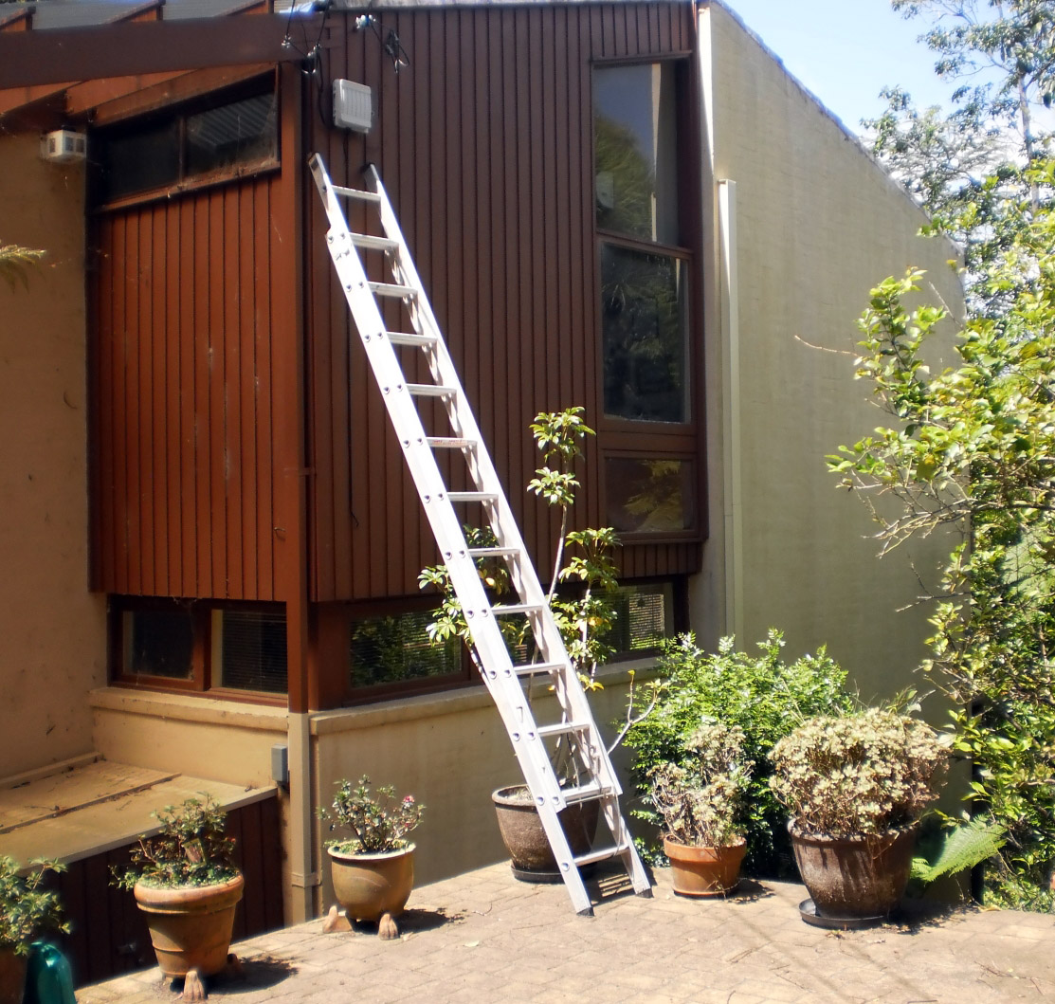

Slide 11
Description
The two sides of the ladder are the same length. The rungs of
the ladder are also all the same length and
are equally spaced.
Notes:
Explanation
The two sides of the ladder are the same length so that it can stand upright. The rungs are all the same length because the same person has to fit at different places on the ladder. The rungs are equally spaced because a person would expect to make equal steps up the ladder.
In sorter ladders, the rungs are often made longer at the bottom than the top. This adds to the stability of the ladder.

Slide 12
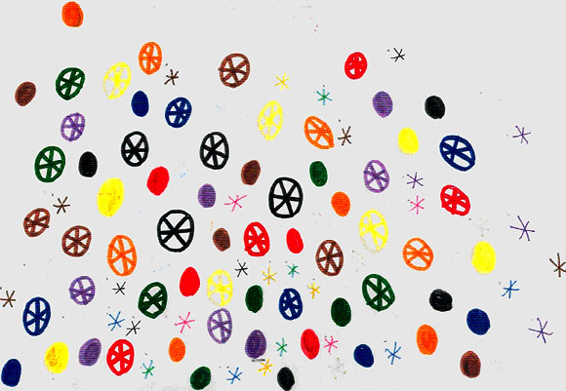
Notes:
Can you see the pattern?

Slide 13
Description
Jane was surprised that the teacher could not see the pattern in her drawing.
Notes:
Can you see the pattern?

Slide 14
Description
She said: “My pattern
—can’t you see it’s a system? Circles, then stars, then wheels. The stars are in the wheels; the wheels are in the circles. I did them four times each, one thing at
a time in eight different colours (3 x 4 x 8 colours). There must
be the same number of circles, stars, wheels.”
Notes:
Can you see the pattern?

Slide 15

Big Idea: Mathematical Patterns are Regular
A brick wall
Image licensed under Creative Commons CC0.
A wooden fence
Source: faukto_digit. Licensed under a Creative-Commons Attribution 2.0 Generic
(CC BY 2.0).
Notes:
Repeating patterns in the environment
Here are two examples of patterns students might find on a pattern hunt.
Both are spatial repeating patterns (Patterns Module 4)
Drawings of such patterns use the same understanding needed to draw rectangular grids.
Students may comment only on the pattern in one direction, for example, describing the wall in the first image as "small brick, big brick, repeated"; others may recognise it as repeating in two dimensions and forming a tessellation.
Such examples provide an excellent context for introducing more advanced language.
The most important term is congruent which is equivalent to saying that a repeating pattern has identical units of repeat.
Other useful terms are rectangle and parallel.
Most repeating patterns in the environment occur in manufactured objects.
Some examples are tiles, pavers, windows, zebra crossings and railway lines.
Such objects are generally assembled from units that are very nearly identical.
They can readily be modelled using cardboard cut-outs and represented digitally using software such as Pattern Blocks.

Slide 16

Notes:
View the online Skwirk resource (by clicking on the Skwirk image) which demonstrates an even number pattern increasing by 2. The second number pattern is a decreasing pattern, going down by twos.
Now try a few number patterns yourself using the Hundreds Square on the next slide.

Slide 17
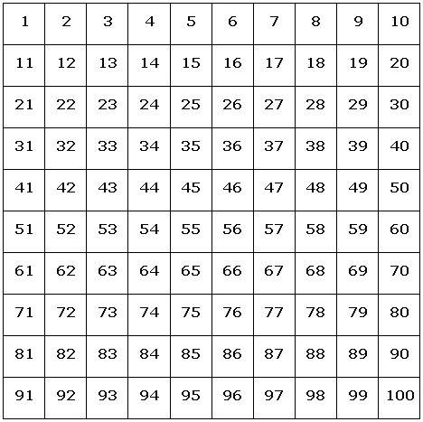
Notes:
A hundred square
Every student should be familiar with the hundred square. There may be one hanging up in the classroom. There are many revealing patterns to be found in it.
Give each participant a hundred square and a supply of counters.
Ask them to count by fives (5, 10, 15…) placing a counter on each number in turn. What pattern do these counters make? Why? Focus on the ones or units digit.
Ask participants to predict the pattern they would get if they counted by tens. Confirm the pattern and explain it, focussing on the tens digit.
Repeat, counting by twos and perhaps by threes, fours or nines.
Extend the above tasks by starting at an arbitrary number (e.g. start at 6 and count by 10).
Classroom Application
Through these tasks, students will strengthen their knowledge of place value and their addition skills. To assess their understanding, repeat the tasks using a blank hundred square.
Advanced students could be challenged to find similar patterns in a calendar.

Slide 18
Focus question
Mathematical patterns are regular.
In what ways can we describe regularity?
Notes:
Now that you have nearly completed this module, consider this question that was posed to you at the beginning. Either in small groups or as a whole share your thoughts, ideas and wonderings with each other in beginning to answer this questions.

Slide 19
Acknowledgements for the Top Drawer Patterns
The Patterns drawer was written by a team from the Faculty of Human Sciences, Macquarie University led by A/Prof. Michael Mitchelmore, School of Education.
The Patterns drawer is an outcome of the extensive research into the role of pattern and structure in early mathematics learning carried out at Macquarie University over the past ten years by Mulligan, Papic, Mitchelmore and others.
A/Prof. Michael Mitchelmore and A/Prof. Joanne Mulligan, School of Education, were responsible for the conceptual design of the drawer. Michael wrote most of the material, assisted by Joanne and colleagues Dr Kate Highfield, Institute of Early Childhood, Ms Jennie Marston, School of Education and Dr Kristy Goodwin, Director, Every Chance to Learn, Sydney.

Slide 20
© The Australian Association of Mathematics Teachers (AAMT) Inc. 2017
This work is licensed under a Creative Commons Attribution-NonCommercial-NoDerivatives 4.0 International License (CC BY-NC-ND 4.0) except where otherwise indicated. See https://creativecommons.org/licenses/by-nc-nd/4.0/
Top Drawer Teachers
© Education Services Australia Ltd & The Australian Association of Mathematics Teachers (AAMT) Inc. 2013
Australian Professional Standards for Teachers
© Australian Institute for Teaching and School Leadership Limited (AITSL) 2013
Australian Curriculum
© Australian Curriculum, Assessment and Reporting Authority (ACARA) 2010 to present

