Slide 1
Working with Top Drawer Teachers: The big ideas of patterns
Module 3 of 5: Repeating patterns
Developed by D. Samojlowicz

Slide 2
Big idea: Repeating patterns
Module overview
It should take 45 minutes to 1 hour to complete this module.
AITSL Standards
Syllabus Reference
Good Teaching
Familiar situations
Activities and Resources

Slide 3
AITSL standards
Standard 1: Know students and how they learn
1.2 Understand how students learn
Standard 2: Know the content and how to teach it
2.1 Content and teaching strategies of the teaching area
2.5 Literacy and numeracy strategies
Standard 6: Engage in professional learning
6.2 Engage in professional learning and improve practice

Slide 4
Australian curriculum
Patterns and their applications in the Australian Curriculum: Mathematics
Number and Algebra | Measurement and Geometry | Statistics and Probability
Number and place value (F–8) | Using units of measurement (F–10) | Chance (1–10)
Fractions and decimals (1–6) | Shape (F–7) | Data representation and interpretation (F–10)
Real numbers (7–10) | Geometric reasoning (3–10) | N/A
Money and financial mathematics (1–10) | Location and transformation (F–7) | N/A
Patterns and algebra (F–10) | Pythagoras and trigonometry (9–10) | N/A
Linear and non-linear relationships (7–10) | N/A | N/A
Source: Australian Curriculum: Mathematics
Notes:
Big ideas
Patterns and algebra is a substrand of the Number and Algebra strand of the Australian Curriculum: Mathematics. However, patterning ideas arise in other substrands of this strand, and also in the Measurement and Geometry and the Statistics and Probability strands. Many of the substrands can be approached from the ideas of patterns. You can look at a list of content descriptions from the Foundation year through to year 3 in Patterns and their Applications in the Australian Curriculum: Mathematics.
Review and/or distribute the Australian Curriculum: Mathematics document that contain reference to patterns or in which a pattern approach can be usefully applied.

Slide 5
5 big ideas in the Patterns Top Drawer
Patterns are everywhere
Mathematical patterns are regular
Repeating patterns
Growing patterns
Patterns in shapes
Notes:
Big ideas
We are going to look at the big ideas of patterns that thread through the various substrands of the curriculum. The big ideas included in the Patterns drawer embrace a large proportion of the separate content descriptions for each year level. So each big idea helps in thinking about many topics in the curriculum.
Focussing on the big ideas can also help integrate the different strands. In particular, patterns can link many ideas in number and geometry.

Slide 6
Focus question
Repeating and growing patterns are different. How can we move learners from additive thinking to multiplicative thinking?
Notes:
Repeating patterns are extremely important in early mathematics. In this type of pattern, there is a fixed unit of repeat.
Have participants consider this question both now and as they progress through the module.
Have a discussion about the types of repeating patterns that the participants already know about.
This question will be asked at the end of the module for participants to share how their thoughts and ideas have progress.

Slide 7
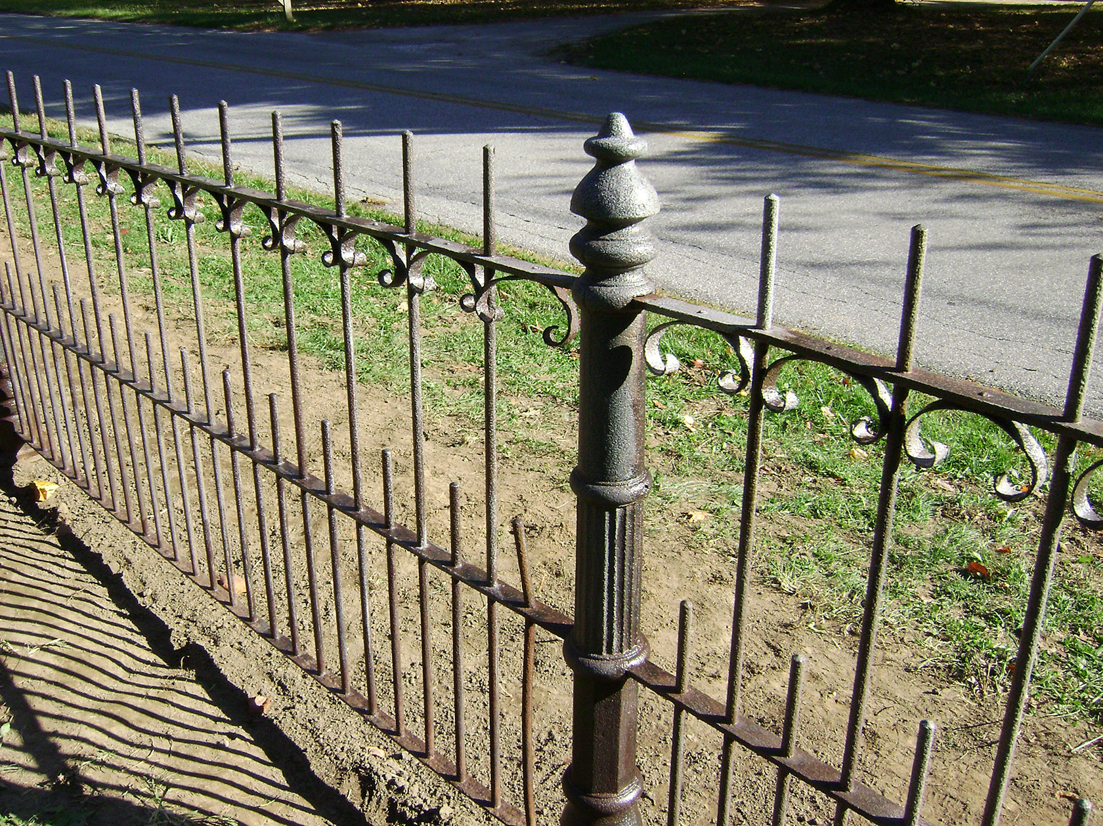
A wrought iron fence Source: NCPTT Media. Licensed under an Attribution-NonCommercial 2.0 Generic (CC BY-NC 2.0).
Notes:
Repeating patterns
Many patterns that students experience in early childhood are repeating patterns.
This fence is a one-dimensional repeating pattern, that is, the pattern repeats in one direction.
The essence of a repeating pattern is that it can be made by repeating a 'chunk' of the pattern.
This chunk is called a unit of repeat.
Can you find units of repeat for the fence?

Slide 8
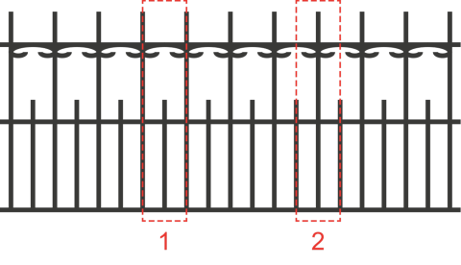
Notes:
One-dimensional repeating patterns
There is always more than one possible unit of repeat. There are usually one or two obvious possibilities but there are often many others that are less obvious. The only requirement is that the whole object (apart possibly from its edges) can be made by repeating the unit.
The fence is a one-dimensional repeating pattern.
Its basic structure is as follows:
Two possible units of repeat are outlined above, one obvious and one not so obvious.
In both cases, extra smaller pieces have to be added at both ends in order to make the complete fence

Slide 9
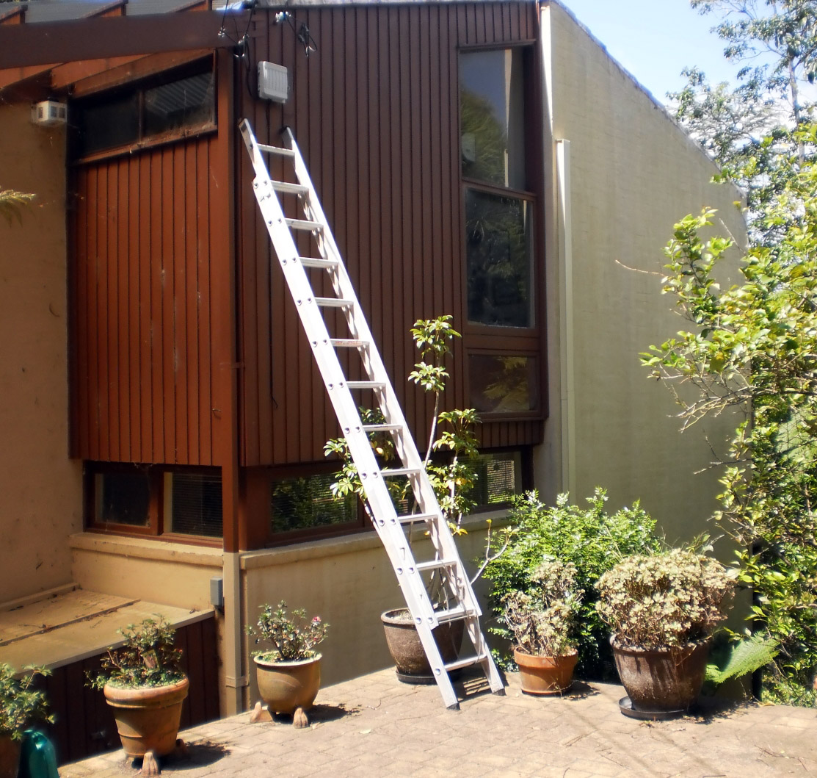
Notes:
The track of footprints shown was made by one person's right and left feet. A possible one-dimensional unit of repeat is one footprint plus the space before the next print made by the same foot.
The ladder shown is also a one-dimensional repeating pattern, made by repeating the rungs at a fixed spacing. Extra pieces are needed at the ends in order to complete the ladder.
(These images can also be found in Patterns Module 3 – Mathematical Patterns are Regular)

Slide 10

Image licensed under Creative Commons Zero
Notes:
The track of footprints shown was made by one person's right and left feet. A possible one-dimensional unit of repeat is one footprint plus the space before the next print made by the same foot.
The ladder shown is also a one-dimensional repeating pattern, made by repeating the rungs at a fixed spacing. Extra pieces are needed at the ends in order to complete the ladder.
(These images can also be found in Patterns Module 3 – Mathematical Patterns are Regular)

Slide 11
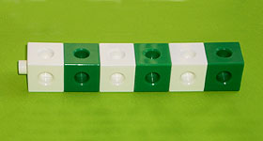
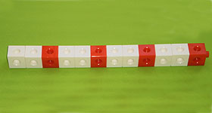
Notes:
Identical units of repeat
Repeating patterns can be used to introduce students to many concepts in the early mathematics curriculum, especially multiplication. However, students need to be able to find the unit of repeat in each pattern.
The idea can be introduced using 'trains' of interlocking cubes arranged in a row.

Slide 12
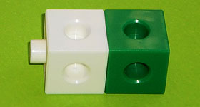
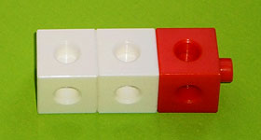
Notes:
These trains can be made using the following units of repeat.

Slide 13
A train of six cubes
A train of twelve cubes
A unit of repeat for the first train
A unit of repeat for the second train
Notes:
The first unit is repeated three times, and the second one is repeated four times.
Students can often copy or extend such patterns without being able to find a unit of repeat. For example, students often see the first pattern as 'alternating white and green' rather than 'white-green repeated'.
If students cannot readily identify units of repeat in one-dimensional patterns, then they may not be able to grasp the multiplication that is implicit in such patterns.

Slide 14
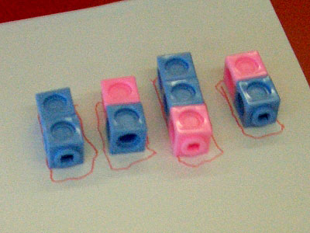
Notes:
Its harder than you think.
This example illustrates the difficulty some children have in finding a unit of repeat for a repeating pattern.
Sophie had great difficulty finding a unit of repeat for a blue-blue-pink train of cubes. This was her first attempt.

Slide 15
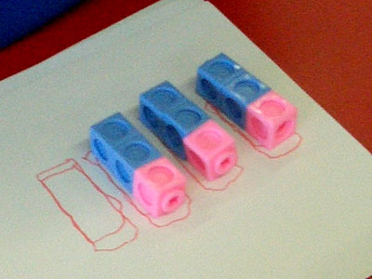
Notes:
After some help from her teacher and several attempts, she eventually managed to break the pattern into three identical units.
After several more examples like this, Sophie was able to confidently find a unit of repeat in complex repeating patterns of cubes. She was also able to draw these patterns and create her own repeating patterns using other materials.

Slide 16

An easy task
A more difficult task
Colour in the missing square in this repeating pattern.
Find the missing letters in this repeating pattern.
A B B ? A B ? ? A B ? C
Notes:
How do you teach the unit of repeat?
There are many ways to help students learn to identify the unit of repeat.
Here are some ways to help students learn to identify the unit of repeat in one-dimensional patterns.
Do not spend a long time making and drawing alternating AB patterns. The alternation often distracts students' attention away from the unit of repeat.
Use hands-on materials such as interlocking cubes. Patterns made from manipulable materials can be easily pulled apart and the pieces compared.
Use examples that have only complete units of repeat. But occasionally make a 'deliberate mistake' and see if students can spot what is wrong.
Ask students to make a repeating pattern using a unit of repeat that you have given them (or one they have created themselves).
Frequently ask students to use the unit of repeat to find the total 'length' of the pattern.
Challenge students to fill in the gaps in a repeating pattern where you have removed some of the pieces. These challenges can range from easy tasks to more difficult tasks.
Always stress that the unit of repeat must be identical throughout the pattern.

Slide 17
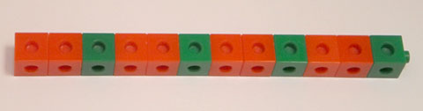
An AAB repeating pattern
Notes:
Repeating patterns and multiplication
Exploration of repeating patterns can form an easy introduction to some of the fundamental ideas of early mathematics.
Here is a very simple repeating pattern made from coloured blocks. It is called a 'train'.
By talking about this pattern, students can come up with the following ideas.
The number of blocks is 1, 2, 3; 4, 5, 6; 7, 8, 9; 10, 11, 12 (rhythmic counting).
The number of blocks is 3, 6, 9, 12 (skip counting).
There are 4 lots of 3 blocks, making 12 blocks in all.
Each unit of repeat is a quarter of the whole object.
After exploring many other similar trains, students could reach some more general ideas.
To find the number of blocks in a train, you multiply the number of blocks in the unit of repeat by the number of repetitions.
To find the number of repetitions needed to make a train of a given size, you divide the total number of blocks by the number of blocks in the unit of repeat.
A number is even if you can make a train with that number of blocks using a unit of repeat consisting of two blocks. If not, the number is odd.
Can you see any other general ideas here?

Slide 18
Notes:
Making border patterns.
Making a repeating pattern around a border is another way of teaching students the unit of repeat concept.
Making patterns around the border of a rectangle is a fun activity for young students, and it can teach them a lot about the unit of repeat.
Start by showing students this pattern, made from interlocking cubes.
After discussing how the pattern is made, give each student, or pair of students, 12 cubes (6 in one colour and 6 in another) and ask them to make a similar border pattern.
Now discuss the numbers.
How many cubes are there altogether?
How many are there of each colour?
Break the border into identical 'chunks'.
How many pieces are there in each chunk?
How many chunks are there?
This activity can be extended by giving students different-sized borders or different sets of cubes to make the border from. For example, you might ask them to make the same-sized border with 12 cubes in 3 different colours.
For more advanced students, pose hypothetical questions such as, "Is it possible to make a repeating pattern in a 3 × 4 border with a unit of repeat consisting of 3 cubes?"

Slide 19
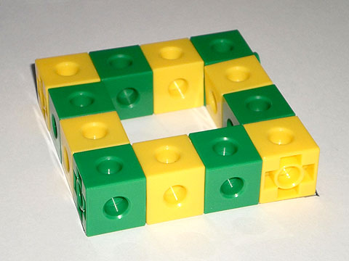
Notes:
Making border patterns.
Making a repeating pattern around a border is another way of teaching students the unit of repeat concept.
Making patterns around the border of a rectangle is a fun activity for young students, and it can teach them a lot about the unit of repeat.
Start by showing students this pattern, made from interlocking cubes.
After discussing how the pattern is made, give each student, or pair of students, 12 cubes (6 in one colour and 6 in another) and ask them to make a similar border pattern.
Now discuss the numbers.
How many cubes are there altogether?
How many are there of each colour?
Break the border into identical 'chunks'.
How many pieces are there in each chunk?
How many chunks are there?
This activity can be extended by giving students different-sized borders or different sets of cubes to make the border from. For example, you might ask them to make the same-sized border with 12 cubes in 3 different colours.
For more advanced students, pose hypothetical questions such as, "Is it possible to make a repeating pattern in a 3 × 4 border with a unit of repeat consisting of 3 cubes?"

Slide 20
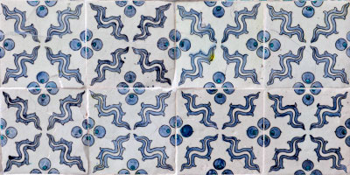
Patterned floor tiles Source: Getty/Pete Ryan
Notes:
Two-dimensional repeating patterns
These tiles form a two-dimensional repeating pattern, that is, the pattern repeats in two directions (both horizontally and vertically).
Like one-dimensional repeating patterns, two-dimensional repeating patterns always have more than one possible unit of repeat. There are usually one or two obvious possibilities, but there are often many others that are less obvious. The only requirement is that the whole object (apart possibly from its edges) can be made by repeating the unit.
The tiles in the image themselves form a unit of repeat, since all the tiles are identical (apart from minor variations). However, the tiles around the edge usually have to be cut to fit the actual floor.
The red square shows a possible unit of repeat. This unit is of particular interest, because the pattern in it is identical to the pattern on each tile.

Slide 21
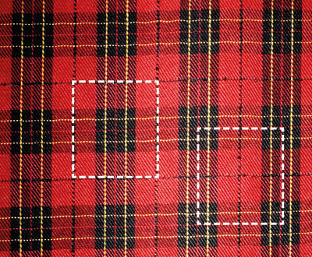
Two possible units of repeat Source: Getty/Arthur S. Aubry.
Notes:
This tartan is a two-dimensional repeating pattern.
Two possible units of repeat are the squares outlined by the dotted lines below.

Slide 22
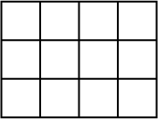
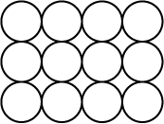
A rectangular grid of squares
A rectangular array of circles
Notes:
This idea can be explored further in Tessellations.
While some shapes fit together to make a two-dimensional repeating pattern that leaves no gaps, this is not possible for other shapes.
Compare how squares and circles fit together in a rectangular pattern.
A pattern of shapes that fit together without any gaps is called a tessellation. So squares form a tessellation (a rectangular grid), but circles do not.

Slide 23
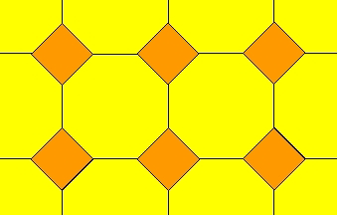
A tessellation of squares and octagons
Notes:
Tessellations can also be made from more than one shape, as long as they fit together with no gaps.
Through exploring how shapes fit together, students can learn much about those shapes. They can learn about the number and lengths of the sides of each shape, as well as the angles at the corners. They can also encounter concepts such symmetry, congruence, similarity and parallels.

Slide 24
Focus question
Repeating and growing patterns are different. How can we move learners from additive thinking to multiplicative thinking?
Notes:
Now that you have nearly completed this module, consider this question that was posed to you at the beginning. Either in small groups or as a whole share your thoughts, ideas and wonderings with each other in beginning to answer this questions.

Slide 25
Acknowledgements for Top Drawer Patterns
The Patterns drawer was written by a team from the Faculty of Human Sciences, Macquarie University led by A/Prof. Michael Mitchelmore, School of Education.
The Patterns Drawer is an outcome of the extensive research into the role of pattern and structure in early mathematics learning carried out at Macquarie University over the past ten years by Mulligan, Papic, Mitchelmore and others.
A/Prof. Michael Mitchelmore and A/Prof. Joanne Mulligan, School of Education, were responsible for the conceptual design of the drawer. Michael wrote most of the material, assisted by Joanne and colleagues Dr Kate Highfield, Institute of Early Childhood, Ms Jennie Marston, School of Education and Dr Kristy Goodwin, Director, Every Chance to Learn, Sydney.

Slide 26
© The Australian Association of Mathematics Teachers (AAMT) Inc. 2017 This work is licensed under a Creative Commons Attribution-NonCommercial-NoDerivatives 4.0 International License (CC BY-NC-ND 4.0) except where otherwise indicated. See https://creativecommons.org/licenses/by-nc-nd/4.0/
Top Drawer Teachers © Education Services Australia Ltd & The Australian Association of Mathematics Teachers (AAMT) Inc. 2013
Australian Professional Standards for Teachers © Australian Institute for Teaching and School Leadership Limited (AITSL) 2013
Australian Curriculum © Australian Curriculum, Assessment and Reporting Authority (ACARA) 2010 to present

