Slide 1
Working with Top Drawer Teachers:
The big ideas of patterns
Module 4 of 5: Growing patterns
Developed by D. Samojlowicz

Slide 2
Big idea: Growing patterns
Module overview
It should take 1 to 1.5 hours to complete this module.
    AITSL Standards
    Syllabus Reference
    Good Teaching
      Familiar situations
    Activities and Resources

Slide 3
AITSL standards
Standard 1: Know students and how they learn
  1.2 Understand how students learn
Standard 2: Know the content and how to teach it
  2.1 Content and teaching strategies of the teaching area
  2.5 Literacy and numeracy strategies
Standard 6: Engage in professional learning
  6.2 Engage in professional learning and improve practice

Slide 4
Australian curriculum
Patterns and their applications in the
Australian Curriculum: Mathematics
Number and Algebra | Measurement and Geometry | Statistics and Probability
Number and place value (F–8) | Using units of measurement (F–10) | Chance (1–10)
Fractions and decimals (1–6) | Shape (F–7) | Data representation and interpretation (F–10)
Real numbers (7–10) | Geometric reasoning (3–10) | N/A
Money and financial mathematics (1–10) | Location and transformation (F–7) | N/A
Patterns and algebra (F–10) | Pythagoras and trigonometry (9–10) | N/A
Linear and non-linear relationships (7–10) | N/A | N/A
Source: Australian Curriculum: Mathematics
Notes:
Big ideas
Patterns and algebra is a substrand of the Number and Algebra strand of the Australian Curriculum: Mathematics. However, patterning ideas arise in other substrands of this strand, and also in the Measurement and Geometry and the Statistics and Probability strands. Many of the substrands can be approached from the ideas of patterns. You can look at a list of content descriptions from the Foundation year through to year 3 in Patterns and their Applications in the Australian Curriculum: Mathematics.
Review and/or distribute the Australian Curriculum: Mathematics document that contain reference to patterns or in which a pattern approach can be usefully applied.

Slide 5
5 big ideas in the patterns drawer
    Patterns are everywhere
    Mathematical patterns are regular
    Repeating patterns
    Growing patterns
    Patterns in shapes
Notes:
Big ideas
We are going to look at the big ideas of patterns that thread through the various substrands of the curriculum. The big ideas included in the Patterns drawer embrace a large proportion of the separate content descriptions for each year level. So each big idea helps in thinking about many topics in the curriculum.
Focussing on the big ideas can also help integrate the different strands. In particular, patterns can link many ideas in number and geometry.

Slide 6
Focus question
Repeating and growing patterns are different. How can we move learners from additive thinking to multiplicative thinking?
Notes:
A growing pattern is made up of 'chunks', called terms, that change in a regular way.
Have participants consider this question both now and as they progress through the module.
Have a discussion about the types of growing patterns that the participants already know about.
This question will be asked at the end of the module for participants to share how their thoughts and ideas have progress.

Slide 7
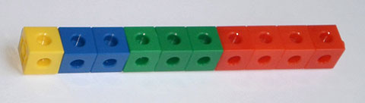
A growing pattern of cubes
Notes:
Growing patterns
The row of cubes is made from four chunks, each in a different colour. The lengths of these chunks are 1, 2, 3 and 4 cubes. We expect the next chunk to have 5 cubes, and so on. This is a regular pattern because the chunks get bigger by 1 each time.
The row of cubes is an example of a growing pattern. In growing patterns, the chunks are called terms. There has to be a rule that tells you how each term is obtained.

Slide 8

Try this growing pattern activity
  Take a sheet of A3 paper
  and fold it in half
  Then fold it in half again
  and then again
Source: https://www.flickr.com/photos/71344537@N07/6455620021
Notes:
Growing patterns
Here is another, more complicated example. The standard paper size, A4, is only one in the international standard A-series of paper sizes.
These sizes form a growing pattern. (Although the sizes are getting smaller, it is still considered to be a growing pattern.)
Each term is a particular size of paper.
For each term, the length of each side is always √2 (approximately 1.414) times its width.
As a result, each size can be made by folding the previous size in half. Because of this rule, it is possible to continue the series as far as you like.
There is further information about international standard paper and envelope sizes on Wikipedia.

Slide 9
  Measure the sides each time you fold
  Record in a table
  What patterns can
  you see?
Source: https://www.flickr.com/photos/71344537@N07/6455620021
Notes:
Growing patterns
Here is another, more complicated example. The standard paper size, A4, is only one in the international standard A-series of paper sizes.
These sizes form a growing pattern. (Although the sizes are getting smaller, it is still considered to be a growing pattern.)
Each term is a particular size of paper.
For each term, the length of each side is always √2 (approximately 1.414) times its width.
As a result, each size can be made by folding the previous size in half. Because of this rule, it is possible to continue the series as far as you like.
There is further information about international standard paper and envelope sizes on Wikipedia.

Slide 10
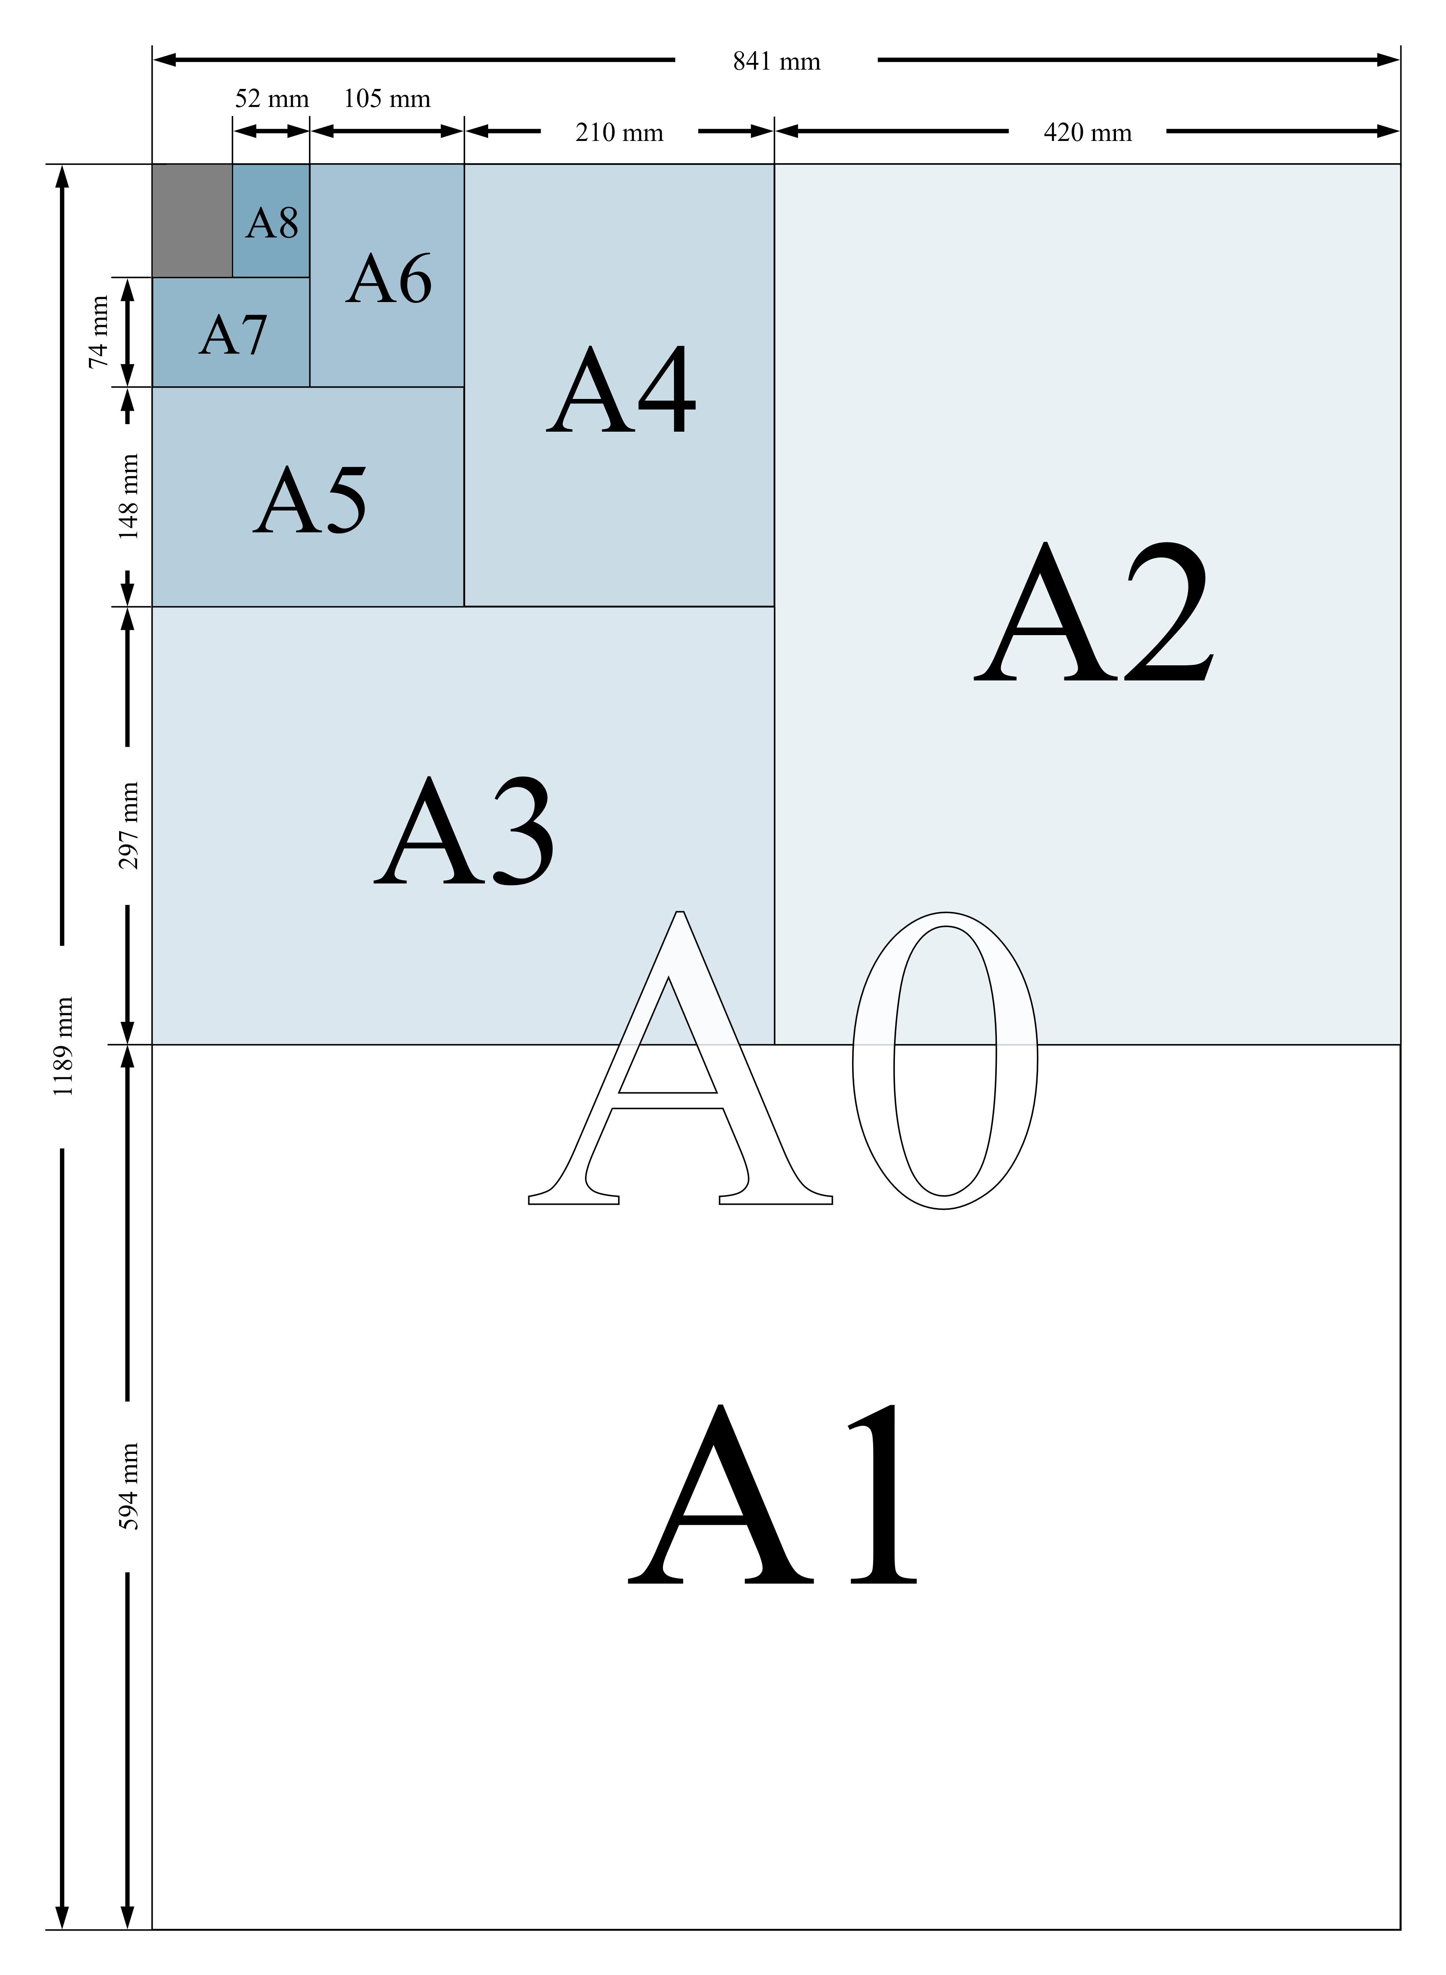
Source: https://upload.wikimedia.org/wikipedia/commons/1/16/A_size_illustration2.svg
Notes:
Growing patterns
Here is another, more complicated example. The standard paper size, A4, is only one in the international standard A-series of paper sizes.
These sizes form a growing pattern. (Although the sizes are getting smaller, it is still considered to be a growing pattern.)
Each term is a particular size of paper.
For each term, the length of each side is always √2 (approximately 1.414) times its width.
As a result, each size can be made by folding the previous size in half. Because of this rule, it is possible to continue the series as far as you like.
There is further information about international standard paper and envelope sizes on Wikipedia.

Slide 11
Size | Dimensions (mm)
A0 | 841 x 1189
A1 | 594 x 841
A2 | 420 x 594
A3 | 297 x 420
A4 | 210 x 297
A5 | 148 x 210
Notes:
Growing patterns
Here is another, more complicated example. The standard paper size, A4, is only one in the international standard A-series of paper sizes.
These sizes form a growing pattern. (Although the sizes are getting smaller, it is still considered to be a growing pattern.)
Each term is a particular size of paper.
For each term, the length of each side is always √2 (approximately 1.414) times its width.
As a result, each size can be made by folding the previous size in half. Because of this rule, it is possible to continue the series as far as you like.
There is further information about international standard paper and envelope sizes on Wikipedia.

Slide 12
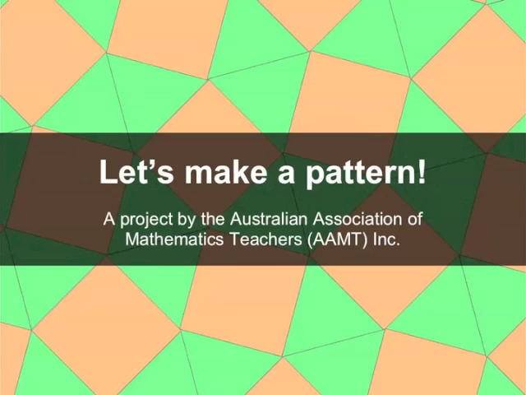
Notes:
Show participants the video Let's Make a Pattern! This video shows how a pattern can be constructed by adding successive 'rings' of pattern blocks around a central block.
Notice how this activity combines ideas of tessellations (using triangles and squares from a set of pattern blocks) and growing patterns.
Ask students to repeat the same construction, and reconsider the questions asked in the video.
You can use this slide show version of Let's Make a Pattern! to guide the discussion.
Now challenge students to use the same idea to make their own growing patterns, using either real pattern blocks or digital versions of pattern blocks.
They could use a single pattern block, any pair of blocks (as in the video), or even three blocks. Display the most creative patterns.
You might also like to try the Tessellate decorate series of learning objects:
L7782 Tessellate decorate: squares
L7781 Tessellate decorate: rectangles
L7785 Tessellate decorate: rhombuses
L7787 Tessellate decorate: trapeziums
L7783 Tessellate decorate: equilateral triangles
L7784 Tessellate decorate: hexagons and triangles
L7788 Tessellate decorate: three shapes
L7786 Tessellate decorate: right-angled triangles

Slide 13
Try working through the growing pattern activity yourself.
  How do the shapes and angles fit together?
  Predict what might the students in your class do.
  How could this activity be extended into the
  older grades?
Notes:
Try working through the growing pattern activity yourself.
How do the shapes and angles fit together?
Predict what might the students in your class do.
How could this activity be extended into the older grades?

Slide 14
Start with an equilateral triangle.

Slide 15
Then put a square on each side.

Slide 16
Now fill in the gaps with triangles.

Slide 17
Look at the pattern around the middle triangle.

Slide 18
It goes

Slide 19
then

Slide 20
and again.

Slide 21
There are three lots of .
Why are there three?

Slide 22
Because there are three sides to the triangle!

Slide 23
How many pieces are there in this ring?

Slide 24
How many pieces are there in this ring?
9
8
9
7
1
3
6
2
5
4
3
6

Slide 25
In this ring, there are 9 pieces: 3 lots of 3.
9
8
9
7
1
3
6
2
5
4
3
6

Slide 26
Now let’s try another ring around this pattern.
9
3
6

Slide 27
Put squares on the sides of the triangles.

Slide 28
Then put triangles on the squares.

Slide 29
Now fill in the gaps with triangles.

Slide 30
What is the pattern in this ring?

Slide 31
There are three lots of .

Slide 32
How many pieces are there in this ring?
18
6
12

Slide 33
There are 18 pieces: 3 lots of 6.
18
6
12

Slide 34
There were 9 pieces in the first ring,
18
6
12

Slide 35
and 18 pieces in the second ring.

Slide 36
How many pieces will there be in the next ring?

Slide 37
Have a think about that.
Let’s look at something else.

Slide 38
Look at how the pieces fit together at each point in the pattern.

Slide 39
Everywhere you look, two squares and three triangles fit around a point.

Slide 40
Can you find any more patterns?

Slide 41
Let’s Make a Pattern!
Concept: Michael Mitchelmore
Realisation: Julia Mitchelmore
© AAMT 2012

Slide 42
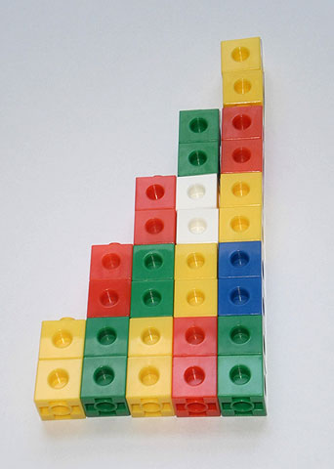
A staircase pattern
Notes:
Making a staircase
The following activity can be used to introduce the idea of a growing pattern. At the same time, it can reinforce students’ understanding of a rectangular grid.
Ask students to make pairs of interlocking cubes of the same colour, and then assemble them into this 'staircase' pattern.
Students should then draw the staircase, firstly from the model and then from memory. Students' drawings will show their understanding of the growth pattern (2, 4, 6, 8, 10). For example, some students may not place the various columns of their staircase on a common baseline.
Link the staircase to ideas of multiplication (e.g. 4 groups of 2 make 8).
You can extend this activity by asking students to continue the staircase by making it come down again in the same pattern (with columns of 8, 6, 4 and 2 cubes). The continuation reveals further patterns (including symmetry).
It is also valuable to have students draw the staircase on large-scale grid paper (with 1 cm squares).

Slide 43
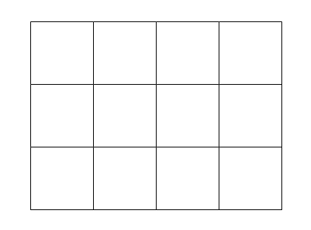
This rectangular
grid is filled with 12 identical squares, with no spaces between them.
Notes:
Rectangular Grids

Slide 44
That same rectangular grid can be seen as three rows of
four squares.
Notes:
Rectangular Grids

Slide 45
It can also be seen as four columns of three squares.
Notes:
Rectangular Grids

Slide 46
Some Year 1 students were given square tiles and asked to make a 3 x 4 rectangular grid, like this one, and then draw it.
Notes:
Rectangular Grids

Slide 47
They easily made the grid, but had difficulty drawing it. Here are some of their drawings.
Notes:
Ashah knew that the grid was made of squares and had some idea that they were arranged in rows, but she could not complete the pattern.
Bonny concentrated on the squares around the edge of the grid, but did not have the correct number of squares.
Only Con drew the structure correctly, but she drew each square separately instead of using straight lines to show the rows and columns.
These drawings are typical of young students. They suggest that many do not fully understand the row-column structure of the rectangular array. They may therefore have some difficulty understanding its use to illustrate multiplication, area or fractions.

Slide 48
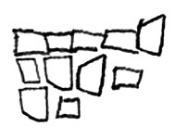
What elements has Ashah:
focussed on?
missed out on?
How could Ashah correct it?
Ashah’s drawing
Notes:
Ashah knew that the grid was made of squares and had some idea that they were arranged in rows, but she could not complete the pattern.
Bonny concentrated on the squares around the edge of the grid, but did not have the correct number of squares.
Only Con drew the structure correctly, but she drew each square separately instead of using straight lines to show the rows and columns.
These drawings are typical of young students. They suggest that many do not fully understand the row-column structure of the rectangular array. They may therefore have some difficulty understanding its use to illustrate multiplication, area or fractions.

Slide 49
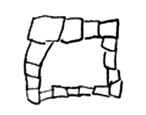
What elements has Bonney:
focussed on?
missed out on?
How could Bonney correct it?
Bonney’s drawing
Notes:
Ashah knew that the grid was made of squares and had some idea that they were arranged in rows, but she could not complete the pattern.
Bonny concentrated on the squares around the edge of the grid, but did not have the correct number of squares.
Only Con drew the structure correctly, but she drew each square separately instead of using straight lines to show the rows and columns.
These drawings are typical of young students. They suggest that many do not fully understand the row-column structure of the rectangular array. They may therefore have some difficulty understanding its use to illustrate multiplication, area or fractions.

Slide 50
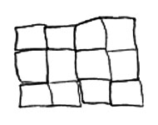
What elements has Con:
focussed on?
missed out on?
How could Con correct it?
Con’s drawing
Notes:
Ashah knew that the grid was made of squares and had some idea that they were arranged in rows, but she could not complete the pattern.
Bonny concentrated on the squares around the edge of the grid, but did not have the correct number of squares.
Only Con drew the structure correctly, but she drew each square separately instead of using straight lines to show the rows and columns.
These drawings are typical of young students. They suggest that many do not fully understand the row-column structure of the rectangular array. They may therefore have some difficulty understanding its use to illustrate multiplication, area or fractions.

Slide 51
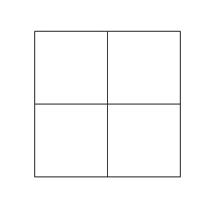
2 x 2 window
Notes:
Ashah knew that the grid was made of squares and had some idea that they were arranged in rows, but she could not complete the pattern.
Bonny concentrated on the squares around the edge of the grid, but did not have the correct number of squares.
Only Con drew the structure correctly, but she drew each square separately instead of using straight lines to show the rows and columns.
These drawings are typical of young students. They suggest that many do not fully understand the row-column structure of the rectangular array. They may therefore have some difficulty understanding its use to illustrate multiplication, area or fractions.

Slide 52
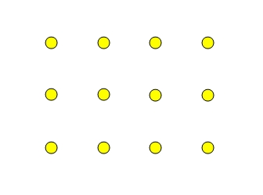
This is an array of dots; a 3 x 4 array.
Notes:
Rectangular Arrays
By studying rectangular arrays, students can also learn the structure of the rectangular grid pattern.
A rectangular array consists of a set of objects arranged in a similar way to a rectangular grid. It is one way of packing objects (e.g. eggs) efficiently.
Activities with arrays can help students understand the rectangular grid pattern. Here are some suggestions.
* Supply students with drawings of various rectangular arrays of black dots and coloured counters.
* Ask them to create their own colour patterns by placing the counters on the dots.
* Ask students to draw arrays of various sizes from memory.
* Supply students with drawings of various rectangular arrays of dots and ask them to count the number of dots in each array.
Then ask them to extend each array by one row and one column, and count the number of dots again.
Through such exercises, students will learn that the dots are aligned and equally spaced.
More advanced learners can be challenged to copy and extend a triangular grid pattern of dots.

Slide 53
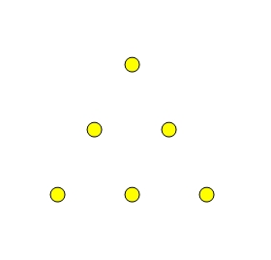
A triangular array
Notes:
More advanced learners can be challenged to copy and extend a triangular grid pattern of dots.

Slide 54
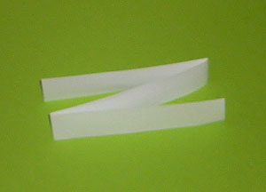
The strip folded into three equal parts.
Notes:
Growing Fractions
You can use patterns to illustrate simple fractions.
Each student will need at least three strips of paper about 2 cm wide and 30 cm long.
Ask students to divide one of their strips into two equal parts. How many folds were required? What is each part called?
Challenge students to divide another strip into three equal parts by folding. Expect a lot of trial and error. Students may come up with the idea of folding a 'Z snake'.

Slide 55
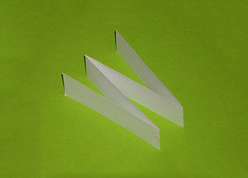
The strip folded into four equal parts.
Notes:
Repeat with folding into four equal parts. Encourage students to fold a 'W snake' rather than re-folding the halves.
Summarise and explain the patterns students observe.
* The parts in the strips are getting smaller.
* The number of parts and the number of folds both increase by one each time.
* The number of folds is always one less than the number of parts.
Ambitious students may continue the pattern to greater numbers of folds.
See Folding Patterns for another patterning activity involving fractions.

Slide 56
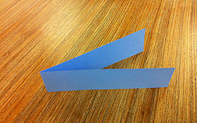
The strip folded
in two.
Notes:
Folding Patterns
Take a 30 cm long strip of paper and fold it in two.
Then unfold it and ask students: How many parts are there?
Point out that the two parts are the same size (because they match) so that each part is a half of the strip. Also count the number of folds.

Slide 57
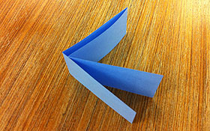
The strip folded
in two, twice.
Notes:
Folding Patterns
Take a 30 cm long strip of paper and fold it in two.
Then unfold it and ask students: How many parts are there?
Point out that the two parts are the same size (because they match) so that each part is a half of the strip. Also count the number of folds.

Slide 58
No. of times folded | No. of equal parts | Name of each part | No. of folds
1 | 2 | Half | 1
2 | 4 | Quarter | 3
3
4
Patterns in the table
Notes:
Now ask students to describe and explain the patterns in the table. You can download Patterns in the Table which gives a completed table and some discussion points.
Note especially the doubling pattern in the second column and the way in which unitary fractions are named.
Able students could be asked to predict the 10th row of the table.

Slide 59
Focus question
Repeating and growing patterns are different. How can we move learners from additive thinking to multiplicative thinking?
Notes:
A growing pattern is made up of 'chunks', called terms, that change in a regular way.
Have participants consider this question both now and as they progress through the module.
Have a discussion about the types of growing patterns that the participants already know about.
This question will be asked at the end of the module for participants to share how their thoughts and ideas have progress.

Slide 60
Acknowledgements for Top Drawer Patterns
The Patterns Drawer was written by a team from the Faculty of Human Sciences, Macquarie University led by A/Prof. Michael Mitchelmore, School of Education.
The Patterns Drawer is an outcome of the extensive research
into the role of pattern and structure in early mathematics learning carried out at Macquarie University over the past ten years by Mulligan, Papic, Mitchelmore and others.
A/Prof. Michael Mitchelmore and A/Prof. Joanne Mulligan, School of Education, were responsible for the conceptual design of the drawer. Michael wrote most of the material, assisted by Joanne and colleagues Dr Kate Highfield, Institute of Early Childhood,
Ms Jennie Marston, School of Education and Dr Kristy Goodwin, Director, Every Chance to Learn, Sydney.

Slide 61
© The Australian Association of Mathematics Teachers (AAMT) Inc. 2017
This work is licensed under a Creative Commons Attribution-NonCommercial-NoDerivatives 4.0 International License (CC BY-NC-ND 4.0) except where otherwise indicated. See https://creativecommons.org/licenses/by-nc-nd/4.0/
Top Drawer Teachers
© Education Services Australia Ltd & The Australian Association of Mathematics Teachers (AAMT) Inc. 2013
Australian Professional Standards for Teachers
© Australian Institute for Teaching and School Leadership Limited (AITSL) 2013
Australian Curriculum
© Australian Curriculum, Assessment and Reporting Authority (ACARA) 2010 to present

