Slide 1

Opening the Top Drawer to Reasoning
Big Ideas 1 & 2 – Same & Different and Visualisation
Foundation to Year 6
Designed and written by: L.Spohn BEd (Mathematics)

Slide 2

Big Ideas of Reasoning
Module Overview
It should take approximately one hour to complete this module.
Learning Outcomes
AITSL Standards
Australian Curriculum links
Activities and resources

Slide 3
Big Ideas of Reasoning
Learning Outcomes
• To explore the “Big Ideas of Reasoning” – Same and Different.
• Understand Same and Different in the context of reasoning and there connection to the Australian Curriculum.
• To explore activities to assist in the teaching of Same and Different.

Slide 4

The following AITSL Standards will be addressed:
Professional Knowledge
Standard 1: Know students and how they learn
1.2 Understand how students learn
Standard 2: Know the content and how to teach it
2.1 Content and teaching strategies of the teaching area
2.5 Literacy and numeracy strategies
Professional Practice
Standard 3: Plan for and implement effective teaching and learning
3.4 Select and use resources
Professional Engagement
Standard 6: Engage in professional learning
6.1 Identify and plan professional learning needs
6.2 Engage in professional learning and improve practice

Slide 5
Big Ideas of Reasoning
6 Big Ideas in the Reasoning Top Drawer
Same and Different (Foundation to Year 6)
Visualisation(Foundation to Year 6)
Mathematical Truth
IF-Then
Deduction
Proof
Notes:
Younger students first encounter mathematical reasoning through observing similarities and differences between objects. As they develop and practise various types of inductive and deductive thinking, they move towards more formal reasoning and the writing of proofs.
It is vital that students learn to think about what makes things the same and what makes them different.

Slide 6
Australian Curriculum Links
for Same & Different
Foundation Year:
Sort and classify familiar objects and explain the basis for these classifications. Copy, continue and create patterns with objects and drawings ACMNA005
Sort, describe and name familiar two-dimensional shapes and three-dimensional objects in the environment ACMMG009
Establish understanding of the language and processes of counting by naming numbers in sequences, initially to and from 20, moving from any starting point ACMNA001
Year 1:
Recognise and classify familiar two-dimensional shapes and three-dimensional objects using obvious features ACMMG022
Investigate and describe number patterns formed by skip counting and patterns with objects ACMNA018
Develop confidence with number sequences to and from 100 by ones from any starting point. Skip count by twos, fives and tens starting from zero ACMNA012
Notes:
Big Ideas
Reasoning descriptions are different in each Year level and are covered across the strands and substrands of the AC.
Here are the descriptions for Foundation to Year 2.

Slide 7
Australian Curriculum Links
for Same & Different
Year 2:
Describe and draw two-dimensional shapes, with and without digital technologies ACMMG042
Describe patterns with numbers and identify missing elements ACMNA035
Year 4:
Compare angles and classify them as equal to, greater than or less than a right angle ACMMG089
Investigate number sequences involving multiples of 3, 4, 6, 7, 8, and 9 ACMNA074
Year 5: Describe translations, reflections and rotations of two-dimensional shapes. Identify line and rotational symmetries ACMMG114
Describe, continue and create patterns with fractions, decimals and whole numbers resulting from addition and subtraction ACMNA107
Year 6: Continue and create sequences involving whole numbers, fractions and decimals. Describe the rule used to create the sequence ACMNA133
Notes:
Big Ideas
Reasoning descriptions are different in each Year level and are covered across the strands and substrands of the AC.
Here are the descriptions for Foundation to Year 2.

Slide 8


Big Idea: Same and Different
Focus Question:
When students are comparing and contrasting in mathematics, what are they likely to be doing?
http://www.magnifyingaids.com/Clocks
http://www.american-time.com/products-by-family/wall-clocks
Notes:
Here are some pictures for foundation students.

Slide 9
Big Idea: Same and Different
"What is the same?" "What is different?"
1 2 3 4
What do all these numbers have in common?
Write down as many as you can find.
What is different about each number?
You can put more than one property if you want.
Notes:
The use of the questions "What is the same?" and "What is different?" encourages mathematical reasoning.
It is vital that students learn to think about what makes things the same and what makes them different.
When comparing and contrasting, students are likely to be:
noticing and describing
explaining and justifying
thinking analytically
finding relationships
using logic
focussing on important features.
The next slide gives some ideas of what students may say

Slide 10
Big Idea: Same and Different
Students can compare and contrast with the use of:
Classification
Noticing and comparing properties of shapes
Imagining missing elements
Notes:
Here are some pictures for foundation students.

Slide 11
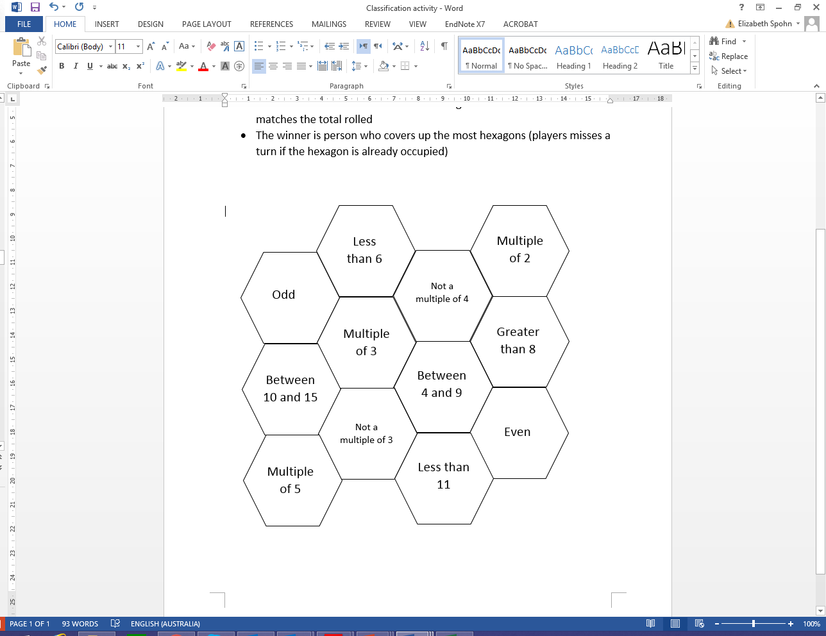
Big Idea: Same and Different
Classification Activity

Slide 12

Big Idea: Same and Different
Noticing and comparing properties of shapes
Consider the following shapes
What do all these shapes have in common?
Write down as many as you can find.
What is different about each shape?
Record more than property

Slide 13
Big Idea: Same and Different
Imagining missing elements
An important aspect of reasoning in mathematics is to find missing elements.
They are used to:
balance or solve equations
predict terms in number sequences or series and sequences
complete patterns, tables and arrays
solve problems.

Slide 14
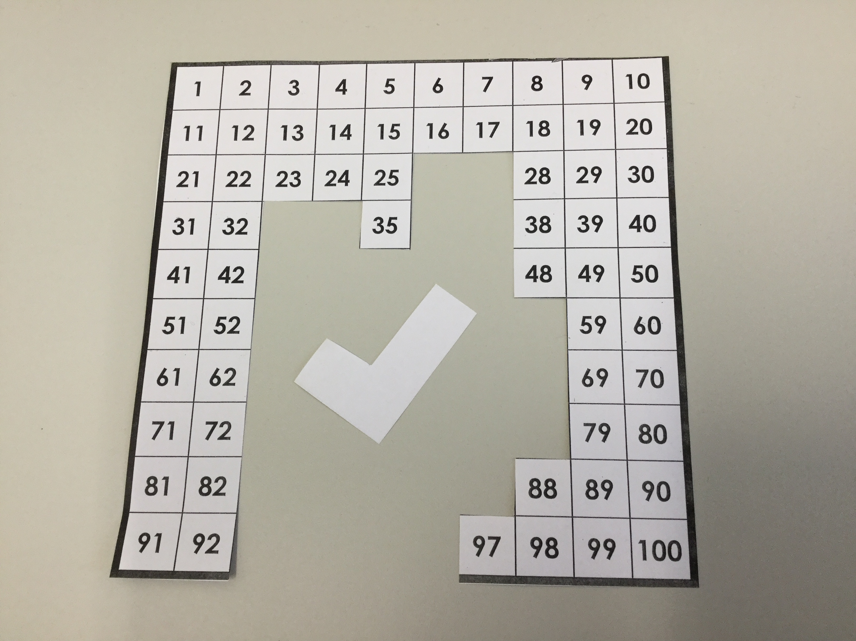
Big Idea: Same and Different
Imagining missing elements activity
What might the numbers on the cut out, “L shaped” piece be?
I know that one of the numbers is 65, what could the other numbers be?

Slide 15
Big Idea: Same and Different
Imagining missing elements activity
How might we provide an enabling prompt?
How might we provide an extending prompt?

Slide 16
Big Ideas of Reasoning
6 Big Ideas in the Reasoning Top Drawer
Same and Different (Foundation to Year 6)
Visualisation(Foundation to Year 6)
Mathematical Truth
IF-Then
Deduction
Proof

Slide 17
Visualisation
First encountered through observing similarities and differences between objects
Practice of inductive and deductive reasoning leads to more formal reasoning and writing of proofs.

Slide 18
Big Idea: Visualisation
Visualisation of information
Visualisation is a powerful mechanism for learning mathematics.
Visual images are a powerful way of conveying mathematical thinking and information.

Slide 19
Visualisation Video
Analysing patterns on a hundreds board

Slide 20
Big Idea: Visualisation
Visualisation of Information Activity
Choose one of 3, 4, 6, 7, 8 or 9 and then consider its multiples placed on a hundreds chart.
Predict the patterns your multiples will make.
Then investigate in your small group how quickly you can determine the pattern. Check that your prediction is correct and discuss different ways to finalise the pattern.
Choose another number from the list and repeat the activity.
Focus question:
What questions would you ask your students to promote their reasoning skills?

Slide 21
Acknowledgements for the Top Drawer Reasoning
The reasoning drawer is based on In Teachers’ Hands – Reasoning, a project of the Mathematical Association of Victoria in 2011. Writers for this project were Prof. Peter Sullivan and Prof. Mike Askew, Faculty of Education, Monash University, Dr Leicha Bragg, School of Education, Deakin University, Ms Sue Fine, Mathematics Consultant, A/Prof. Marj Horne, School of Education, Australian Catholic University, and Prof. Dianne Siemon, School of Education, Royal Melbourne Institute of Technology. They were assisted by A/Prof. Judith Mousley, School of Education, Deakin University, Ms Sharyn Livy, Mathematical Association of Victoria, and many other mathematics educators who provided expert advice and feedback.
This highly expert team brought together their extensive experience in the field to create the ideas incorporated in the Reasoning drawer.
A/Prof. Judith Mousley was responsible for the conceptual design of the drawer and wrote most of the material.

