Slide 1

Opening the Top Drawer to Reasoning
Big Ideas 3 & 4 – Mathematical truth and If-then
Year 4 to Year 10
Designed and written by: L.Spohn BEd (Mathematics)

Slide 2

Big Ideas of Reasoning
Module Overview
It should take approximately one hour to complete this module.
Learning Outcomes
AITSL Standards
Australian Curriculum links
Activities and resources

Slide 3
Big Ideas of Reasoning
Learning Outcomes
• To explore the “Big Ideas of Reasoning” – Mathematical truth and If-then.
• Understand Mathematical truth and If-then
in the context of reasoning and there connection to the Australian Curriculum.
• To explore activities to assist in the teaching of Mathematical truth and If-then.

Slide 4

The following AITSL Standards will be addressed:
Professional Knowledge
Standard 1: Know students and how they learn
1.2 Understand how students learn
Standard 2: Know the content and how to teach it
2.1 Content and teaching strategies of the teaching area
2.5 Literacy and numeracy strategies
Professional Practice
Standard 3: Plan for and implement effective teaching and learning
3.4 Select and use resources
Professional Engagement
Standard 6: Engage in professional learning
6.1 Identify and plan professional learning needs
6.2 Engage in professional learning and improve practice

Slide 5
Big Ideas of Reasoning
6 Big Ideas in the Reasoning Top Drawer
Same and Different
Visualisation
Mathematical Truth for Years 4 to 8
IF-Then
Deduction
Proof

Slide 6
Australian Curriculum Links
for Mathematical Truth
Year 4:
Compare angles and classify them as equal to, greater than, or less than, a right angle. ACMMG089
Evaluate the effectiveness of different displays in illustrating data features including variability. ACMSP097
Year 5:
Describe and interpret different data sets in context. ACMSP120
Year 6:
Investigate, with and without digital technologies, angles on a straight line, angles at a point and vertically opposite angles. Use results to find unknown angles. ACMMG141
Compare observed frequencies across experiments with expected frequencies. ACMSP146
Year 8:
Establish properties of quadrilaterals using congruent triangles and angle properties, and solve related numerical problems using reasoning
ACMMG202
Notes:
Big Ideas
Reasoning descriptions are different in each Year level and is covered across the strands and substrands of the AC.
Here are the descriptions for Foundation to Year 2.

Slide 7
Big Idea: Mathematical Truth
6 Big Ideas in the Reasoning Top Drawer
Mathematical Truth
The notion of truth underpins many key ideas in mathematics.
One approach to stimulating students' reasoning skills is to focus on the truth of propositions.

Slide 8
Big Idea: Mathematical Truth
Focus Question:
What does it mean by the Truth of propositions?
Notes:
One approach to stimulating students' reasoning skills is to focus on the truth of propositions.

Slide 9
Big Idea: Mathematical Truth
Truth of Propositions Activity
Consider the statement:
"Any quadrilateral will tessellate"
Is this statement true some of the time, all of the time or never true?
Notes:
There are many opportunities for teachers of mathematics to ask questions:

Slide 10
Big Idea: Mathematical Truth
Truth of Propositions Activity
Consider the statement:
"Any quadrilateral will tessellate"
Is this statement true some of the time, all of the time or never true?
Always true: Explain how you know this
Never true: Explain how you know this.
Sometimes true: Explain when and why it is true.
Notes:
There are many opportunities for teachers of mathematics to ask questions:

Slide 11
Big Idea: Mathematical Truth
Suggested questions to Year 5–10 students
Is this (proposition) true?
Is it just sometimes true, or is it or always true?
When is it true?
How do you know?
How could we demonstrate/show/prove that it is true?
Notes:
Reasoning statements to use with students
When proposing the statement above, ask questions such as the following.

Slide 12
Big Ideas of Reasoning
6 Big Ideas in the Reasoning Top Drawer
Same and Different
Visualisation
Mathematical Truth for Years 4 to 8
IF-Then for Year 5 to 10
Deduction
Proof

Slide 13
Big Ideas of Reasoning
If-Then Statements in the AC:Mathematics
Patterns and Algebra
Year 5: Use equivalent number sentences involving multiplication and division to find unknown quantities (ACMNA121)
Year 7: Introduce the concept of variables as a way of representing numbers using letters (ACMNA175)
Year 7: Create algebraic expressions and evaluate them by substituting a given value for each variable (ACMNA176)
Linear and non-linear relationships
Year 7: Investigate, interpret and analyse graphs from authentic data (ACMNA180)
Year 10: Solve linear simultaneous equations, using algebraic and graphical techniques including using digital technology (ACMNA237)
Notes:
Here we can see where the Big Idea : If-Then Statements fits into the strands of the AC for Year 5 to Year 10.

Slide 14
Big Idea: IF-THEN
If-then statements
If-then statements are used in deductive reasoning.
'If-then' is a key idea in mathematics and the sentence structure "If… then…" is very commonly used. It is at the core of most planning and of much deductive thinking.
It is vital for students to get used to hearing, thinking about and using if-then statements.
Notes:
Valid statements can be used to build logical arguments.
'If-then' is a common form of argument. In senior mathematics classes, the notation used for this argument is p→q. You can read more about this notation and watch a video from the Math Planet website at http://www.mathplanet.com/education/geometry/proof/if-then-statement.
However, much younger students should learn this form of argument.
A typical if-then problem and variations on it make a good starting point. You can download Insects and Spiders: An Avenue for If-then Thinking.

Slide 15
Big Idea: IF-THEN
IF-THEN Activity
Insects and spiders: An avenue for ‘If-then’ thinking
There are some insects and spiders. Altogether, they have 7 heads and 48 legs.
How many insects and how many spiders are there?
Notes:
A typical problem that stimulates ‘If-then’ reasoning is:
This problem sets up processes for if-then thinking.
Have your participants think of ways they could enable their students to complete this task
Students need to think through the possibilities, given that a spider has 8 legs and 1
head and an insect has 6 legs and 1 head. This is ‘If-then’ thinking.
The above problem is probably suitable for years 4–10, depending on the approach
taken.
For example, primary students could draw or make the heads then use
matchsticks as ‘legs’ to experiment, while older students might design a table,
spreadsheet or graph.
There are suggestions for modifying the activity to suit various year levels.
http://topdrawer.aamt.edu.au/content/download/21089/281723/file/tdt_R_insectsandspiders.pdf

Slide 16
Big Idea: IF-THEN
Proportional reasoning
Multiplicative thinking is needed to understand ratio and proportion.
Proportional reasoning involves the consideration of numbers in relative terms and the use of multiplicative relationships.
Proportional reasoning underpins the work done in other domains of mathematics.
Notes:
Multiplicative thinking is needed to understand ratio and proportion.
One of the big ideas of fractions is the concept of a fraction as a ratio.
That is, the size of a fraction can be thought of as the relationship between its numerator and denominator.
Ratios and proportions involve multiplicative comparisons.
Proportional reasoning involves the consideration of numbers in relative terms and the use of multiplicative relationships.
Quantities can be compared and the value of one quantity can be predicted based on the value of another.
In recipes for example, if one quantity is doubled then the other ingredients have to be doubled.
While proportional reasoning is commonly taught in secondary mathematics classrooms, research shows that primary students can understand the basic concepts well.
Proportional reasoning underpins the work done in other domains of mathematics.
Students continue to use proportional thinking when they work with scale diagrams, simultaneous equations, trigonometry and other topics, as well as in everyday problem solving.
The article on the AAMT website Facilitating the Development of Proportional Reasoning Through Teaching Ratio identifies 'points of growth' that give teachers a framework for understanding students' thinking in terms of proportional reasoning.

Slide 17
Big Idea: IF-THEN
Proportional Reasoning Activity
If 10 balls of wool are needed to make 15 beanies, how many balls of wool are needed to make 9 beanies?
Explain your answer.
Notes:
Participants should have read the article “Facilitating the Development of Proportional Reasoning Through Teaching Ratio”
Ask participants to work on this task individually
What would they expect their students to do?
Have participants share ideas with whole group.
Suggest some solutions: use a dual number line or a ratio table

Slide 18
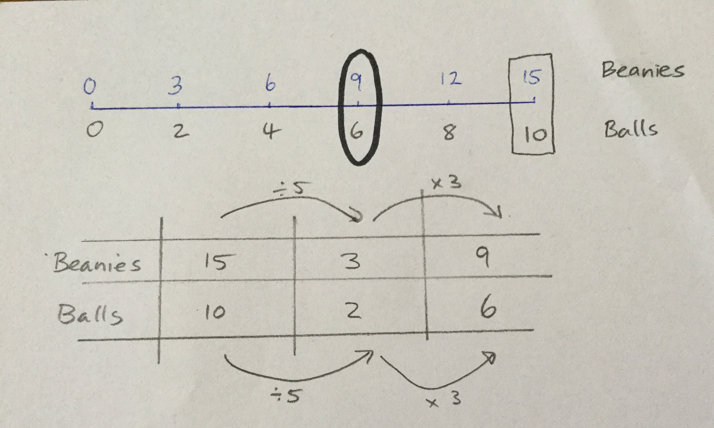
Big Idea: IF-THEN
Proportional Reasoning Activity
Notes:
Show participants two possible solutions

Slide 19
Big Ideas of Reasoning
Proportional Reasoning in the AC:Mathematics
Fractions and Decimals
Year 4: Investigate equivalent fractions used in contexts (ACMNA077)
Chance
Year 5: List outcomes of chance experiments involving equally likely outcomes and represent probabilities of those outcomes using fractions (ACMSP116)
Year 6: Describe probabilities using fractions, decimals and percentages (ACMSP144)
Real Numbers
Year 7: Express one quantity as a fraction of another, with and without the use of digital technologies (ACMNA155)
Geometric Reasoning
Year 9: Solve problems using ratio and scale factors in similar figures (ACMMG221)
Notes:
Here we can see where the Big Idea : Proportional reasoning fits into the strands of the AC for Year 4 to Year 9.

Slide 20
Acknowledgements for the Top Drawer Reasoning
The reasoning drawer is based on In Teachers’ Hands – Reasoning, a project of the Mathematical Association of Victoria in 2011. Writers for this project were Prof. Peter Sullivan and Prof. Mike Askew, Faculty of Education, Monash University, Dr Leicha Bragg, School of Education, Deakin University, Ms Sue Fine, Mathematics Consultant, A/Prof. Marj Horne, School of Education, Australian Catholic University, and Prof. Dianne Siemon, School of Education, Royal Melbourne Institute of Technology. They were assisted by A/Prof. Judith Mousley, School of Education, Deakin University, Ms Sharyn Livy, Mathematical Association of Victoria, and many other mathematics educators who provided expert advice and feedback.
This highly expert team brought together their extensive experience in the field to create the ideas incorporated in the Reasoning drawer.
A/Prof. Judith Mousley was responsible for the conceptual design of the drawer and wrote most of the material.

