Slide 1

Opening the Top Drawer to Reasoning
Big Ideas 5 & 6
Deduction and Proof
Years 1 to 10
Designed and written by: L.Spohn BEd (Mathematics)

Slide 2

Big Ideas of Reasoning
Module Overview
It should take approximately one hour to complete this module.
AITSL Standards
Australian Curriculum links
Activities and resources

Slide 3
Big Ideas of Reasoning
Learning outcomes
• To explore the “Big Ideas of Reasoning” – Deduction and Proof
• Understand deduction and proof in the context of reasoning and there connection to the Australian Curriculum.
• To explore activities to assist in the teaching of deduction and proof

Slide 4

The following AITSL Standards will be addressed:
Professional Knowledge
Standard 1: Know students and how they learn
1.2 Understand how students learn
Standard 2: Know the content and how to teach it
2.1 Content and teaching strategies of the teaching area
2.5 Literacy and numeracy strategies
Professional Practice
Standard 3: Plan for and implement effective teaching and learning
3.4 Select and use resources
Professional Engagement
Standard 6: Engage in professional learning
6.1 Identify and plan professional learning needs
6.2 Engage in professional learning and improve practice

Slide 5
Australian Curriculum Links
For Deduction
Year 1: Recognise and describe one-half as one of two equal parts of a whole
ACMNA016
Year 2: Recognise and interpret common uses of halves, quarters and eighths of shapes and collections
ACMNA033
Year 4: Compare angles and classify them as equal to, greater than, or less than, a right angle ACMMG089
Evaluate the effectiveness of different displays in illustrating data features including variability ACMSP097
Year 5: Describe translations, reflections and rotations of two-dimensional shapes. Identify line and rotational symmetries ACMMG114
Describe and interpret different data sets in context ACMSP120

Slide 6
Australian Curriculum Links
For Deduction
Year 6: Investigate combinations of translations, reflections and rotations, with and without the use of digital technologies
ACMMG142
Investigate, with and without digital technologies, angles on a straight line, angles at a point and vertically opposite angles. Use results to find unknown angles ACMMG141
Compare observed frequencies across experiments with expected frequencies ACMSP146
Year 8: Establish properties of quadrilaterals using congruent triangles and angle properties, and solve related numerical problems using reasoning
ACMMG202

Slide 7
Big Ideas of Reasoning
6 Big Ideas in the Reasoning Top Drawer
Same and Different
Visualisation
Mathematical Truth
IF-Then
Deduction (Year 1 to 10)
Proof (in Year 10)

Slide 8
Big Idea: Deduction
6 Big Ideas in the Reasoning Top Drawer
Deduction
What is deduction?
Deduction involves drawing a conclusion.
Deductive reasoning is an important skill.

Slide 9
Big Idea: Deduction
Examples of deductive reasoning:
Even numbers are integers that can be arranged as pairs.
I can arrange six blocks as three pairs.
So six is an even number.

Slide 10
Big Idea: Deduction
A year 7 teacher described the following scenario to her mathematics class.
“Playing around with adding integers (whole numbers), Max came to two conclusions.
The sum of any four even numbers is a multiple of 4.
The sum of any three consecutive numbers must be a multiple of 3. “
Work in small groups to work out if both of Max’s statements were true all the of the time.

Slide 11
Big Ideas of Reasoning
6 Big Ideas in the Reasoning Top Drawer
Same and Different
Visualisation
Mathematical Truth
IF-Then
Deduction (Year 1 to 10)
Proof (in Year 10)

Slide 12
Australian Curriculum Links
For Proof
Year 10: Formulate proofs involving congruent triangles and angle properties
ACMMG243
Year 10: Apply logical reasoning, including the use of congruence and similarity, to proofs and numerical exercises involving plane shapes
ACMMG244

Slide 13
Big Idea: Proof
Proof
Students need to learn that conjecture is not the same as proof.
Mathematics depends on proof for its development, usefulness and veracity.
Proof is the foundation of mathematics, so proving is a foundation skill in school mathematics.
Notes:
Mathematics depends on proof for its development, usefulness and veracity.

Slide 14
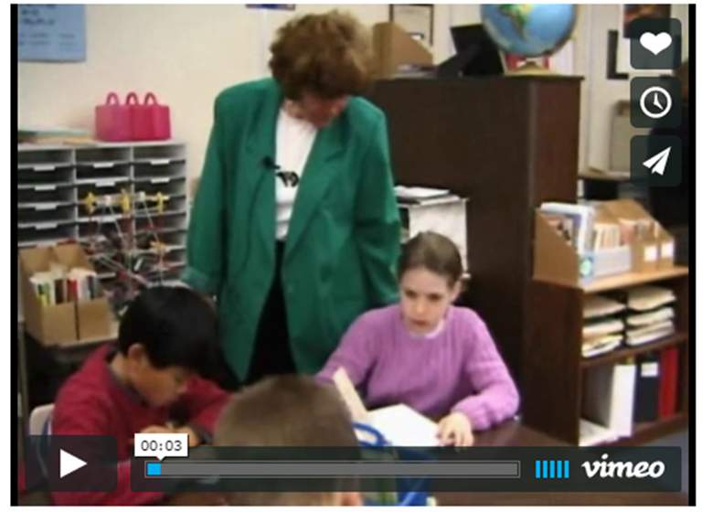
Big Idea: Proof
Proof: The Foundation of mathematics
Deductive reasoning applies general principles to specific instances.
Primary students are capable of arguing deductively.
Notes:
Show participants the video

Slide 15
Big Idea: Proof
Proof: The Foundation of mathematics
For secondary students, geometry is a common area for proof exercises. However, many Number and Algebra activities also lend themselves to formal proof.
For example, the activity Magic Vs is a proof activity that is suitable for years 4–10.

Slide 16
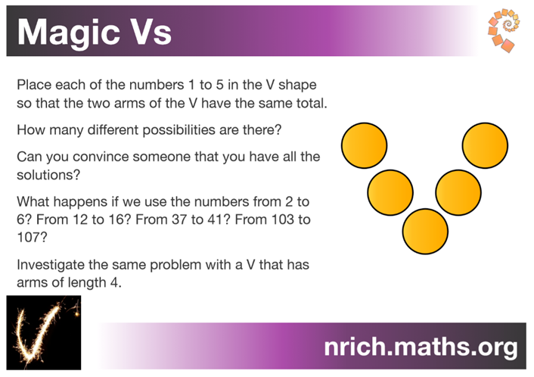
Big Idea: Proof
Proof: The Foundation of mathematics
Work on this activity independently of others in the group.
After you have answered the questions on the right, share your findings with others in the group.
Discuss how this activity could be used with your students to encourage the big ideas of Reasoning.
Notes:
Distribute the Magic V handout
Have participants work independently of others
Then share ideas with group members
Magic V sheet can be found following the link below:
http://topdrawer.aamt.edu.au/Reasoning/Big-ideas/Proof/Proof-The-foundation-of-mathematics

Slide 17
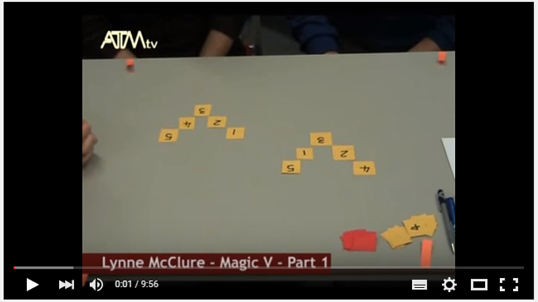
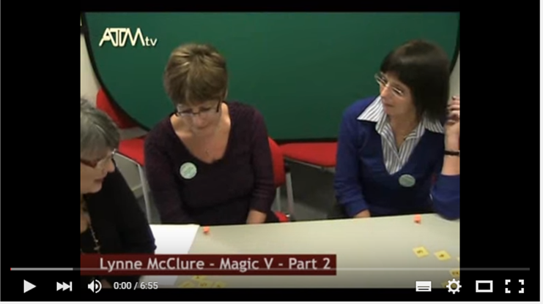
Big Idea: Proof
Proof: The Foundation of mathematics
Notes:
Click on the image to view Part 1 of the video
Click on the image to view Part 2 of the video

Slide 18
Pythagoras Theorem
In a right angled triangle the square on the hypotenuse is equal to the sum of the squares on the other two sides.
c² = a² + b²
c
a
b

Slide 19
Acknowledgements for the Top Drawer Reasoning
The reasoning drawer is based on In Teachers’ Hands – Reasoning, a project of the Mathematical Association of Victoria in 2011. Writers for this project were Prof. Peter Sullivan and Prof. Mike Askew, Faculty of Education, Monash University, Dr Leicha Bragg, School of Education, Deakin University, Ms Sue Fine, Mathematics Consultant, A/Prof. Marj Horne, School of Education, Australian Catholic University, and Prof. Dianne Siemon, School of Education, Royal Melbourne Institute of Technology. They were assisted by A/Prof. Judith Mousley, School of Education, Deakin University, Ms Sharyn Livy, Mathematical Association of Victoria, and many other mathematics educators who provided expert advice and feedback.
This highly expert team brought together their extensive experience in the field to create the ideas incorporated in the Reasoning drawer.
A/Prof. Judith Mousley was responsible for the conceptual design of the drawer and wrote most of the material.

