Slide 1
Beginning algebraic reasoning
Module 2: Relational thinking and subtraction
Click to continue

Slide 2

Developed by Max Stephens
University of Melbourne
Click to continue

Slide 3
How to use this module
Turn up the sound on your computer. Movies and sound will play automatically.
There will be pauses for discussion — take as long as you need.
Slides will indicate when you should click to continue.
You can go back any time.
This module will likely take 45 minutes to work through.
Refer to the Facilitator’s Pack for more information.
All ready? Then let’s start…
Click to continue

Slide 4

Introduction
Click to continue

Slide 5

What number goes in the box?
Do not calculate the answers. Explain your relational thinking briefly.
Click to continue

Slide 6
What number goes in the box?
Do not calculate the answers. Explain your relational thinking briefly.
+2
–2
75
81
–5
+5
247
–1
+1
Is there anything about the last question that could make the calculation more efficient? Discuss
Click to continue

Slide 7
Key ideas
the idea of equivalence
number sentences as mathematical statements
operations being used
Click to continue

Slide 8
Find the missing number
68
Click to continue

Slide 9
Find the missing number
+9
68
+9
Click to continue

Slide 10
Find the missing number
Incorrect relational thinking
+9
50
–9
Click to continue

Slide 11
What is ‘difference’?
‘Taking away’ is an action just as ‘adding to’ or ‘multiply by’ are actions.
‘Difference’ is a relation between two known quantities; ‘more than’ or ‘less than’ are relations too.
Click to continue

Slide 12
What is ‘difference’?
Angie is 11 years old and her brother is 14.
What is the difference in their ages?
Will this ever change?
Discuss
Click to continue

Slide 13
What is ‘difference’?
Angie is 11 years old and her brother is 14.
We can represent this difference in their ages by writing: 14 – 11 = 3
How will this expression change in 5 years, 8 years, and 10 years?
Discuss
Click to continue

Slide 14
What is ‘difference’?
Angie is 11 years old and her brother is 14.
Now: 14 – 11 = 3
5 years: 19 – 16 = 3
8 years: 22 – 19 = 3
10 years: 24 – 21 = 3
Difference is a relation.
Click to continue

Slide 15
Representing difference with a number line
Click to continue

Slide 16
Representing difference with a number line
Click to continue

Slide 17
The difference between 27 and 19 is the same as the difference between 26 and what number?
Click to continue

Slide 18
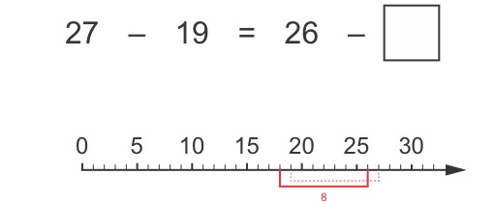
The difference between 27 and 19 is the same as the difference between 26 and what number?
Click to continue

Slide 19
The difference between 27 and 19 is the same as the difference between 26 and what number?
Click to continue

Slide 20
The difference between 27 and 19 is the same as the difference between what number and 9?
Click to continue

Slide 21
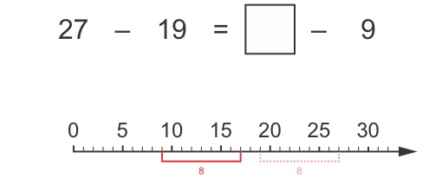
The difference between 27 and 19 is the same as the difference shown below. What are the numbers?
17
Click to continue

Slide 22
The difference between 27 and 19 is the same as the difference shown below. What are the numbers?
Click to continue

Slide 23
The difference between 27 and 19 is the same as the difference shown below. What are the numbers?
Click to continue

Slide 24
How might students find the missing number?
= 14
Click to continue

Slide 25
Are there other ways that students might explain that this statement is true?
91
Discuss
Click to continue

Slide 26
Students’ thinking 105 – 91 = 118 – 104
118 – 104 is 14 so the missing number is 14 less than 105.
If 13 is taken away from 118 and from 104, the difference won’t change.
Add 13 to 105 to get 118, then add 13 to 91 to keep the difference the same.
If you add (or subtract) the same number to 105 and 91, the difference between the numbers on the right side will stay the same.
Click to continue

Slide 27
Simplify calculations
Calculations can be simplified without changing the result:
53 – 29
537 – 298
54 – 30
539 – 300
537 – 300 + 2
Click to continue

Slide 28
With your class
Try some examples with your class.
You can download a short worksheet.
Be observant about the errors made that show incorrect relational thinking.
Click to continue

Slide 29
Summary
Difference helps students to see relationships between the numbers
Equivalent differences can be made
Understanding difference enables simplifying calculations

